Slide 1
Title
Heading
Subheading/optional

Slide 2
EXCEPTIONAL
IMPACT
Learning from and working alongside the faculty are our high-achieving and compassionate students.

Slide 3
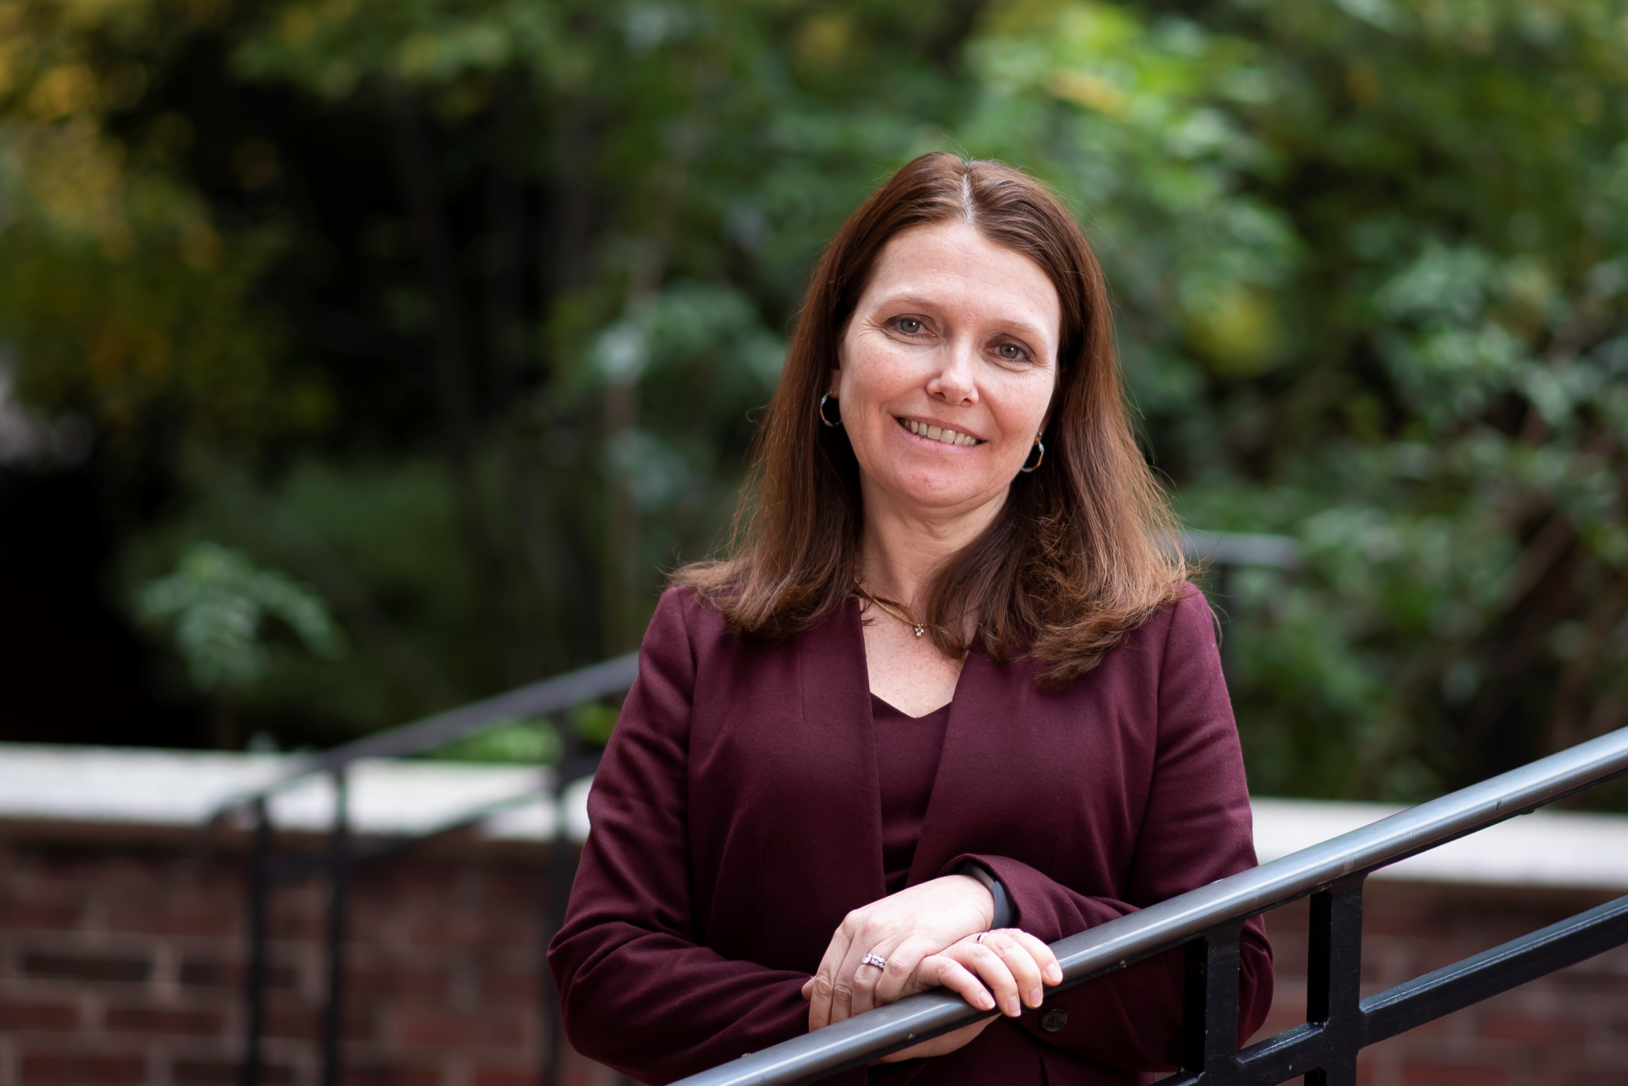
EXCEPTIONAL
IMPACT
Sub Header
Essential to increasing the law school’s impact is supporting our faculty as they prepare the next generation of lawyer leaders and produce influential scholarship that is shaping policy and fields of inquiry.

Slide 4
VIDEO - TITLE

Slide 5
ANOTHER
TITLE
Learning from and working alongside the faculty are our high-achieving and compassionate students.

Slide 6
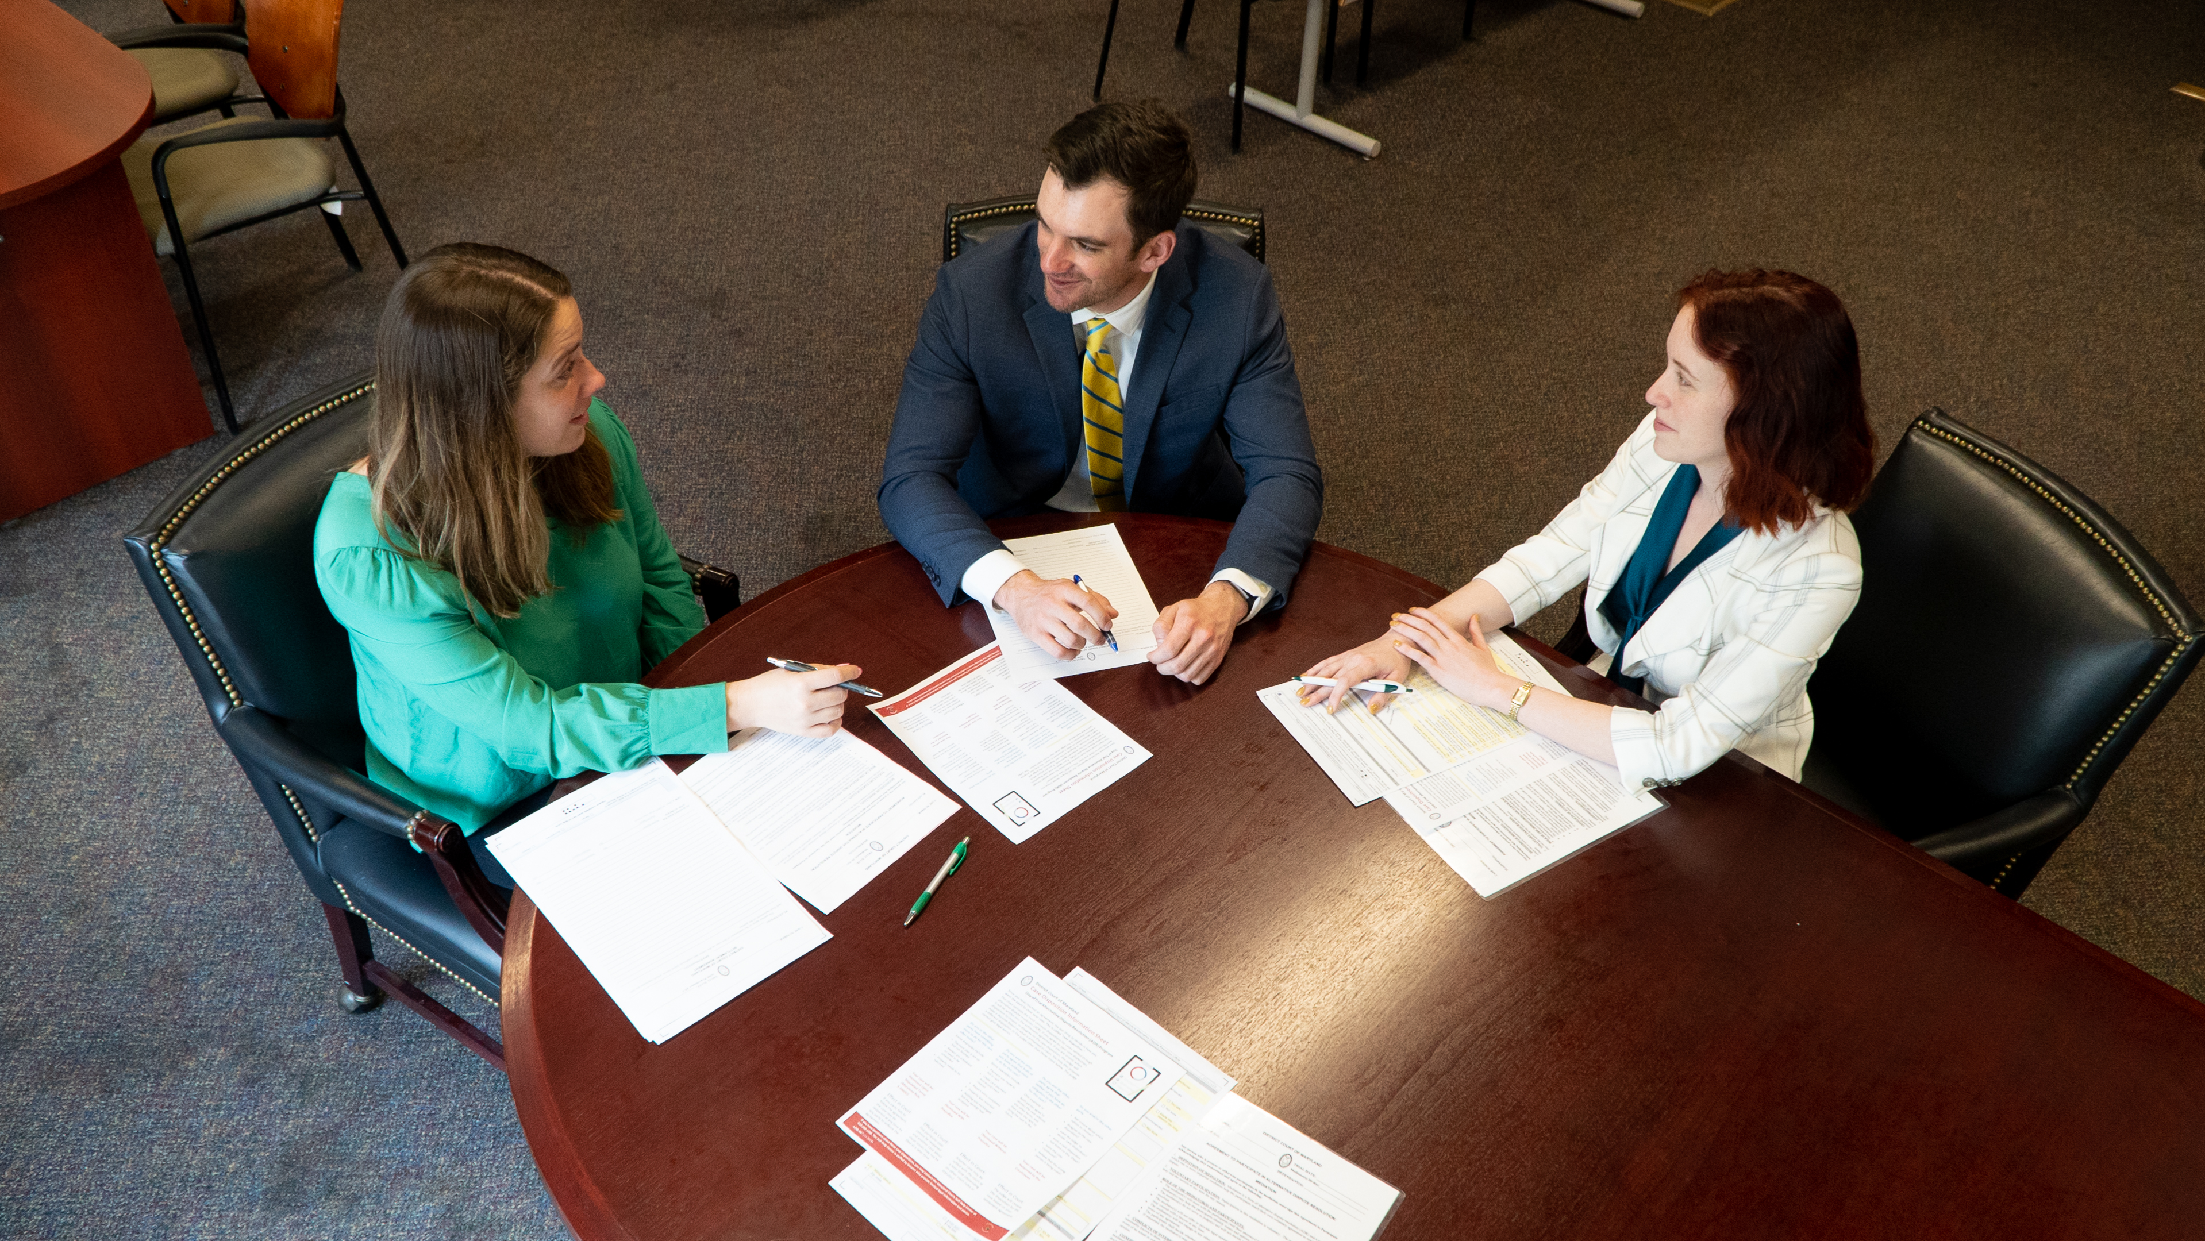
ANOTHER
TITLE
Sub Header
Essential to increasing the law school’s impact is supporting our faculty as they prepare the next generation of lawyer leaders and produce influential scholarship that is shaping policy and fields of inquiry.

Slide 7
VIDEO - TITLE

Slide 8
COMMUNITY
IMPACT
Learning from and working alongside the faculty are our high-achieving and compassionate students.

Slide 9
COMMUNITY
IMPACT
Sub Header
Sub Header
Essential to increasing the law school’s impact is supporting our faculty as they prepare the next generation of lawyer leaders and produce influential scholarship that is shaping policy and fields of inquiry.
Essential to increasing the law school’s impact is supporting our faculty as they prepare the next generation of lawyer leaders and produce influential scholarship that is shaping policy and fields of inquiry.

Slide 10
PHILANTHROPIC
ADVANCEMENT
Learning from and working alongside the faculty are our high-achieving and compassionate students.

Slide 11
VIDEO - TITLE

Slide 12
PHILANTHROPIC
ADVANCEMENT
Sub Header
Essential to increasing the law school’s impact is supporting our faculty as they prepare the next generation of lawyer leaders and produce influential scholarship that is shaping policy and fields of inquiry.

Slide 13
Thank You!

