Slide 1
Tobacco Retail Licensing Implementation
September 24, 2024
Kathi Hoke, Executive Director
Brooke Torton, Managing Director
Blair Inniss, Deputy Director
Legal Resource Center for Public Health Policy
University of Maryland Francis King Carey School of Law

Slide 2
Agenda
2024 Legislative Session:
Tobacco tax increase
Tobacco sales military exemption
CIAA-vaping
Tobacco Retail Modernization Act (2024)
Overview
ID check
Product placement
Health General v. Criminal Law: Enforcement
Emerging product alert/discussion: Sensa
Local Tobacco Training Meeting: October 23rd

Slide 3
Tax Increase Effective July 1
Cigarettes: tobacco tax increased from $3.75 to $5.00 per pack of 20; for a pack of more than 20, increased from .175 per cigarette to .25 per cigarette
OTP: tobacco tax increased from 53% to 60% of the wholesale price (excludes pipe tobacco and cigars)
ESDs: sales and use tax increased from 12% to 20%, including vaping liquid in a container of more than 5ml
Notes:
Maryland had a budget deficit, so MGA had to come up with a way to generate more money to compensate for the deficit, so they updated the tobacco taxes.
Policy experts estimate FY 27About $83 million raised from a tax increase on cigarettes, other tobacco products, and nicotine products

Slide 4
Tobacco Sales Military Exemption Removed Effective October 1
State law now consistent with federal law: no tobacco sales to ANYONE under age 21;
No exemption for active duty military members, ages 18-20;
Should not change retailer behavior, but does eliminate confusion
Notes:
Passed the full Senate and House with a super-majority of votes. There is no risk of veto.
Preventing being sold puts onus on the retailer, so the 18yr/o wont be blamed for buying

Slide 5
Clean Indoor Air Act Changes Effective October 1
Adds vaping to the CIAA (in addition to tobacco and cannabis products)
Requires signage indicating where and where not to vape
Creates a workgroup to study cigar bars and imposes 2-year moratorium on issuing alcoholic beverage licenses to tobacconists

Slide 6
Tobacco Retail Licensing: ID Check
Retailers must check the ID of people under 30 years old before selling them tobacco products
​Only government-issued photo ID is acceptable
To be valid, the ID must be current and not expired

Slide 7
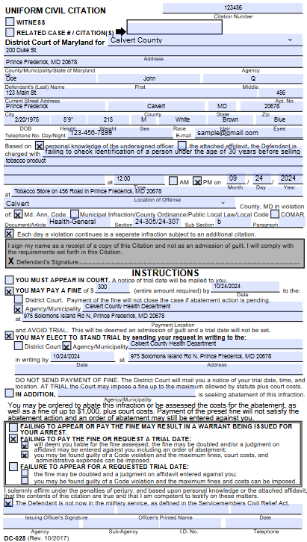
Uniform Civil Citation: ID Check

Slide 8
Tobacco Retail Licensing: Product Placement
Cigarettes, OTP, and ESDs must be located behind a counter in an area accessible only to the licensed retailer, vendors, and employees
Does not apply to premium cigars or licensed tobacconists

Slide 9
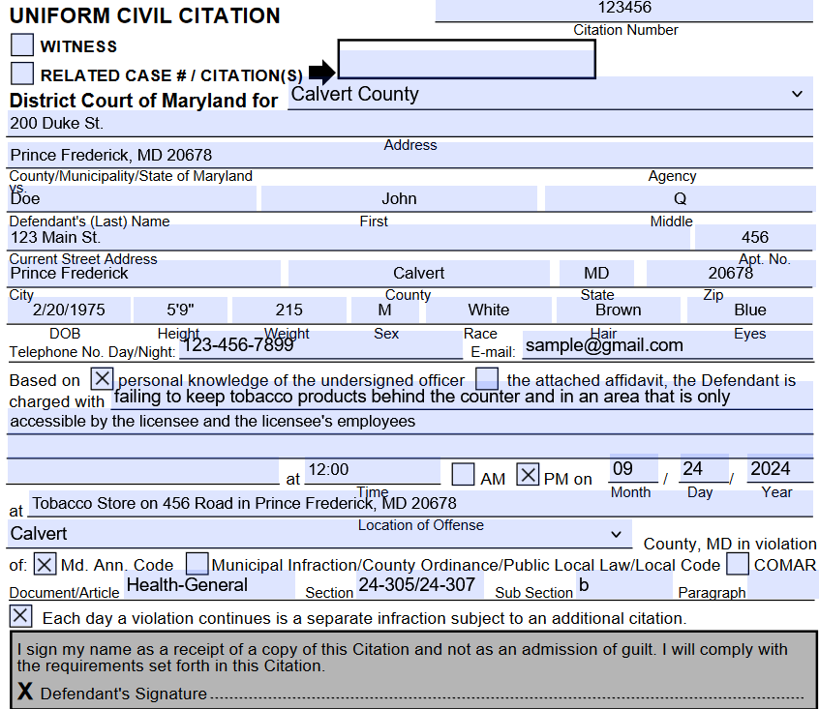
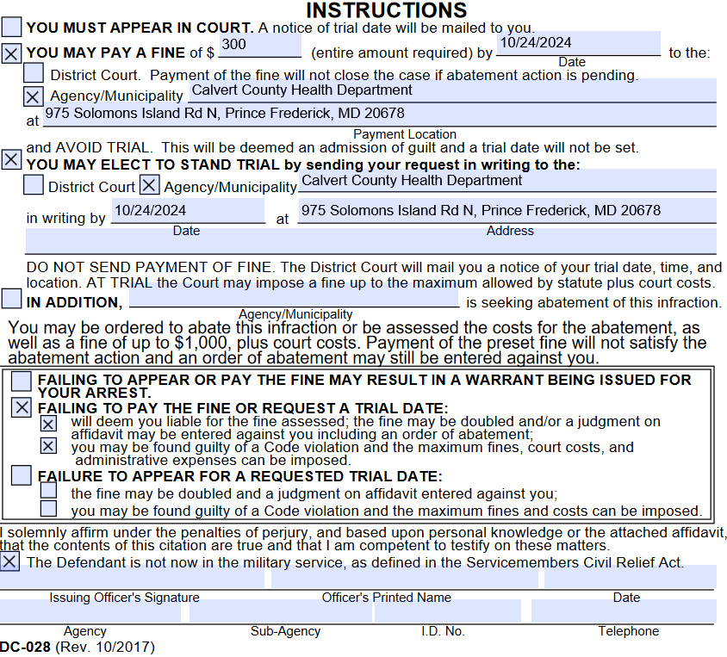
Uniform Civil Citation – Example

Slide 10
Tobacco Retail Licensing
Mandates MDH or designee conduct at least 1 enforcement check of each retailer annually, with follow up after an underage sale
Increases fines for first violation to $500 under Criminal Law Article
Mandates ATCC suspend for up to 90 days for second violation and up to 180 days for a third violation; and revoke license for subsequent violation.
Notes:
Fine is currently $300 for first violation
Follow-up required within 180 days

Slide 11
Tobacco Retail Licensing
Raises the retail license fee to $300;
Makes clear that the licensee may be criminally cited (Criminal Law, 10-107) for sale by the clerk!
Requires a report from MDH, ATCC, Comptroller, and Department of Education:
# of retail licensees, including proximity to schools and health care facilities, and geographic density;
Feasibility of limiting # of licensees
Prevalence of use, public health and economic impacts of tobacco use, including flavored
Notes:
However, Montgomery County will continue to receive the fee funds for enforcement.
“personally or through an employee” page 17
Report due 10/1/2025

Slide 12
Health-General, 24-305 and 24-307 v. Criminal Law
Law | Section 10-107 of the MD Criminal Law Code | Section 24-305 of the MD Health-General Code | Section 24-307 of the MD Health-General Code
What does the law prohibit? | Distribution and/or sale of tobacco products, including ESDs | Distribution and/or sale of ESDs | Distribution and/or sale of tobacco products, including ESDs
Is this a civil or criminal violation? | Criminal | Civil | Civil
Who can enforce the law? | Sworn Law Enforcement ONLY | Sworn Law Enforcement, MDH Secretary or designee, County Health Officer or a designee | Sworn Law Enforcement, MDH Secretary or designee, County Health Officer or a designee
Who can be cited? | Licensee, clerk, both or unlicensed person | Licensee or unlicensed person | Licensee or unlicensed person
Penalties | $500 for a first offense $1,000 for a second offense if within 24 months $3,000 for each subsequent offense if within 24 months ***Court orders ATCC to suspend/revoke | $300 for a first offense $1,000 for a second offense if within 24 months $3,000 for each subsequent offense if within 24 months | $300 for a first offense $1,000 for a second offense if within 24 months $3,000 for each subsequent offense if within 24 months
Trial Required? | Yes | No (Defendant may request) | No (Defendant may request)
Hearing | District Court | District Court | District Court
Fine Allocation | State | County | County

Slide 13
Tobacco Training Meeting
Save the date: October 23rd, 9:00a.m.-2:00p.m.
Be prepared to discuss:
Are LHDs referring retailers to the ATCC for 2+ violations in one calendar year OR in a twelve-month period? What has been accepted/rejected?
Are retailers often violating twice in 24 months?
Are you experiencing repeat violations by owners with multiple locations? For example, owner has violation at Store 1 and then another at Store 2.
How often are owners reestablishing their business and listing a new, but related owner as the licensee?

Slide 14
Questions?
Publichealth@law.umaryland.edu
Btorton@law.umaryland.edu
Binniss@law.umaryland.edu
Khoke@law.umaryland.edu
Mgriest@law.umaryland.edu

