Slide 1

Preparing for 2025 Tobacco Policy Updates
January 14, 2025

Slide 2
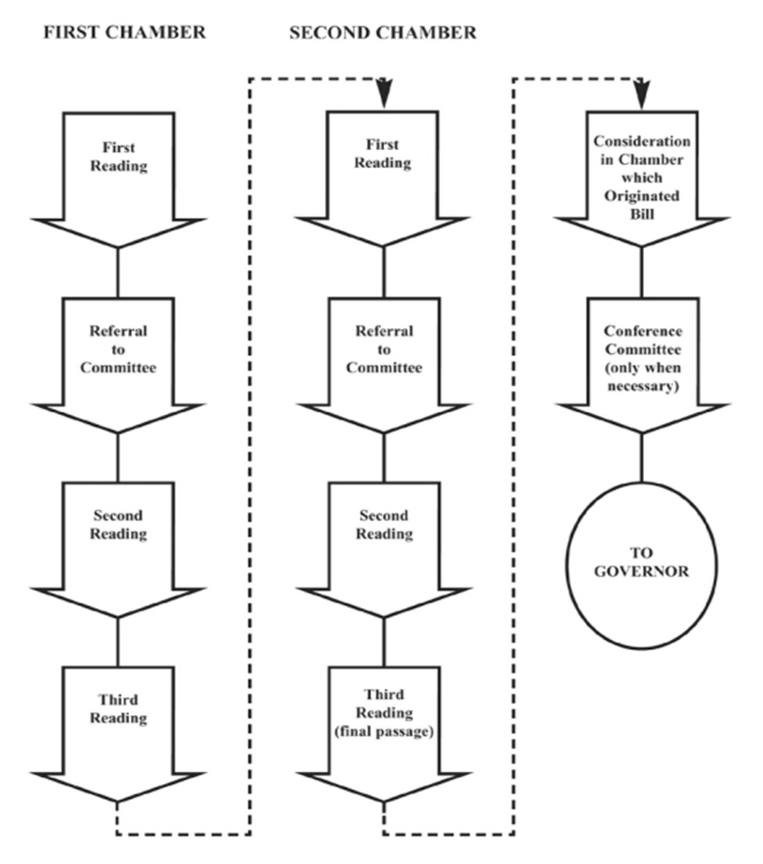
Maryland Legislative Session
January 8: Session convenes
February 3: Senate bill introduction deadline
February 7: House bill introduction deadline
March 17: Bill crossover date
April 7: Sine die

Slide 3
Bills of Interest (Filed)
SB108 Multifamily Dwellings-Smoking Policies
  Applies to condos and co-ops (4 or more units); owned or rented
  Applies to smoking (ALL) and vaping (BR 16.7-101)
  Requires a policy at least as stringent as CIAA+local
    Where smoking permitted
    Where smoking prohibited
    How complaints made/processed
    Penalty/fine
  Does not limit ability to sue*
  Does not preempt more stringent local law

Slide 4
Bills of Interest (Anticipated)
    ATCC* MOU Change
    ESD Registry
    Equity Fee (administered by OAG)
    Vape wholesalers
    Cigar Bars**
  *ATCC Monthly Meeting (virtual)
  Thursday, January 16, 3:00 to 4:00 p.m.
  **Workgroup on Issuance of Alcoholic Beverages Licenses to Tobacconists
  Meeting (virtual) Friday, January 17, 9:00 to 10:00 a.m.
  Public comments at the end

Slide 5
Participating in the Legislative Process: Lobbying
Lobbying activities are defined in Md. Code Ann. Gen. Provisions § 5–702
Legislative Action Lobbying: A person communicates with a legislative branch official or employee for the purpose of influencing any legislative action and incurs at least $500 in expenses or is compensated at least $2,500
Executive Action Lobbying: A person communicates with an executive branch official or employee for the purpose of influencing executive action and spends at least $100 or is compensated at least $2,500

Slide 6
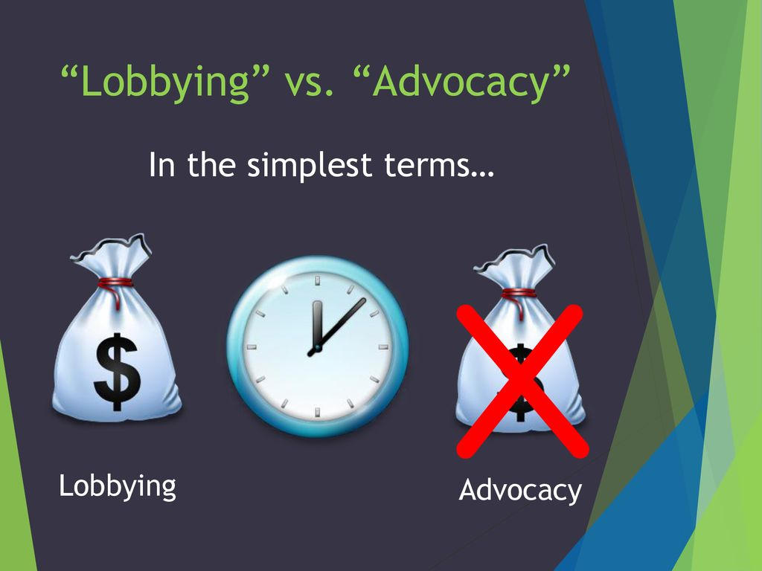
Participating in the Legislative Process: Advocacy
Merriam-Webster defines advocacy as the act or process of supporting a cause or proposal

Slide 7
Why Advocate?
YOU are the expert
Mostly part-time legislators who have other jobs
Educating policymakers about the needs of your organization or community is something anyone can do

Slide 8
Testifying
Testimony
  Can be written and/or oral
  Public must sign up prior to the hearing
  Keep oral comments brief – 2-3 minutes MAX
  Decide what are the 2-3 main points you need to tell that group of people in that setting at that time
  Listen to others testifying and don’t be redundant
Committee members can ask questions
  Don’t worry about technical questions, just tell it from your perspective and let them know you’ll get back to them with the technical answers

Slide 9
Contacting Your Elected Official
Ideally, you are registered to vote
  https://elections.maryland.gov/voter_registration/
Who are they? www.mdelect.net
Mail, fax, or email letters
Call your legislators
Visits

Slide 10
Advocacy Survival Skills
Accentuate the positive
Plan for small wins
Keep it simple
Be passionate and persistent
Be prepared to compromise
Enjoy yourself!

Slide 11
LRC Legislative Tracking
Real-time tracking of public health bills
  Legislative Tracker
Bi-weekly Zoom updates begin January 21st at 11:30
  Join Zoom Meeting
Email publichealth@law.umaryland.edu to be added to the listserv

Slide 12
SAVE THE DATE
2025 Maryland Tobacco Conference
June 4, 2025
University of Maryland, Baltimore County

Slide 13
THANK YOU

