Slide 1
Preparing for 2024 Policy Updates
January 10, 2024

Slide 2
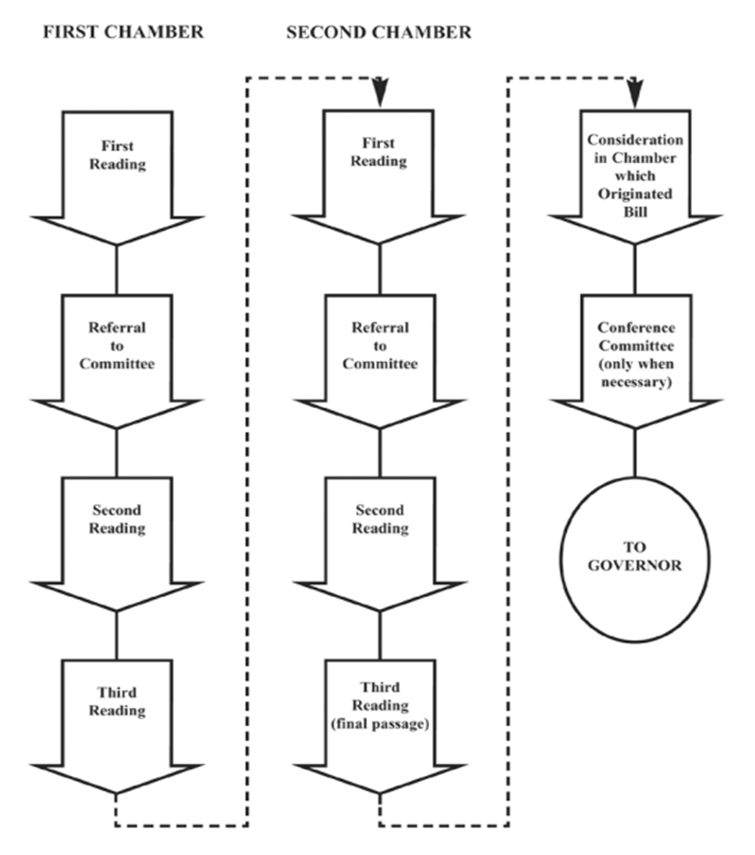
Maryland Legislative Session
January 10: Session convenes
February 5: Senate bill introduction deadline
February 9: House bill introduction deadline
March 18: Bill crossover date
April 8: Sine die

Slide 3
Maryland General Assembly
188 Members
141 House of Delegates/47 Senate: 3 for 1 ratio
Find Your Legislators
90-Day Session/Special Sessions
Citizen Legislature
Four Year Cycle: 2024 2nd Year of Term
Current Member Profile (2023)
Notes:
Dem 72% to Rep 28%; Party affiliation tends to be less important than regional or urban/suburban/rural divides. This was very much the case pre-Hogan (with a blip during Ehrlich 03-07, also an R) but party was more of a divide in Hogan era. We expect a return to the lesser impact with the Moore Administration. There are 4 recognized parties: Democratic, Republican, Libertarian, Green, and Working Class. More rural communities—Western/Southern/Eastern Shore tend to be more R; urban and suburban tend to be more D. There has not been much change in the 70/30 split over several decades.
They only report gender on male/female basis. For 2023: Overall: 57% male; 43% female; state is 48/52. The Senate is 66/34 while the House is 55/45—since we tend to see movement from H to S, we expect to see S female number increase over time. This breakdown has shifted (more females) over the last two decades. We have the first female Speaker of the House (Speaker Adrienne Jones); before now we had never had a female statewide elected official at the state level (Barbara Mikulski in US Senate as only example on federal level). Our current Congressional delegation is entirely male.
They only report “Caucasian (62%), African-American (34%), Asian (4%), and Other (1%)” (state is 55/30/6/9)—don’t ask me why this is the case.
Congress is about 33% lawyers, a percentage that has fallen over the decades. Read: https://clp.law.harvard.edu/knowledge-hub/magazine/issues/lawyers-in-politics/declining-dominance/ Maryland has remained steady in the 20-30% range; currently 24% have JD. We have two MDs—Senator Lam and Delegate Hill. Only 13% full-time legislator.
85% have college degree or higher

Slide 4
BEFORE THERE IS A BILL, THERE IS . . . AN IDEA, A PROBLEM, AN OPPORTUNITY
Sources of Legislation:
Advocacy Organizations
Individuals/Community Groups
Legislative Studies (Task Forces/Commissions)
Administration (Governor, Executive Agencies)

Slide 5
SECURING A SPONSOR
Best to look for a sponsor:
In Committee that will hear bill;
Delegation if impacts one County/type of County;
With subject matter expertise.
This is a strategic and political decision that can be difficult to “undo” in later years.

Slide 6
FIRST READING
“Read” by Clerk of House/Secretary of Senate
Assigned to Committee
sometimes assigned to 2 committees
Typically, one takes lead and other will act only if passed by lead;
Can have joint hearing and voting.

Slide 7
Fiscal and Policy Note
Impact on State and Local Government; Small Business
Read it carefully; can try to get corrections—but best to try to get information to drafter in advance, via sponsor; and/or earn reputation as helpful person on certain issues
Point out any errors or omissions clearly and directly in written and oral testimony
Note should be amended if significant amendments made to bill during session.
Notes:
REIN Race and Equity Impact Note

Slide 8
HEARINGS
Do not yet have protocols for 2024 (do not expect big changes from 2023)!
Everyone who signs in will be heard in person (2-3 minutes each)
Some virtual testimony permitted
Create panels and avoid duplication
Proponents then Opponents; so rebut in advance (unless large number of people; then may alternate panels)
Oral testimony should be 2-3 minutes long—DO NOT READ!!!
Notes:
Members may ask questions during testimony but rarely interrupt.
Usually ask of panel after all have testified—so coordinate who answers what in case they direct to panel and not an individual.
Names on placard in front of member (on Zoom as well)
Hearings can go for minutes or hours—be prepared
Order of bills—usually announced at start; might be posted online if virtual?

Slide 9
AFTER THE HEARING
May be assigned to a sub-committee to make recommendation to committee; focus on those members
Committee Voting Sessions
May make amendments; vote on them first (simple majority)
Majority vote (tie does NOT pass): Favorable (with amendments); Unfavorable; No Position (rare); Refer to Interim Study (technically dead)
Only favorable (or favorable with amendment) passed on to full body
Floor Report Prepared
Notes:
You can watch hearings after the fact—video camera icon next to Committee name on bill landing page.
See handout on how to watch live or recorded hearings

Slide 10
SECOND READING
Presented at Floor Session; “Committee Reprint” if extensive amendments
Opportunity for question and debate
May be amended; if offered, voted on first; majority carries
Special Order—to a date certain; Laid Over—next day/session
Voice Vote—majority
Ordered “printed for third reading” (except if crossed over; then “passed to third reader”)
Notes:
Floor Session: Monday nights, typically mornings Tuesday to Thursday at first, then includes Fridays, toward the end they open and close all day!

Slide 11
THIRD READER
May NOT be amended unless is CROSSED OVER BILL
Special Order permitted (often delay tactic)
Roll Call—recorded vote; majority
**Majority exceptions:
Constitutional Amendment or Emergency Bill: 3/5 of each house
Repeat in other house . . . unless CROSS FILED

Slide 12
PRESENTMENT TO GOVERNOR
Must be presented within 20 days of adjournment (do not become law if not presented)
GOVERNOR may: 1) sign; 2) refuse to sign (pocket veto: treated as if signed on 31st day after presentment); 3) veto (must do within 30 days of presentment)
Now allowed to line item veto a budget allocation added by GA
No veto of constitutional amendment
Veto Override: NOT in first year of session (2023); otherwise, at first session following (whether regular or special); 3/5 vote of each house to override
Notes:
Can be presented DURING session; if in first 83 days, Gov’r has 6 days; in last week, Gov’r has 30 days
if veto during session—may be considered in that session
NOTE: OAG Letters on constitutionality

Slide 13
EFFECTIVE DATE
Emergency: on signature of Governor (or on 7th day after presentment if not) or other date set in bill
Fiscal: July 1
General: October 1
Earliest: June 1
Latest: Can be whenever in future

Slide 14
2024 Bills of Interest

Slide 15
HB 199/SB 141: Multifamily Dwellings - Smoking Policies
Revival from 2023 (SB 817)
Requires the governing body of a multifamily dwelling to develop a smoking policy that is at least as stringent as the state and local laws

Slide 16
SB 186: Prince George's County - Alcoholic Beverages - Cigar Lounge License
Effectively identical to 2023 cigar lounge bill in Wicomico County (SB 795)
Establishes a Class B-CL (cigar lounge) beer, wine, and liquor license in Prince George’s County
Cigar lounge can sell beer, wine, and liquor for on-premises consumption
Exempts Class B-CL licenses in PG County from compliance with the Clean Indoor Air Act

Slide 17
Tobacco Retail Licensing (TRL)
The bill is expected to have multiple provisions related to the retail marketing of tobacco products
Could include:
Prohibiting self-service displays
Mandatory ID checks
Increase license fees
Increase penalties for sales to minors

Slide 18
Electronic Smoking Device Registry
Establish a registry of vape products that are authorized for sale in Maryland
ATCC can suspend/revoke a license or impose a civil penalty for selling unauthorized products

Slide 19
LRC Legislative Tracking
Real-time tracking of public health bills
Bi-weekly Zoom updates begin January 23rd at 11:30
Email publichealth@law.umaryland.edu to be added to the listserv

Slide 20
SAVE THE DATE
2024 Maryland Tobacco Conference
June 5, 2024
BWI Marriott

