Slide 1
Maryland Center of Excellence on Problem Gambling
2025 Legislative Overview

Slide 2
Mission Statement
The Maryland Center of Excellence on Problem Gambling promotes healthy and informed choices regarding gambling and problem gambling through various key initiatives and partnerships.
The Center works closely with appropriate state stakeholders and brings together experts from a variety of disciplines including psychiatry, medicine, epidemiology, social work, and law.

Slide 3
Key Initiatives and Resources
Public Awareness: Campaigns through social media, TV, radio, public service announcements, community outreach, public awareness materials and lending library
Prevention Programs: Targeted to the full age continuum and to diverse populations and at-risk groups
Public Policy: To provide information regarding strategies to address the impact of gambling on Public Health within Maryland
Research: To provide evidence-based data on public health aspects of gambling disorders and evaluate and develop evidence-based strategies for prevention and intervention

Slide 4
Key Initiatives and Resources
Free Training: On problem gambling awareness, prevention and intervention strategies with CEUs
Provider Referral Directory: To provide technical assistance to the health care and behavioral health care providers in Maryland to enhance capacity to address the issue of problem gambling amongst Maryland residents at No Cost
Peer Recovery Support: To assist individuals dealing with at risk and problem gambling connect with recovery resources within Maryland and to remove any barriers to recovery
Helpline: Maryland Problem Gambling Helpline 1-800-GAMBLER

Slide 5
Maryland Legislative Process

Slide 6
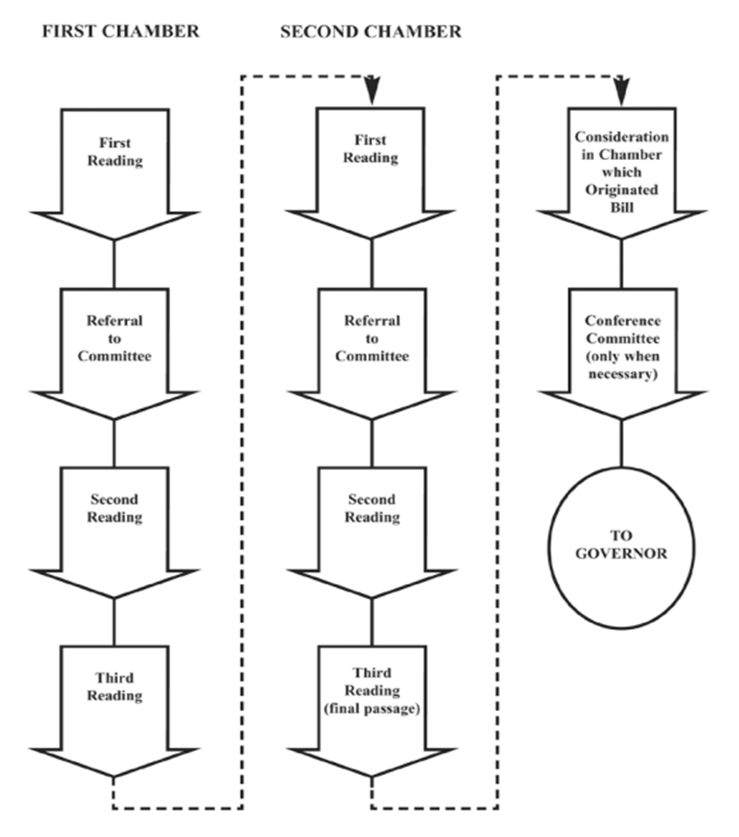
2025 Maryland Legislative Session
January 8: Session convenes
February 3: Senate bill introduction deadline
February 7: House bill introduction deadline
March 17: Bill crossover deadline
April 7: Sine Die
May 7: Final day for extended session

Slide 7
Maryland General Assembly
188 Members
141 House of Delegates/47 Senate: 3 for 1 ratio
Find Your Legislators
Four Year Cycle: 2025 3rd Year of Term
Current Member Profile (2025)

Slide 8
First Reading
“Read” by Clerk of House/Secretary of Senate & Assigned to Committee
Senate Committees
Budget and Taxation
Education, Energy, and the Environment
Executive Nominations
Finance
Judicial Proceedings
Rules
House Committees
Appropriations
Economic Matters
Environment and Transportation
Health and Government Operations
Rules and Executive Nominations
Judiciary
Ways and Means Committee

Slide 9
Hearing
Everyone who signs in will be heard in person
Some virtual testimony permitted
Create panels and avoid duplication
Proponents then Opponents; so rebut in advance (unless large number of people; then may alternate panels)
Oral testimony should be 2-3 minutes long—DO NOT READ!!!

Slide 10
After the Hearing
May be assigned to a sub-committee to make recommendation to committee; focus on those members
Committee Voting Sessions
May make amendments; vote on them first (simple majority)
Majority vote (tie does NOT pass): Favorable (with amendments); Unfavorable; No Position (rare); Refer to Interim Study (technically dead)
Only favorable (or favorable with amendment) passed on to full body
Floor Report Prepared

Slide 11
Second Reading
Presented at Floor Session; “Committee Reprint” if extensive amendments
Opportunity for question and debate
May be amended; if offered, voted on first; majority carries
Special Order—to a date certain; Laid Over—next day/session
Voice Vote—majority
Ordered “printed for third reading” (except if crossed over; then “passed to third reader”)

Slide 12
Third Reading
May NOT be amended unless is CROSSED OVER BILL
Roll Call—recorded vote; majority
**Majority exceptions:
Constitutional Amendment or Emergency Bill: 3/5 of each chamber
Crossover… rinse and repeat

Slide 13
Presentment to the Governor
Must be presented within 20 days of adjournment (does not become law if not presented)
GOVERNOR may: 1) sign; 2) do nothing; 3) veto
No veto of constitutional amendment
Veto Override: At next session (whether regular or special); 3/5 vote of each chamber to override

Slide 14
Effective Date
Emergency: on signature of Governor (or on 7th day after presentment) or other date set in bill
Fiscal: July 1
General: October 1
Earliest: June 1
Latest: Can be whenever in future

Slide 15
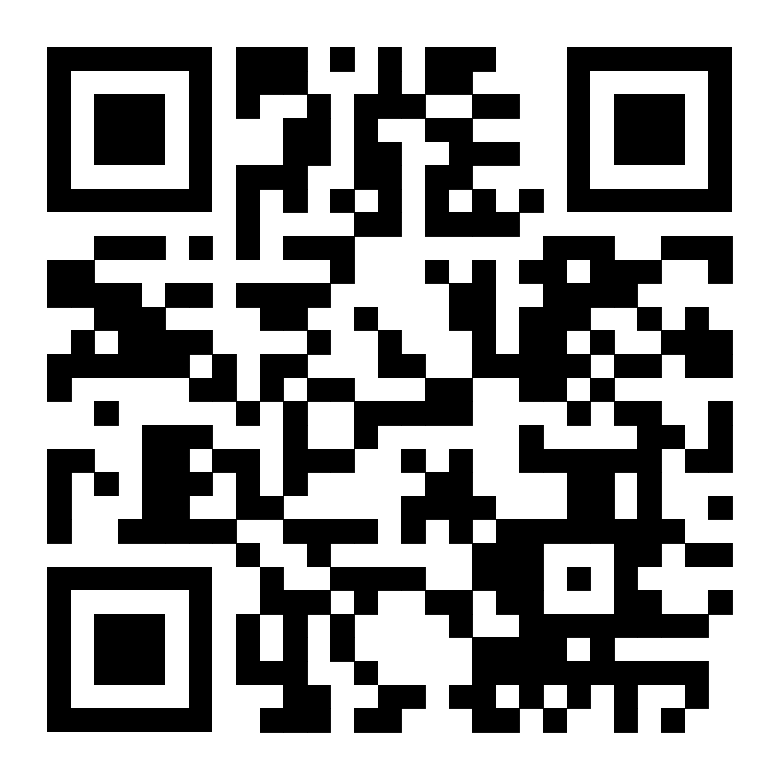
Bill Tracking
Public Policy Listserv
Legislative Tracker
https://mgaleg.maryland.gov/mgawebsite/
Register for a free account at MyMGA

Slide 16
Bills of Interest

Slide 17
SB 86: Online Sports Wagering - Problem Gambling Resources - Required Contact Information
Requires mobile sports wagering licensees to publish prominently on the homepage of its online sports wagering website and mobile app
If you or someone you know has a gambling problem, click here or call 1-800-GAMBLER for help
“Click Here” should link to the Maryland Center of Excellence on Problem Gambling website.

Slide 18
HB 17: Internet Gaming - Authorization and Implementation
Creates an authorization and implementation plan for iGaming
Expresses legislative intent that minorities, women, and minority- and women- owned businesses are encouraged to participate in the iGaming industry
The Governor is authorized to enter into multijurisdictional iGaming agreements
Includes an allocation to the Problem Gambling Fund
Users must be at least 21 with periodic age and identity verification

Slide 19
Potential and Anticipated Bills
Problem Gambling Education
Educating public school students on the danger of problem gambling
General Protections
Mobile deposit limits
VEP Opt-out
Age restrictions
Ban prop betting on college athletes
Data sharing
University Geo-Fencing
Problem Gambling Fund
Maryland Department of Health prevalence studies concerning problem and pathological mobile gambling
Distribute a portion of proceeds from fantasy competitions and sports wagering to the Problem Gambling Fund

Slide 20
Join our Mailing List https://www.mdproblemgambling.com/join
Stay up to date on Center initiatives
Learn how you can get involved:
Awareness
Training
Prevention
Public Policy

Slide 21
Questions
or
Comments

Slide 22
Presented by
Blair Inniss, JD, MA
Pronouns: she/her/hers
Government Relations Manager
410-706-5999
binniss@law.umaryland.edu

