Slide 1
background
1 in 4 adults in Maryland have a disability
10% of Marylanders have a mobility disability
10% of Marylanders have a cognitive disability
5% of Marylanders have a disability that results in their inability to live independently
Over 780,000 Marylanders have a mental health disability (19x the population of Annapolis)
Disability & Health U.S. State Profile Data: Maryland | CDC

Slide 2
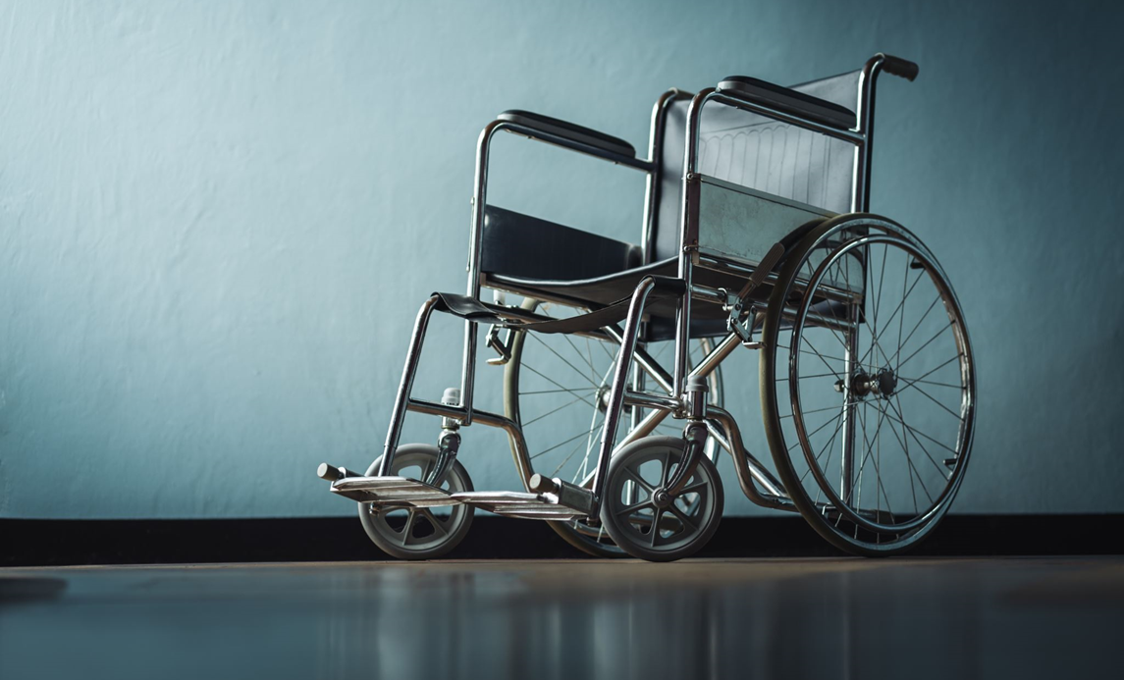
Disability civil rights history
Notes:
Megan

Slide 3
1800s: “Ugly” laws
1974: Last “Ugly” law repealed
1927: Buck v Bell
1935: Social Security Act
1974: Supplemental Security Income (SSI)
Ongoing: Marriage Penalty
1962: Ed Roberts fights to attend UC Berkeley
1964: Civil Rights Act
Excludes people with disabilities
1965: Medicare & Medicaid
1983: Home and Community-based Services (HCBS)
1999: Olmstead
2014: HCBS Standards
1965: Voting Rights Act
2002: Help America Vote Act (2002)
1970: Judy Heumann sues the NYC school board to become a teacher
1971: PARC v Pennsylvania
1972: Mills v. Board of Education of DC
1975: EHCA (precursor to the IDEA)
1972: Willowbrook
1974: Pennhurst (court oversight through 1998)
1982: Youngberg v Romeo
1973: Section 504 of the Rehabilitation Act
1977: Implementing regulations
1985: Cleburne v Cleburne Living Center
1990: Capital Crawl & the ADA
2004: Tennessee v Lane
2010: Affordable Care Act
2010: Rosa’s Law
2020+: Crisis Standards of Care

Slide 4
This history results in…
Segregation
Institutionalization
Isolation
Higher risk of being subject to overbroad and unnecessary guardianship
Lack of access to medical care and support
Ongoing bias, stereotypes, and low expectations

Slide 5
Maryland HCBS Programs
Purpose: provide home and community-based services in-lieu of institutionalization
DDA: Community integration
NF or state facility serving people w/ I/DD
Hospital pipeline to NFs
Maryland LTSS Bluebook: https://health.maryland.gov/mmcp/longtermcare/SiteAssets/Pages/Maryland-Money-Follows-the-Person/LTSS%20Bluebook%202019.pdf

Slide 6
Overuse of and Over Reliance on Guardianship
Families are regularly advised to seek guardianship
Orders overly broad and lack specifics and needed limitations
Guardianship treated like a cure all

