Slide 1
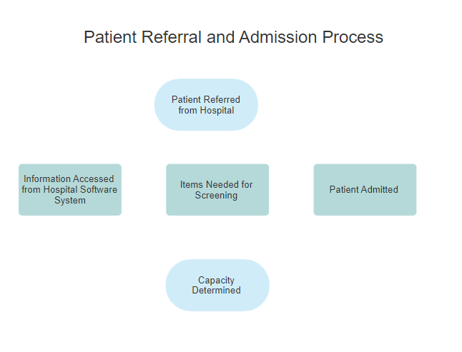
Admitting Patients Who Lack Decision Making Capacity to A Skilled Nursing Home

Slide 2
Needed for SNF Admission
Physician’s order
Medical History and Physical exam
Discharge Summary that includes medications, treatments and plan of care
Health Care Contact Information
Health Care Advance Directives
Note: A variety of other items are needed and considered

Slide 3

Hospital Referral System
-Medical
-Financial
Portfolio MD
Navi Health
Aiden
Ensocare
Out of State Hospital Programs Vary

Slide 4

Upon Admission, Patient Lacks Capacity and No Readily Identifiable Authorized Agent
Upon Admission, Evaluate Capacity
Complete Certs of Incapacity
Begin to investigate for interested persons-scour hospital records, meet with the resident over several days as acute confusion/delirium resolves, patients’ phone reveal contacts, ancestry and Zappa websites, Lexus Nexus, social media sources, check facility sign in system for visitors, check in with interdisciplinary team members if they have seen visitors or had discussions with the residents about family or friends, send certified letters to identified contacts, request welfare checks be performed at prior known addresses.
If a contact is never located, or known possible agents are unavailable, initiate guardianship
If determined likely to be LTC, initiate MA application pending guardianship.

