Slide 1

UNREPRESENTED PATIENTS
CLINICIAL CONSIDERATIONS
Yoram Unguru, MD, MS, MA
Herman & Walter Samuelson Children’s Hospital at Sinai Division of Pediatric Hematology/Oncology
Johns Hopkins University - Berman Institute of Bioethics

Slide 2
CASE
DB, 64yo with advanced emphysema/COPD, acute on chronic respiratory failure status post tracheostomy
Repeated hospitalizations for most of calendar year (x10 mos)
Hospitalization complicated by numerous recurrent infections including colonization & multi-drug-resistant organisms
No effective available treatments
Notes:
Good morning. I’d like to thank Diane for organizing and spearheading today’s meeting and for the opportunity to briefly present.
To set the stage, I’m going to share an actual case our Ethics Committee consulted on. It’s one of many and captures some of the challenges I imagine others here also encounter when attempting to care for and do right by so-called unrepresented patients.
Infectious disease consultant concluded no effective available treatments

Slide 3
CASE con’t
Prior to current hospitalization, DB was employed & lived independently with a roommate
Ongoing cognitive decline with inability to perform ADLs
Seven months earlier, DB requested “all interventions & full code”
Five months ago, DB was declared to lack DM capacity

Slide 4
CASE con’t
Given worsening clinical status, clinical team sought to engage DB in goals of care discussions
DB repeatedly resisted attempts by the clinical team to engage &/or dialogue
No knowledge of DB’s preferences, values or wishes
Presently, DB is noncommunicative
Notes:
In his current clinical status, it is unknown whether DB would (still) want all measures pursued and unfortunately, he consistently blocked the clinical team’s attempts to discuss his goals.

Slide 5
CASE #1 con’t
DB is unrepresented
  Lacks DMC w/no family, friend or other individual to speak on his behalf
Sister and Aunt identified
  Little to no contact with DB and neither “knows DB”
  Neither is willing to serve as DB’s representative
  Both defer to the clinical team for decisions
Roommate - “I want nothing to do with DB”
  Unwilling to serve as DB’s representative
Two former coworkers unable to offer insight as to DB’s pref/values
Notes:
DB’s preferences are unknown. Although several family members and acquaintances were identified, none has a meaningful relationship with DB and none were willing to serve as his surrogate or proxy.

Slide 6
MEDICAL RECOMMENDATION
DB has untreatable infections & viable treatments have been exhausted
Clinical status has worsened (pressors) & will certainly further deteriorate
Ongoing interventions are medically ineffective
REC: Palliative care & comfort measures

Slide 7
ETHICS CONSULTATION - PAC
Substituted judgment
Best interest versus harms
Ethically permissible to invoke medically ineffective declaration (HCDA)
Focus - respect DB’s dignity; aggressively tx pain & limit suffering
Update family members regarding care plan & its rationale
Notes:
The ethics consultants are serving as a patient advisory committee.
For adults who lack DM capacity, clinical decisions typically rely upon substituted judgement based upon what the patient would have wanted were he able to state as such. Substituted judgment requires some knowledge of, or sense of a patient’s wishes, which in DB’s case did not exist, and therefore, substituted judgment was not an option. Accordingly, one must decide based upon DB’s perceived best interest while balancing and limiting unnecessary harms.

Slide 8
WHAT’S IN A NAME?
Un-befriended / Unrepresented / Incapacitated patient without advocate
Unrepresented

Slide 9
ETHICS
Many clinicians are uncomfortable caring for unrepresented patients
Patient Advisory Committee (PAC)
Where no PAC, Ethics Committees step-in
Notes:
It seems that many clinicians are uncomfortable proceeding in such decisions.
Some hospitals have Patient Advisory Committees to assist in these situations. At my Hospital, the Ethics Committee serves as the PAC, and we are often called.

Slide 10
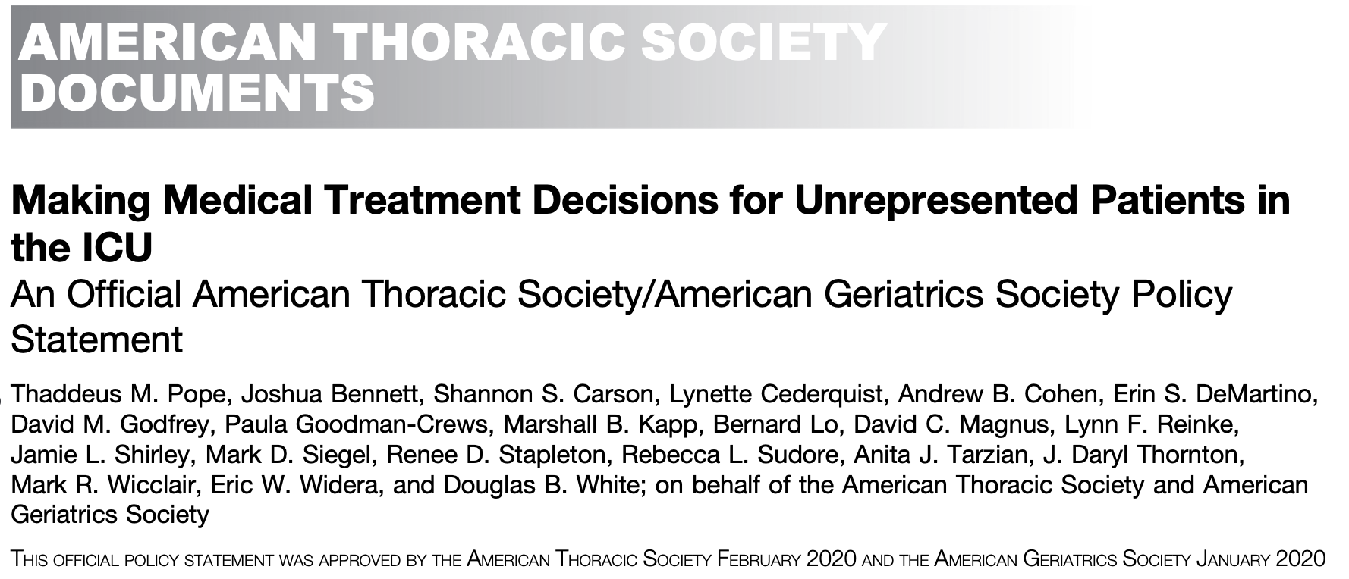
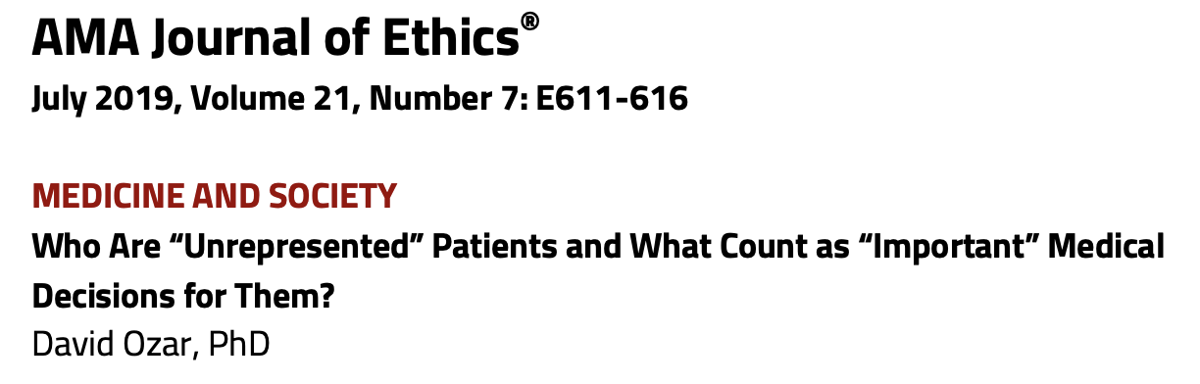

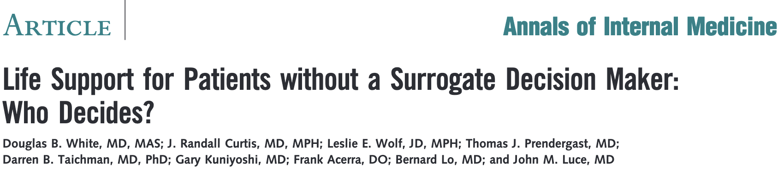
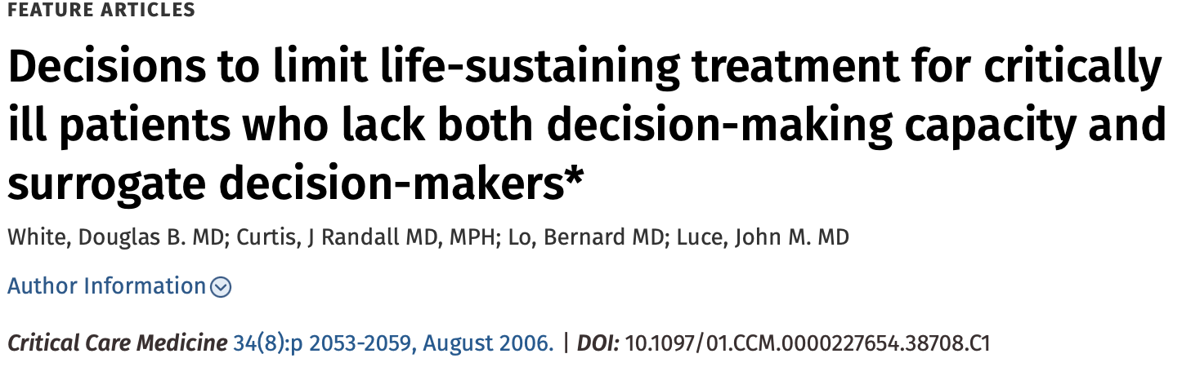



ETHICS
Notes:
The following data and recommendations are gleaned from these sources and my experience.

Slide 11
RISKS
Patients who lack a decision-maker are at ↑ risk for
  Over-treatment
  Under-treatment
  Delayed treatment
  Treatment inconsistent with their preferences & values
  Treatment may occur w/o consent & against pt’s wishes
In the absence of clear guidance, clinicians vary widely in how they make specific decisions for patients
  Heightened risk for inequity / disparity / bias
Notes:
Patients lacking a decision-maker are at heightened risk for over- / under-treatment, delayed treatment, or treatment inconsistent with their preferences and values.
Consequences for teams often is one of 3 approaches: treat; withhold/withdraw treatment; delay treatment. When treating these patients, treatment may occur without consent and treatment may be against the patient’s wishes.
Data suggests that clinicians’ treatment decisions may be influenced by medically irrelevant features such as race, gender identity, ethnicity, religion, SEC status and clinicians’ implicit biases.

Slide 12
DATA
Unrepresented patients are commonly encountered
  In ICU settings, 16% of patients are unrepresented (2006)
  ~50% of critical care clinicians & hospitalists care for at least 1 unrepresented patient/month (2019)
ICU stays often are twice as long compared to other patients
Notes:
Unrepresented patients are hospitalized more than one may realize. In ICU settings, a 2006 study noted 16% of ICU patients are unrepresented while more recent surveys noted nearly half of respondents reported encountering 1 such patient every month.
Beyond the ethical issues, this has important practical implications as unrepresented patients often have ICU stays twice as long as other patients. I’ll remind you of the seemingly ever-present bed-crunch in Maryland hospitals. Limiting unnecessary length of stay for all patients is low-hanging fruit in terms of addressing bed allocation.

Slide 13
Meaningful steps to identify potential family, friends, providers, or others who may know of and potentially, represent the patient’s wishes.
Institutions should offer ACP to prevent patients at high-risk for becoming unrepresented from becoming so.
Institutions should manage decision-making for unrepresented patients using input from a diverse interprofessional, multidisciplinary committee rather than ad hoc by treating clinicians. Such decision-making is a collaborative effort between the clinical team and the multi-disciplinary committee.
Institutions should manage decision-making via a fair process consistent with procedural due process.
Notes:
As we all recognize, a court-appointed guardian takes time, time that patients and clinicians often do not have. Thus, patients, clinicians, and hospitals require and deserve a different solution such as that advocated by the multi-society task force has recommended, one which aims to have a fair and practical process for treatment decisions for unrepresented patients.
Meaningful steps should be taken to identify potential family, friends, providers, or others who may know of and potentially, represent the patient’s wishes.
Institutions should offer ACP to prevent patients at high-risk for becoming unrepresented from becoming so.
Institutions should manage decision-making for unrepresented patients using input from a diverse interprofessional, multidisciplinary committee rather than ad hoc by treating clinicians. Such decision-making is a collaborative effort between the clinical team and the multi-disciplinary committee.
Institutions should manage decision-making via a fair process consistent with procedural due process.

