Slide 1
Guardianship Presentation
Brandon Floyd, Senior Analyst,
Government Affairs & Policy

Slide 2
Overview
Guardianship
General Assembly Hospital Throughput Work Group Recommendation
MHA Engagement
Guardianship Legislation
Challenges to Guardianship

Slide 3
Guardianship

Slide 4
Guardianship of Person
Purpose: Concerned with the personal well-being and care of an individual who is unable to manage their own affairs due to physical or mental incapacity
Responsibilities: Decisions related to personal needs, medical care, living arrangements, education etc.
Guardianship of the person (see Estates and Trusts, § 13-705)

Slide 5
Guardianship of Property
Purpose: Manage the financial assets and property of an individual who is unable to handle these matters due to incapacity
Responsibilities: Manages the individual's finances, including paying bills, managing investments, handling real estate, and making decisions about the use and protection of the individual's assets
Guardianship of property (see Estates and Trusts, § 13-201)

Slide 6
General Assembly hospital Throughput Work Group

Slide 7
General Assembly hospital throughput work group
Convened at the request of the Health and Government Operations and Senate Finance Committees chairs
Comprised of General Assembly members, hospital leaders, and policy advocates
Tasked with analyzing health care delivery across the continuum of care to identify opportunities to improve hospital throughput and alleviate long wait times in emergency rooms
Improving the guardianship process was identified as a means of ensuring patients receive care in the most appropriate setting while freeing up much-needed hospital inpatient capacity

Slide 8
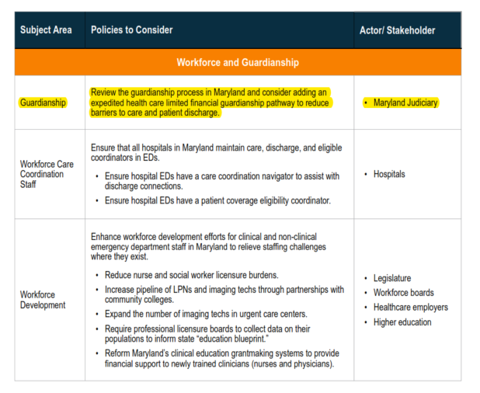
General Assembly hospital throughput work group
Guardianship Recommendation:
  Improve patient care by expediting proper patient placement
  Reduce administrative burden on hospital staff
  Improve hospital throughput

Slide 9
Hospital Engagement

Slide 10
Hospital Efforts
Convened internal hospital guardianship work group for policy development
Surveyed hospital members’ discharge process
Length of time between hearing request and hearing date
Length of time between hearing request and date of guardianship order
Met with stakeholders to discuss challenges and processes

Slide 11
2024 Legislation

Slide 12
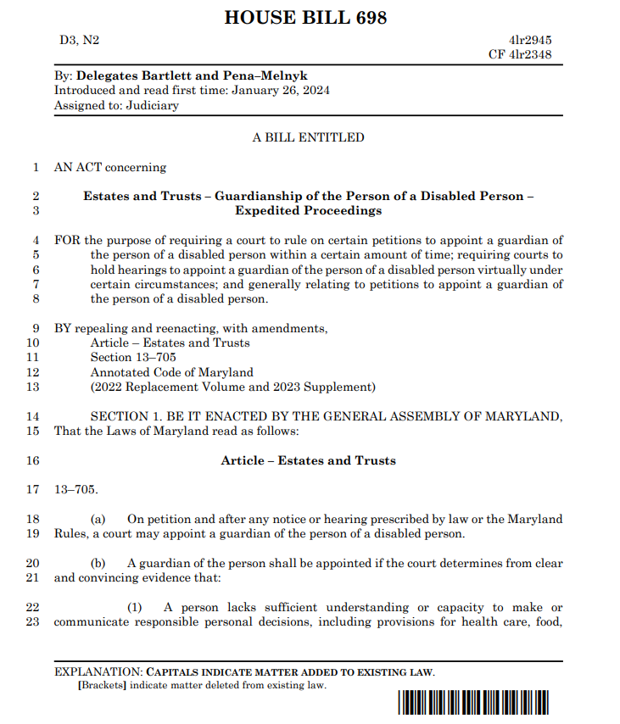
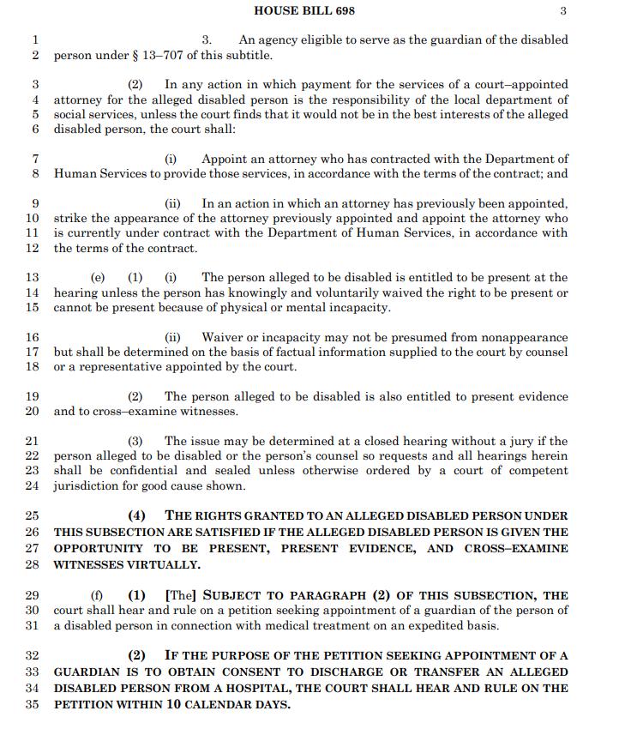
HB 698/ SB 759
Legislative Goals
  Establish an alternative expedited process
  Improve patient discharge process for vulnerable adult populations
  Assist Hospital Throughput /Reduce ED Wait Times
  Enact flexible hearing process (virtual / in-person)

Slide 13
Challenges

Slide 14
Challenges
Jurisdictional Court Procedural Differences
  Variance in hearing processes for guardianship and emergency guardianships (staff and resources)
Requirements from post-acute facilities and nursing homes
Ensuring adequate patient protections in an expediated process

