Slide 1
Guardianship (& Alternatives) Working Group

Slide 2
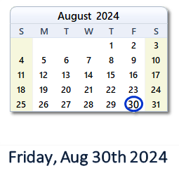

Slide 3
Introductions
Who do you represent?
Your role or work related to guardianship and this issue.

Slide 4
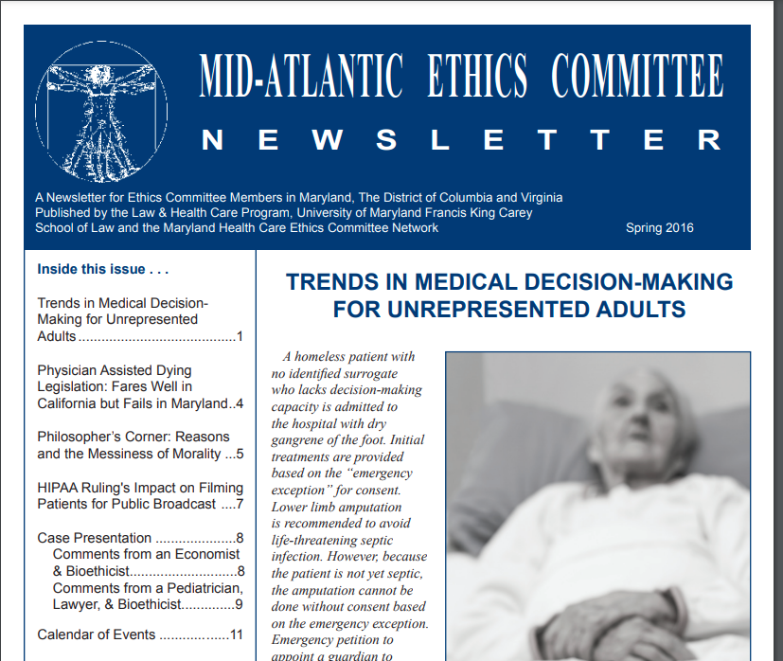
Maryland Healthcare Ethics Committee Network

Slide 5
Goal
Propose a set of options as to how decisions can be made for individuals who are hospitalized and lack the capacity to make decisions for themselves and have no family or friends available to make those decisions
Focus on:
Treatment and Discharge decisions
Options that are:
Efficient
Recognize due process rights
Respect and consider wishes of patient to extent known
Do not negatively affect patient health

Slide 6
HB 698/SB 759
Would add to the Guardianship of the Person statute (Sec. 13-705 of Est. & Trusts):
(f)
(1) ) SUBJECT TO PARAGRAPH (2) OF THIS SUBSECTION, THE court shall hear and rule on a petition seeking appointment of a guardian of the person of a disabled person in connection with medical treatment on an expedited basis.
(2) IF THE PURPOSE OF THE PETITION SEEKING APPOINTMENT OF A GUARDIAN IS TO OBTAIN CONSENT TO DISCHARGE OR TRANSFER AN ALLEGED DISABLED PERSON FROM A HOSPITAL, THE COURT SHALL HEAR AND RULE ON THE PETITION WITHIN 10 CALENDAR DAYS
(G) A HEARING ON A PETITION UNDER THIS SECTION SHALL BE HELD VIRTUALLY UNLESS THE PARTY SEEKING THE APPOINTENT OF A GUARDIAN OR THE ALLEGED DISABLED PERSON REQUESTS THAT THE HEARING BE HELD IN PERSON.

Slide 7
Maryland Dept. of Aging
Maryland’s 19 Area Agencies of Aging, which are overseen by the Dept. of Aging (MDOA) serve as public guardians in last resort situations for adults 65 and older where no other family member or suitable alternative guardian is available. Once notified of the need for a public guardian, AA personnel spend nearly half of their time researching family members and pursuing guardianship avoidance options. “Older adults in these guardianship petitions routinely are living alone, do not have organized finances, thus the marshaling of their assets depends on the guardians of the property, who are usually court appointed attorneys that operate on their own timelines. Once the older adult’s financial picture has been determined, the AAA guardianship staff works to determine what post-acute care setting the older adult can afford, which sometimes requires a move and judicial transfer of the case to another jurisdiction with more affordable assisted living options.

Slide 8
Maryland Judiciary
Although well intentioned, this bill raises constitutional issues and would undermine rights and protections afforded to respondents to guardianship proceedings.
The timeline of 10 days for a hearing is unworkable as it would not allow for scheduling of contested cases or a jury trial if needed. The timeline does not recognize the demands of other pending cases or the trial calendars of attorneys involved. The Judiciary is in the best position to schedule the matters before it in consideration of all relevant factors.
Most petitions filed by hospitals include requests for the appointment of a guardian of the property. There is no public guardianship of property, so courts must rely on the group of attorneys who do this work and who are paid from the person under guardianship’s assets.

Slide 9
Maryland Developmental Disabilities Coalition/Disability Rights Maryland
Md. Code, Est. & Trusts Sec. 13-705(f) already provides a mechanism for an expedited hearing process for decisions related to medical decisions, which includes the discharge and transfer process.
The real barrier for many patients . . . is not the lack of a guardian, but the lack of affordable, accessible, and safe discharge locations.
We are deeply concerned about the risks HB 698 creates for people with disabilities being placed under unnecessary, plenary guardianship orders; The over-reliance on and improper use of guardianship is a complex problem rooted in disability discrimination and ageism. HB0698 will only add to these risks and problems within the guardianship system.

Slide 10
Montgomery County Dept. of Health and Human Services
Under the bill, county APS programs will have to investigate and respond to petitions to obtain consent to discharge or transfer an alleged disabled person within 10 days rather than 30 days.
Further, the bill amends the Est. & Trusts Article 13-705(f) which deals specifically with guardianship in connection with medical treatment. Although “medical treatment” is not defined in statute or caselaw, consent to discharge or transfer from a hospital may not fall within the definition of treatment. Generally, this statute has been used for alleged disabled persons who require time-sensitive emergency surgery or treatment and a guardian of the person was required for the treatment.

Slide 11
Maryland Rules of Procedure Rule 10-201(f)
Sets forth a process for an expedited hearing for medical treatment
Petition for an expedited decision must be filed along with a petition for guardianship of the person
Entitles the alleged disabled person to a jury trial on issue of whether a guardianship is necessary
May require alleged disabled person’s attorney to investigate allegations in the petition, interview interested persons and assess the needs of the disabled person

Slide 12

Health Care to Guardianship Pipeline
2021 Maryland AoC received grant from Administration for Community Living at USDHHS
To:
Perform an assessment of Maryland’s guardianship system
Identify drivers of the pipeline and
Identify ways to divert patients to less restrictive and more person-centered options than guardianship

Slide 13
2011 recommendation by Working Group on Hospitalized Adult Disabled Persons – Appointment of Temporary Limited Guardian
Maryland should establish a short-term surrogate decision-making mechanism specifically for disabled adults in hospitals who are unable to make discharge and placement decisions. This policy should be implemented as a “less restrictive alternative” to the guardianship process. Any cases not meeting requisite criteria, or having a conflict or objection, would lead to a petition for guardianship with full safeguards.
The Working Group identified two possible models for the surrogate decision-making mechanism including:
Patient Care Advisory Committees and
Clinical Review Panels

Slide 14
2011 recommendation by Working Group on Hospitalized Adult Disabled Persons – Appointment of Temporary Limited Guardian
The Working Group included representatives from the following agencies and organizations:
• DHR (including local Social Service Departments’ Guardianship Programs);
• Department of Aging;
• Area Agencies on Aging;
• Administrative Office of the Courts;
• Department of Health and Mental Hygiene;
• Hospitals;
• Nursing home industry;
• Office of the Attorney General;
• Court appointed attorneys in guardianship cases; and
• Citizens from guardianship review boards.

Slide 15
2011 recommendation by Working Group on Hospitalized Adult Disabled Persons – Appointment of Temporary Limited Guardian
Maryland should establish a short-term surrogate decision-making mechanism specifically for disabled adults in hospitals who are unable to make treatment decisions. This policy should be implemented as a “less restrictive alternative” to the guardianship process. Any cases not meeting requisite criteria, or having a conflict or objection, would lead to a petition for guardianship with full safeguards.
The Working Group identified two possible models for the surrogate decision-making mechanism including:
Patient Care Advisory Committees and
Clinical Review Panels

Slide 16
Discharge Recommendations: one idea
Tennessee Legislation
Authorizes an Expedited Limited Healthcare Fiduciary (ELHF) to make safe discharge decisions for patients who may not be able to make such decisions and lack family or friends to make decisions for them
The court, on petition of a person interested in the respondent’s welfare may appoint an ELHF whose authority is for the limited purpose of consenting to discharge, transfer, and admission as well as any financial arrangements or medical care necessary to affect such discharge, transfer or admission.
An ELHF’s authority may not exceed 60 days.
Immediately upon receipt of a petition the court must appoint an attorney ad litem to represent the respondent in the proceeding.

Slide 17
Discharge Recommendations: one idea
Tennessee Legislation
Court must hold a hearing on the appropriateness of the appointment within 5 days of the appointment
Appointment is not based on the respondent’s incapacity

Slide 18
Discharge Recommendations: one idea
Washington Legislation
Requires the Office of the Public Guardian (OPG) to contract with public or private entities to provide decision-making services for individuals who are currently receiving care in a hospital setting who are ready to discharge and are without a qualified person who is willing and able to serve as a guardian. (also must meet income guidelines)
OPG must also establish a navigator service to provide assistance and support for individuals in hospitals including assistance in navigating options for guardianship, public conservatorship, decision-making assistance, and estate administration services.

Slide 19
Thank you

