Slide 1
The “healthcare to guardianship pipeline”
This presentation was supported, in part, by a grant (No. 90EJIG0027-02-00) from the Administration for Community Living (ACL), U.S. Department of Health and Human Services (DHHS). Grantees carrying out projects under government sponsorship are encouraged to express freely their findings and conclusions. Therefore, points of view or opinions do not necessarily represent official ACL or DHHS policy.

Slide 2


About us
Erica C.R. Costello, JD, NCG
Director
ABA Commission on Law and Aging
Nisa C. Subasinghe, Esq.
Domestic & Guardianship Program Manager
Administrative Office
of the Courts

Slide 3
The “healthcare to guardianship pipeline”
Hospitals
Skilled nursing facilities
Other healthcare settings

Slide 4

The Guardianship Pipeline
Across the Country

Slide 5
What’s driving the Pipeline?
Medical care or treatment
Discharge to a residential setting
Payment for a skilled nursing facility
Application for government benefits
Access to financial records

Slide 6
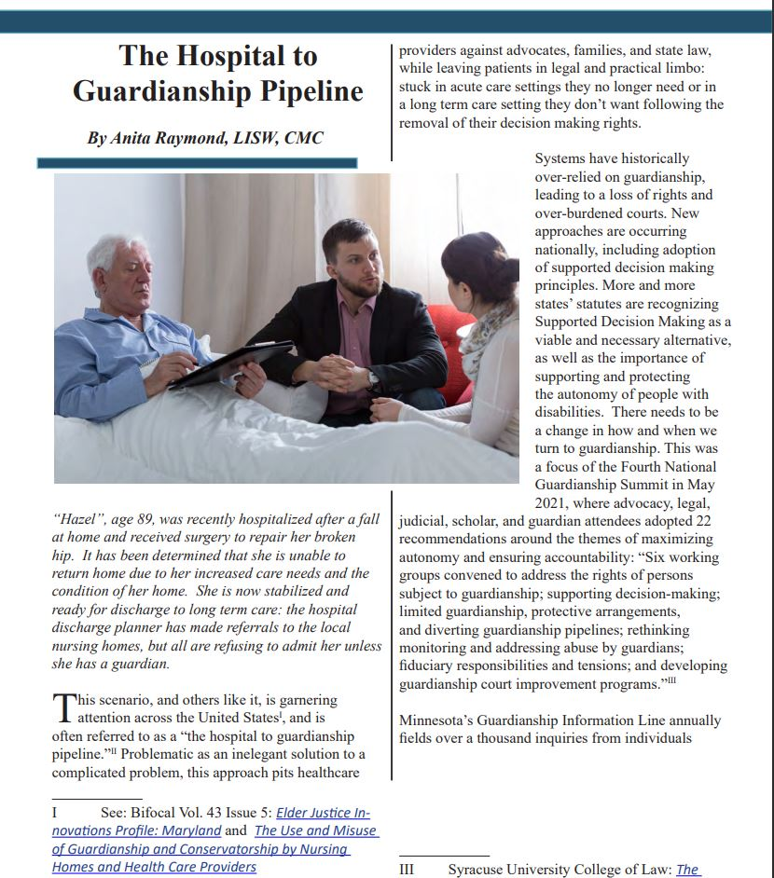
Minnesota
“Guardianship is sometimes the default response, an attempt to seek a fast, uncomplicated response. But Guardianship is neither fast nor without complications. Further, when systems turn to guardianship prematurely, or as the go-to response, they don’t first explore less restrictive alternatives, sometimes even ignoring or not discovering the existence of previously completed advance directives or financial planning tools, both of which would be viable, legal, immediately available alternatives to guardianship for personal and financial decision making.”
Anita Raymond, The Hospital to Guardianship Pipeline, Bifocal, Vol. 44, Issue 6, https://www.americanbar.org/groups/law_aging/publications/bifocal/vol44/bif-vol44-issue6/hospital-guardianship-pipeline/

Slide 7

New York
NY Times Investigation
  Out of 3,302 guardianship cases filed in Manhattan (NY) from 2002 to 2012, 12.4% were filed by nursing homes
  Might be filed due to problems with family or unpaid debt
  NY Justice Alexander W. Hunter ruled such petitions were inappropriate and ordered the nursing homes to pay the legal costs. (In re S.K., 827 N.Y.S.2d 554, 557 (Sup. Ct. 2006))
  “Whether or not the person is receiving skilled care and whether or not the costs of skilled nursing care are covered by the person’s health insurance policy, are not proper subjects of a guardianship proceeding.”
  Nina Bernstein, To Collect Debts, Nursing Homes are Seizing Control Over Patients, N.Y. Times, (Jan. 25, 2015), https://www.nytimes.com/2015/01/26/nyregion/to-collect-debts-nursing-home-seizing-control-over-patients.html?hp&action=click&pgtype=Homepage&module=second-column-region&region=top-news&WT.nav=top-news

Slide 8
Massachusetts
Boston Medical Center formed a multi-disciplinary group of stakeholders (including legal, business, social work, case management, psychiatry, hospitalist and executive leadership) to create interventions for streamlining the guardianship process.
After using outside counsel to petition for guardianship, the hospital found:
  The average length of stay (LOS) for patients needing a guardian dropped from 150 days to 39 days
  The median LOS for patients needing a guardian dropped from 100 days to 34 days
  An additional 5-10 beds were freed up for use by the hospital
  Wendoly Ortiz Langlois, & Dianne Yacovone, Improving the Guardianship Process: Better for Patients and Better for Hospitals, Health City (May 13, 2019), https://www.bmc.org/healthcity/policy-and-industry/guardianship-process-change-better-patients-and-hospitals

Slide 9

Indiana
2010 study conducted of patients who were appointed guardians during acute care hospitalization at Wishard Memorial Hospital (WMH) in Indianapolis, IN.
Of the 71 patients with medical records available, 89% had a temporary guardianship petitioned because of the need for placement only.
45 (67.2%) of the 71 patients had an available family member who was not appointed as temporary guardian. The most common documented reason was that the family member “unable or unwilling.”
The median time between the patient’s admission and date of documented incapacitation was 1 day; median time between documented incapacitation and guardianship request was 14 days; and the median time between the guardianship request and appointment of permanent guardianship was 37 days.
Bandy, R. J., et. al. Medical decision-making during the guardianship process for incapacitated, hospitalized adults: a descriptive cohort study. J Gen Intern Med. 2010 Oct;25(10):1003-8. doi: 10.1007/s11606-010-1351-8. Epub 2010 Apr 27. PMID: 20422304; PMCID: PMC2955482.

Slide 10
Washington
In July 2022, the Washington State Hospital Association (WSHA) reported healthcare facilities were 120 to 130% full, leading to long wait times in the ER, declining patient care, and disruptions in ambulance services throughout the state.
If the patient has not appointed a decision maker in a power of attorney document, state law requires a court appointed guardian.
The hospitals asked state officials to address discharge and staff issues with measure that include reconsidering the state’s guardianship laws.
Associated Press, WA Hospitals Over Capacity Due to Patient Discharging Woes, apnews.com, (July 18, 2022), https://apnews.com/article/covid-health-washington-government-and-politics-51de6cbe6f440170e5bf42e65b118d7a

Slide 11

Missouri
In June 2024, the Department of Justice (DOJ) found the state was violating the Americans with Disabilities Act (Act) by unnecessarily institutionalizing adults with mental illness in nursing facilities.
The DOJ found the state’s court appointed guardianship system was a “pipeline to unnecessary institutionalization.”
Missouri needs to work with the DOJ to come up with a plan to fix the violations or risks being sued by the DOJ.
Clara Bates, Missouri is Breaking Federal Law by Housing Mentally Ill in Nursing Homes, DOJ finds, Missouri Independent (June 20, 2024): https://missouriindependent.com/2024/06/20/missouri-is-breaking-federal-law-by-housing-mentally-ill-in-nursing-homes-doj-finds/

Slide 12

Recommendations From Reviewing the Literature:
Need for greater emphasis on less restrictive alternatives to guardianship
Need for advance planning
Need for benefits planning
Need for further mental health services

Slide 13
The pipeline in Maryland

Slide 14
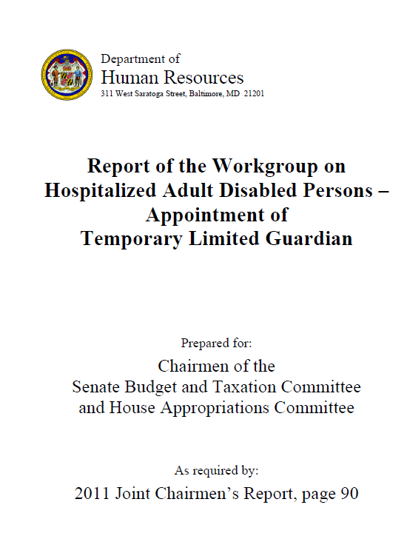
“The current process of establishing guardianship, which relies on the courts to hear guardianship cases, substantially and often times permanently restricts the rights of individuals, and requires costly and lengthy processes when essentially what is needed is “consent for placement” in the least restrictive setting (also referred to as “appropriate setting”) upon discharge from a hospital.”

Slide 15
Recommended policy
Maryland should establish a short-term surrogate decision-making mechanisms specifically for disabled adults in hospitals who are unable to make discharge and placement decisions. This policy should be implemented as a “less restrictive alternative” to the guardianship process. Any cases not meeting requisite criteria, or having a conflict or objection, would lead to a petition for guardianship with full safeguards.

Slide 16
Recommended policy (cont.)
These less restrictive alternatives would:
Accelerate the discharge to appropriate settings of adult disabled persons who no longer require treatment in a hospital setting;
Provide the least restrictive setting that is in the best interest of the patient;
Include a thorough search for a willing surrogate decision maker under Health-General §5-605 (surrogate decision-making statute); and
Provide legal counsel to patients while minimizing the role of the courts

Slide 17
Expedited hearings
Guardianship of the person – “In connection with medical treatment” (Estates & Trusts Art., §13-705(f)
Maryland Rule 10-201(f) (effective January 1, 2019)
  Committee note: Examples of circumstances that may require the hearing on a petition . . . on an expedited basis . . . include threats to the physical or mental health of an alleged disabled person associated with delaying the appointment of a guardian to make a decision about the starting or stopping of treatment or discharge from a health care facility that, although not posing an imminent risk of harm, compromises the medical well-being of the alleged disabled person.
  If the petition is also for guardianship of the property, the court may rule on that portion on an expedited basis as well

Slide 18
Guardianship of the property
“Crisis points”
  Reliance on attorneys to serve as guardians of the property
  Medical Assistance Applications
    Access to records
Role of financial and other institutions

Slide 19


Understanding the pipeline
2021 Elder Justice Innovation Grant | Administration for Community Living, U.S. Department of Health and Human Services
  Diverting the Healthcare-to-Guardianship Pipeline: A Person-Centered Approach
  Goal: Reduce the number of unnecessary or overly broad guardianships

Slide 20
Statewide assessment
Interviews, focus groups, surveys
  Persons subject to guardianship
  Judges & court staff
  Healthcare professionals
  Attorneys
    Petitioners
  Advocacy organizations
Case file reviews
Analysis of state laws, forms, resources

Slide 21
Understanding the pipeline
Consent for medical care
No surrogate decision-maker
Unavailable, unresponsive, abusive surrogate
Discharge Planning
Risk of infection
Increase dementia and/or disorientation in some patients
Limits on available beds
Uncompensated care
May be an expectation of a skilled nursing facility
Application for Medicaid
Access to financial records
Standard of care
Lack of accommodations or supports
Financial exploitation
Barriers:
Concerns:
Barriers:
Payment
Risk of readmission
Logistics of home & community-based services (HCBS)
Effect on hospital ratings

Slide 22
Other Guardianship drivers
Abuse, neglect, exploitation
“School-to-guardianship pipeline”
Fear
Bias
Family conflict

Slide 23
Statewide assessment: Key findings
Need for education
Alternatives to guardianship
Supports & accommodations
Representation of respondents and persons subject to guardianship

Slide 24
Need/Area of Concern | Options
Personal decision-making | Ensuring supports and accommodations Supported decision-making
Medical treatment and discharge planning | Advance directive for health care Surrogate decision-making Medical Orders for Life-Sustaining Treatment (MOLST) | Withholding or withdrawal of medically ineffective treatment Home & Community Based Services and informal options
Mental health/psychiatric treatment | Advance directive for mental health services Voluntary admission to a mental health facility | Involuntary admission a mental health facility Behavioral Health Administration (BHA) resources
Managing assets or benefits | Financial power of attorney Authorized representative for medical assistance Representative Payees and U.S. Department of Veterans Affairs (VA) Fiduciaries Achieving Better Life Experience (ABLE) accounts | Trusts including special needs trusts Banking services Specific transaction (Transaction authorized by court without appointing guardian)
Post-secondary education needs | Transitional planning Community supports and resources
Other issues/concerns | Mediation Long-Term Care (LTC) Ombudsman Responses to abuse, neglect, or exploitation

Slide 25
Statewide assessment: Key findings
Capacity assessments
Limitations
Access to independent assessments ($)

Slide 26
Statewide assessment: Key findings
Placements and case management
Medicaid eligibility
Agency budgets
Access to advance planning options
Need for resources

Slide 27
Statewide assessment: Key findings
Court practices
Case processing times
Limited guardianships
Restoration of rights
Monitoring practices

Slide 28
Other Pipeline-related efforts

Slide 29

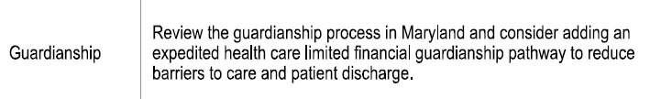
Throughput work group
Emergency Department wait times and throughput challenges
  Infrastructure and Systems
  Patient/Community Related Access to Care
  Hospital Capacity
  Workforce and Guardianship

Slide 30
Task Force on Preventing and Countering Elder Abuse
Senate Bill 797 (2023)
Guardianship Committee – Preliminary Recommendations
  Funding for guardians of the property needed for Medical Assistance qualification
  Other recommendations related to monitoring, information sharing, and ensuring post-appointment representation

Slide 31
Specific Transactions
Estates & Trusts Art., §13-204
Proposed Court Rule
  Goal: Uniform process with existing guardianship safeguards
  Examples of transactions to include establishing eligibility for benefits, accessing records, direct deposit/automatic payment
  Expedited hearing option
  Findings and orders

Slide 32
Other Judiciary Efforts
2021 Elder Justice Innovation Grant Recommendations (pending)
Case management and court processes
Training
Monitoring
Resources

