Slide 1
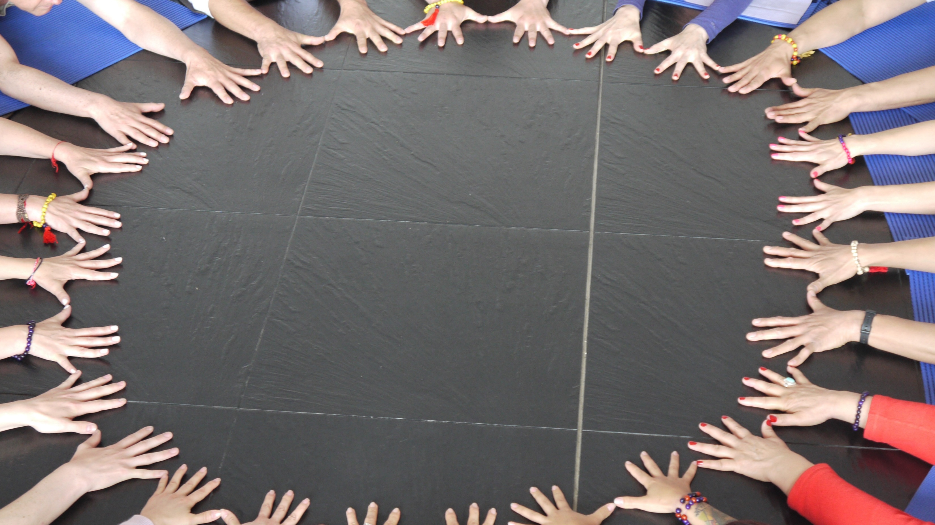
Relationships
RA Collaborative Meeting
August 2, 2022
1:00 pm

Slide 2

Great video Resource
Find more powerful videos on Edutopia’s YouTube channel.

Slide 3
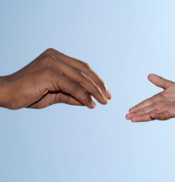
Highlights
Strong relationships are central to the learning process
Healthy attachment helps build a safe environment that fosters risk-taking and exploration which drives learning
Positive relationships create optimal conditions for learning
This Photo by Unknown Author is licensed under CC BY

Slide 4
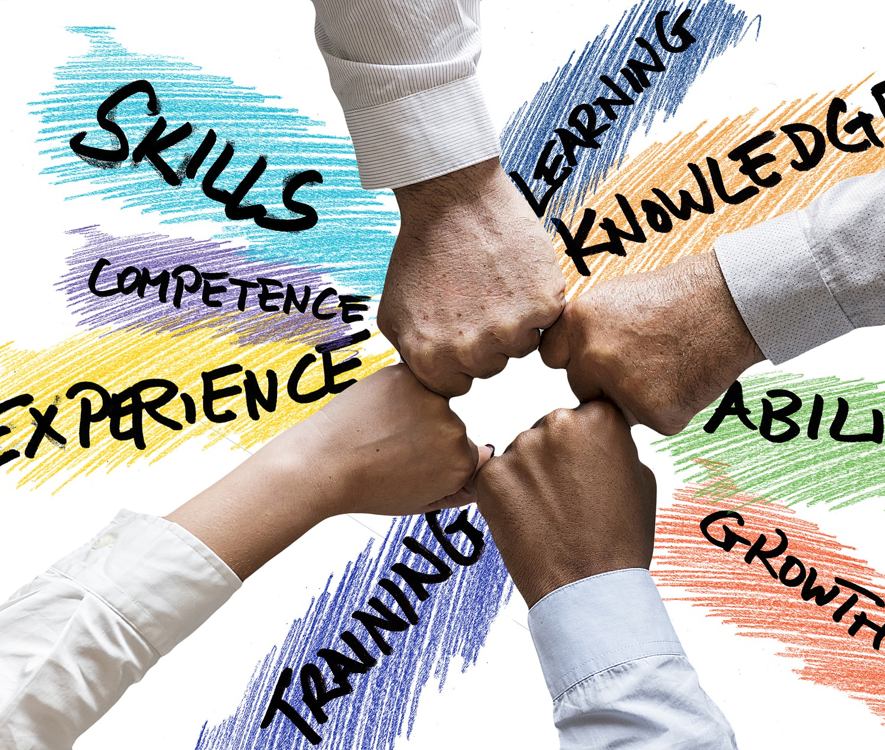
More Highlights
Being vulnerable and showing your authentic self strengthens bonds with students
Students who feel safe and supported are more likely to perform better academically
This Photo by Unknown Author is licensed under CC BY-SA

Slide 5
Sobering Statistics
The National Institute of Mental Health asks high school students if they feel persistently hopeless and depressed.
  20 years ago 26% reported that they did.
  Pre-COVID, 36% reported that they did.
  In 2022, fully 45% of high school students agreed with that statement.
54% of Americans say no one knows them well.
The number of people who say they have no close friends has quadrupled over the last several decades
July 8 PBS Newshour discussion between journalists David Brooks and Jonathan Capehart. They spoke, in part, about mass shootings—who does them and why. Here is part of what David Brooks learned in researching this phenomenon.

Slide 6
Closing Thought
“Emotion and learning are completely connected. If you’re in a positive emotional space, if you feel good about yourself, your teacher, that actually opens up the opportunity for more learning.”
--Linda Darling-Hammond

Slide 7

How Do We Use This Knowledge?
Please share your thoughts out loud or enter them in the chat.

