Slide 1
Restorative Approaches Practices: Affective Statements and Questions
Restorative Approaches Lesson 9
© 2022, Center for Dispute Resolution, Maryland Carey Law

Slide 2
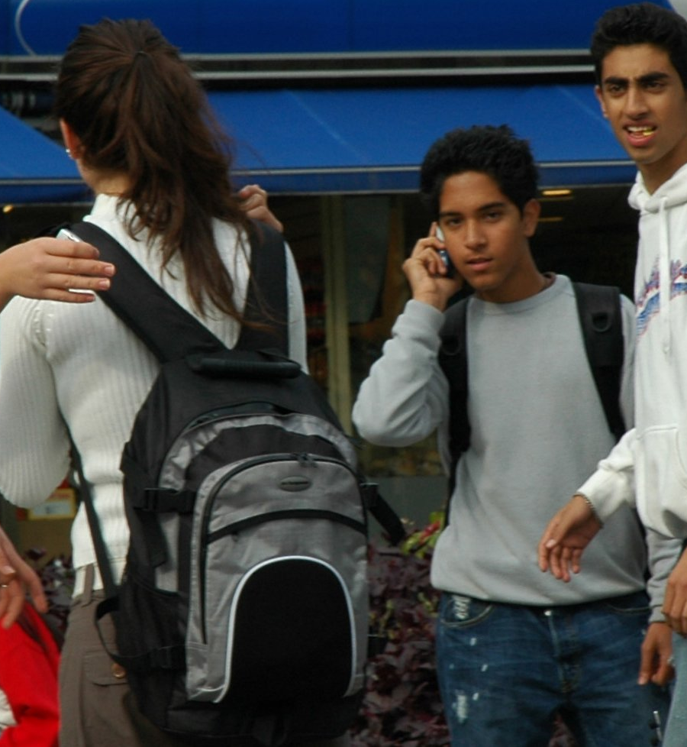
Welcome!
In learning about restorative approaches you know that we use circles to express the restorative philosophy and practice restorative interventions.
You remember the restorative foundations of healing the harm and respecting the human dignity of all participants. And you have seen how every person has a voice to say what they experienced and what they need to make things right as much as possible.
Let’s look now at how you can apply those elements in your everyday life and weave them into your school culture by using restorative practices.
© 2022, Center for Dispute Resolution, Maryland Carey Law
This Photo by Unknown Author is licensed under CC BY

Slide 3
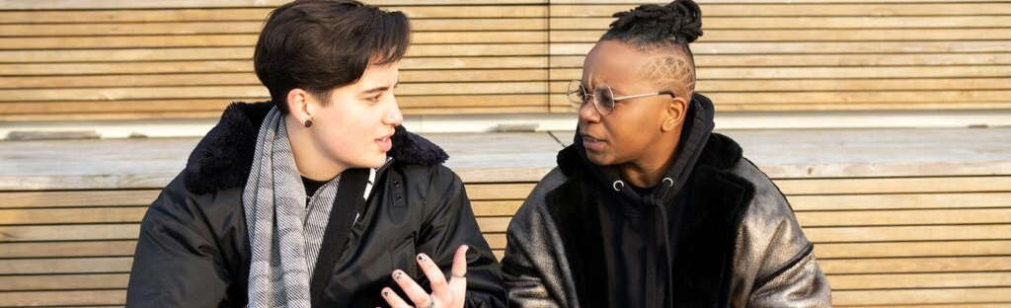
Affective Statements
When someone does something to harm you, expressing how you’ve been affected can be an important step toward healing.
Use affective statements to tell someone, respectfully but directly, how their actions impacted you. Often affective statements can open the pathway to change just by making the problem clear.
When necessary, you can also say what you need to have happen to make things right as much as possible
This Photo by Unknown Author is licensed under CC BY

Slide 4

Examples of Affective Statements
I feel frustrated when you interrupt me as I’m telling my story.
I really love that color on you. It makes me feel _____________.
When you call me that, it makes me feel like you don’t respect me.
When you smiled at me this morning, it really helped reverse my bad mood.
I hate to hear you say those negative things about _______.
This Photo by Unknown Author is licensed under CC BY

Slide 5
Affective Statements & Questions
Remember:
Speak only for yourself and from your own experience
Ask the person to speak only from their own experience
Treat the person with respect
Use your statement to begin a conversation about addressing the problem
Be open to other ideas about how to heal the harm that person’s behavior has caused.
Notes:
Remember that, as with all restorative justice interactions, Affective Statements and Questions should be delivered in a respectful manner. Of course, the response they generate must also be received as respectfully as possible.

Slide 6
Affective Questions for Self-Restoration
Tell me what’s been happening. What has not been working for you?
What were you thinking about this situation when it happened? (and) What have you thought about since?
How are you feeling about this situation?
How is this getting in the way of your goals for school? (or) being the person you want to be at school?
What could you do differently the next time you find yourself in this situation?
Notes:
Suggested by Engaging Schools, author Carol Miller Liebler from the Summer 2014, Teaching Tolerance article Restoring Justice available at http://www.tolerance.org/magazine/number-47-summer-2014/feature/restoring-justice

Slide 7

Affective Questions for Someone Harmed
What did you think when you realized what had happened?
What impact has this incident had on you and others?
What has been the hardest thing for you?
What do you need to feel things are right? Or What would you like to see from this?
This Photo by Unknown Author is licensed under CC BY-NC-ND
Notes:
Bob Costello, Joshua Wachtel and Ted Wachtel (2009) The Restorative Practices Handbook for Teachers, Disciplinarians and Administrators, Bethlehem, PA, International Institute for Restorative Practices From IIRP’s Restorative Practices Handbook, Page 15

Slide 8

Don’t Forget The 3 Restorative Questions
You can also use the three restorative questions to guide conversations around harm.
What happened?
(Everyone tells their story.)
Who has been affected by what happened, and how?
(Hearing others’ experience can build connections.)
How do we make things right?
(Brainstorm about what can be done to heal the harm.)
© 2022, Center for Dispute Resolution, Maryland Carey Law
This Photo by Unknown Author is licensed under CC BY-NC

Slide 9
Try it For Yourself!
Pair up or form a group of three and give each other examples of affective statements or questions you could use to address these situations:
Your long-term friend from elementary school keeps saying bad things about someone you respect.
Some classmates are making fun of another student you don’t know well, but you can see they are hurt by the classmates’ behavior.
An adult at your school repeatedly mispronounces your name.
Notes:
You will need to click to bring up each scenario for your students to work through. We recommend that you keep things moving by giving students just a short time to give each other their responses. Affective statements and questions are best used informally and in the course of natural interactions.

Slide 10
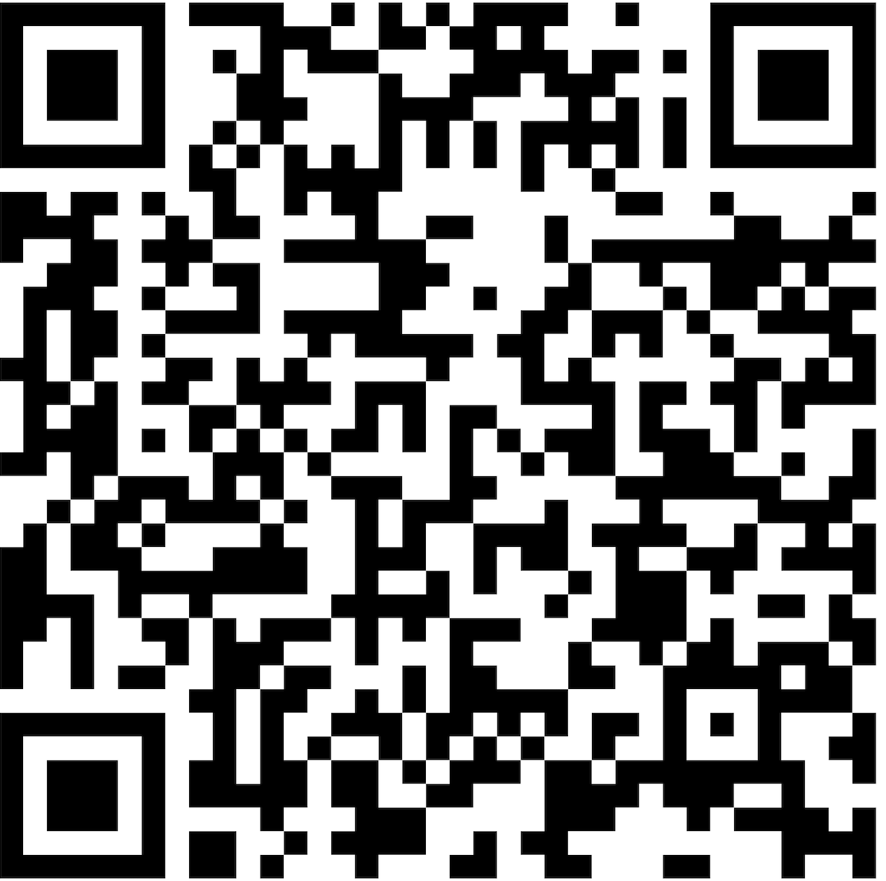
Thank you for learning with us!
For more resources about restorative approaches in education, explore the Restorative Approaches Collaborative Website at https://www.law.umaryland.edu/Programs-and-Impact/Dispute-Resolution/CDRUM/Restorative-Practices/

Slide 11

Special Thanks to . . .
This series of restorative approaches lessons is made possible through the generous financial support of the Charles Crane Family Foundation.
C-DRUM recognizes:
Engaging Schools, author Carol Miller Liebler from the Summer 2014, Teaching Tolerance article Restoring Justice available at http://www.tolerance.org/magazine/number-47-summer-2014/feature/restoring-justice
International Institute for Restorative Practices for their Restorative Questions Cards and Restorative Circles in Schools: Building Community and Enhancing Learning by Bob Costello, Joshua Wachtel and Ted Wachtel
© 2022, Center for Dispute Resolution, Maryland Carey Law

