Slide 1
Restorative Approaches: A New Look at an Old Story
Restorative Approaches Lesson 8
© 2022, Center for Dispute Resolution, Maryland Carey Law

Slide 2
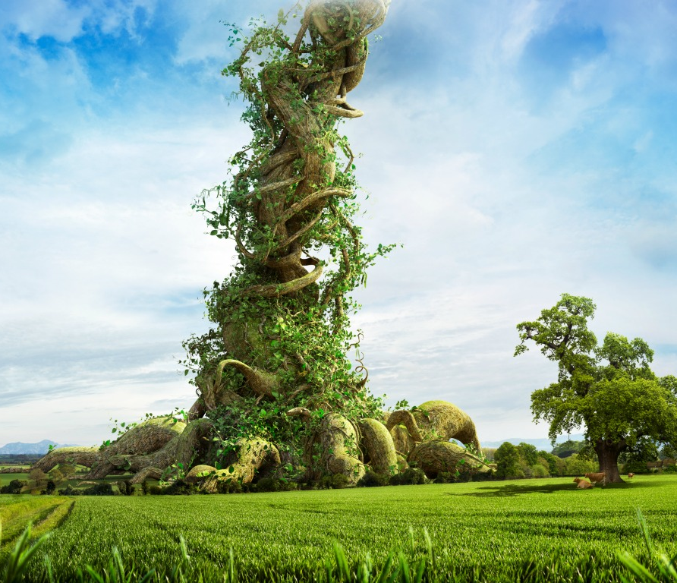
Pop Quiz
Who is the villain of the fable
Jack and the Beanstalk?
This Photo by Unknown Author is licensed under CC BY-SA-NC
© 2022, Center for Dispute Resolution, Maryland Carey Law
Notes:
This is a question to get students thinking about the fable and will give you a sense of who is already familiar with the story of Jack and the Beanstalk. No need to explain it now, as you will read the fable on Slide 6

Slide 3
Collaborate with Reading
On slide 5 you will read the old English fable of Jack and the Beanstalk.
Volunteers should take turns reading aloud some lines (as many or as few as you choose) to the whole class. Everyone who wants to read should get a chance to participate.
When the story is complete, form small groups of up to six people and follow the instructions on slide 6.
© 2022, Center for Dispute Resolution, Maryland Carey Law

Slide 4
Jack and the Beanstalk
As you listen to the story, please decide whose perspective you would like to take of the six characters mentioned. In your small group, you will answer the three restorative questions FROM YOUR CHARACTER’S PERSPECTIVE.
© 2022, Center for Dispute Resolution, Maryland Carey Law
Notes:
Have students volunteer to read this abbreviated (Wikipedia) version of the famous fairy tale, then put them into small groups to unpack the story as a case study.

Slide 5
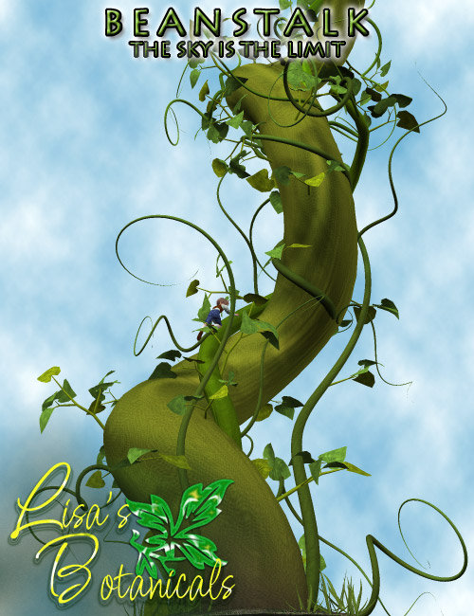
To his starving mother’s dismay, Jack, a poor country boy, trades the family cow for a handful of magic beans. Distressed, Jack’s mother throws the beans out the window. Overnight, the beans grow into a massive, towering beanstalk reaching up into the clouds.
Jack climbs the beanstalk and finds himself in the castle of an unfriendly giant. The giant senses Jack's presence and cries,
Fee-fi-fo-fum, I smell the blood of an Englishman. Be he alive, or be he dead, I'll grind his bones to make my bread.^{[8]}
With help from the Giant’s spouse, Jack is able to retrieve many goods once stolen from his family, including:
a bag of gold,
an enchanted goose that lays golden eggs, and
a magic golden harp that plays and sings by itself.
When the Giant realizes Jack took his treasures, the Giant pursues him. Jack then escapes by chopping down the beanstalk. The giant falls to his death, and Jack and his family prosper.
Retrieved 5/24/2022 from https://en.wikipedia.org/wiki/Jack_and_the_Beanstalk with minor edits by presenter
This Photo by Unknown Author is licensed under CC BY
Notes:
INTERESTING TO NOTE THAT THE ORIGINAL VERSIONS OF THIS FABLE DO NOT PROVIDE A JUSTIFICATION FOR JACK'S THEFT OF THE GIANT'S TREASURES. Also in Wikipedia: The original story portrays a "hero" gaining the sympathy of a man's wife, hiding in his house, robbing him, and finally killing him. In Tabart's moralized version, a fairy woman explains to Jack that the giant had robbed and murdered his father justifying Jack's actions as retribution^{[17]} . . .
Jacobs gave no justification because there was none in the version he had heard as a child.^{[18]}

Slide 6
Working in your small groups . . .
Each person choose one character from this story, and adopt their perspective (how they would have experienced the events):
Jack
Jack’s Mother
The Giant
The Giant’s Spouse
The Enchanted Goose
The Magic Harp
From your character’s perspective, share with your group:
What Happened?
Who was Affected and How?
What Could be Done to Make Things as Right as Possible?
© 2022, Center for Dispute Resolution, Maryland Carey Law
Notes:
Give each small group the case study handout to guide them through this exercise. Once they have decided which character they want to “be” for the case study, have them think about the story’s events from their character’s perspective. Then in their groups, have them answer the three defining questions taking them one at a time as they would in circle.
If you do not have six students for every group, make sure each small group at least has someone to take Jack's perspective and someone else to speak from the Giant's perspective.

Slide 7
When everyone in your group has had a chance to answer each of the three questions from their character’s perspective, revisit the question on the right:
Who is the villain of Jack and the Beanstalk?
© 2022, Center for Dispute Resolution, Maryland Carey Law
Notes:
Listen in on the discussions in your students' small groups and make a note of whether most students' answers have changed from the answers they gave to Slide 2.

Slide 8
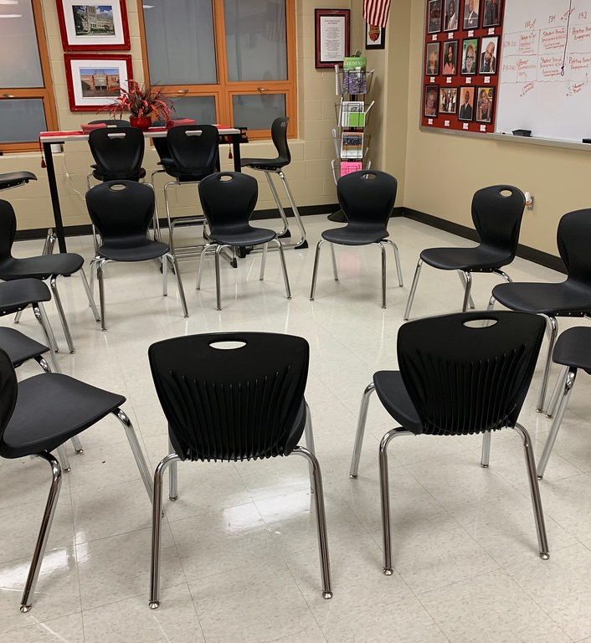
Welcome!
By now you know how to participate in circle. Now that you have read the fable together and applied the key restorative questions to the characters' experiences, let's use circle to talk about your experience.
As usual, let’s begin by moving your chairs into one large circle so everyone can see and hear each other clearly.
© 2022, Center for Dispute Resolution, Maryland Carey Law
This Photo by Unknown Author is licensed under CC BY
Notes:
If time allows, bring your students together in one large circle to process this case study as a large group.

Slide 9
Sitting in your chairs . . .
Take a moment to get quiet and calm.
Take a deep, cleansing breath that fills your lungs, then exhale slowly.
Repeat two more times so you’ve taken three full, deep breaths.
Look at the guidelines you adopted in the last lesson. Do they include what’s needed to help you feel safe and comfortable when you participate in circle?
Show your agreement with a thumbs-up or indicate that you want to make some changes with a thumbs-down signal.
© 2022, Center for Dispute Resolution, Maryland Carey Law

Slide 10
Remember the Talking Piece Process?
Talk only when you are holding the talking piece.
When you are done sharing, hand the talking piece object to the person on your right.
If you are not holding it, listen respectfully to the person talking.
You always have the right to pass the talking piece without comment if you prefer not to speak.
© 2022, Center for Dispute Resolution, Maryland Carey Law

Slide 11
Who is the Villain of this Story?
Did your answer change after you explored it from different perspectives?
Can you think of other situations where you thought you knew who was at fault until you heard their side of the story?
© 2022, Center for Dispute Resolution, Maryland Carey Law
Notes:
Use your circle to have students answer these simple questions. If time allows, let them share any insights they gained from exploring how different perspectives can help us develop a fuller picture of situations. Often in restorative practice, when people are respected, heard, and given the chance, they opt to make things right—sometimes before situations get out of control and people get hurt.

Slide 12
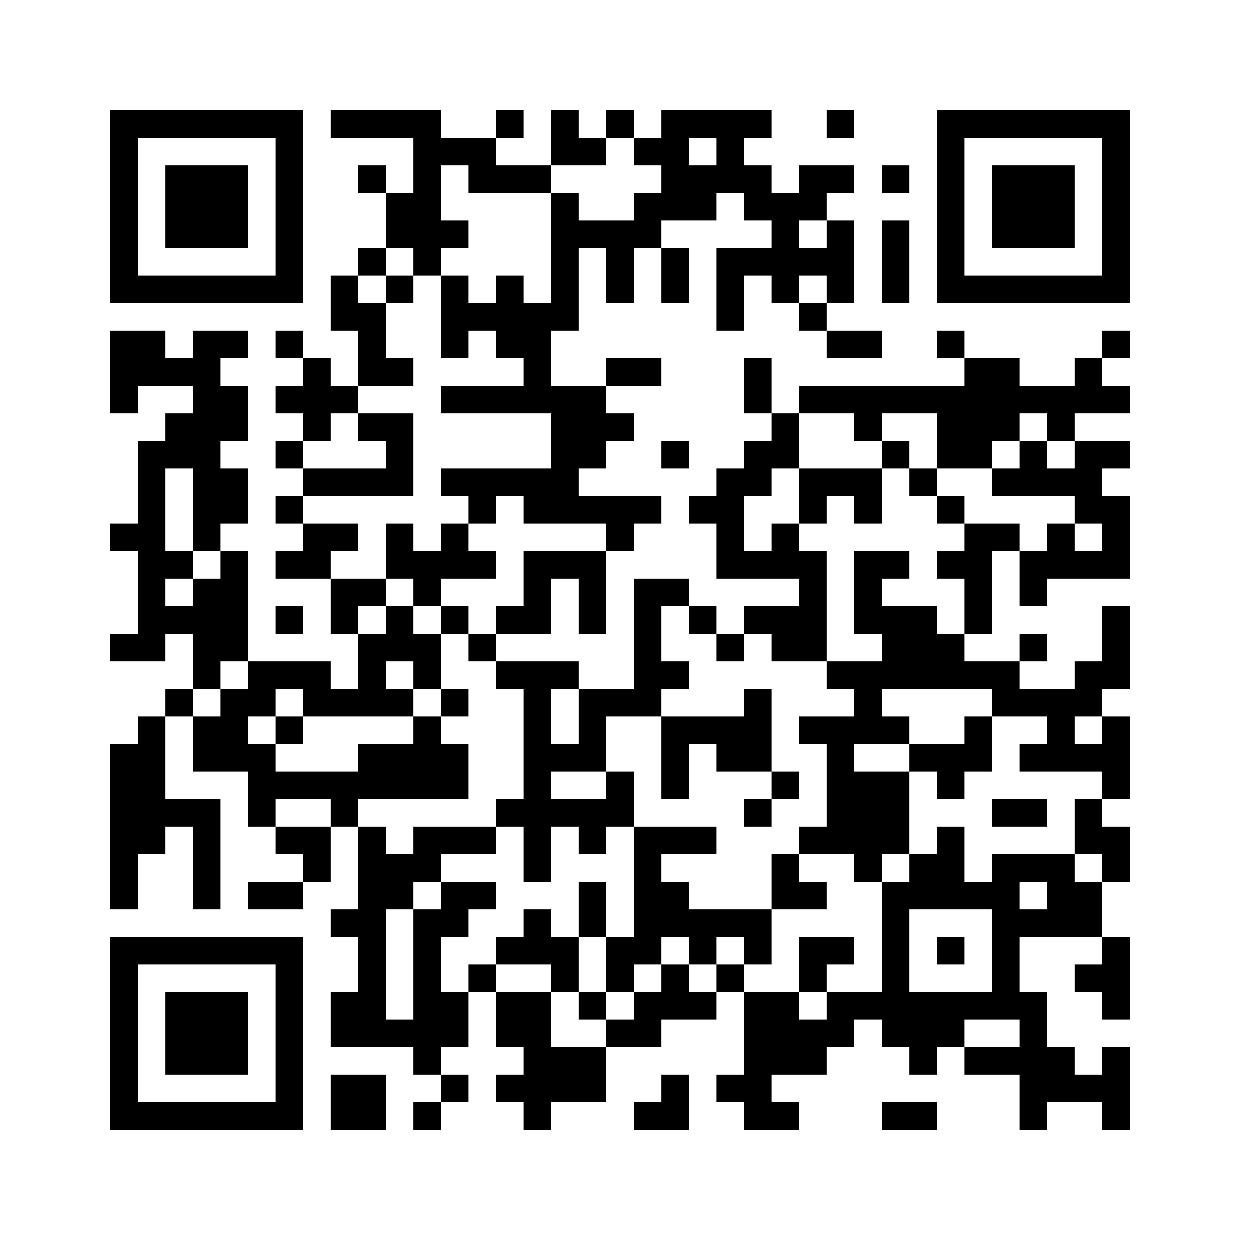
Thank you for learning with us!
For more resources about restorative approaches in education, explore the Restorative Approaches Collaborative Website at https://www.law.umaryland.edu/Programs-and-Impact/Dispute-Resolution/CDRUM/Restorative-Practices/

Slide 13
Special Thanks to . . .
This series of restorative approaches lessons is made possible through the generous financial support of the Charles Crane Family Foundation.
C-DRUM recognizes:
US Department of Justice, Office of Juvenile Justice and Delinquency Prevention Division for their Balanced and Restorative Justice Triangle
International Institute for Restorative Practices for their Restorative Questions Cards and Restorative Circles in Schools: Building Community and Enhancing Learning by Bob Costello, Joshua Wachtel and Ted Wachtel
Wikipedia for their Jack and the Beanstalk entry
© 2022, Center for Dispute Resolution, Maryland Carey Law

