Slide 1
Restorative Interventions: the Players and the Process
Restorative Approaches Lesson 7
© 2022, Center for Dispute Resolution, Maryland Carey Law

Slide 2
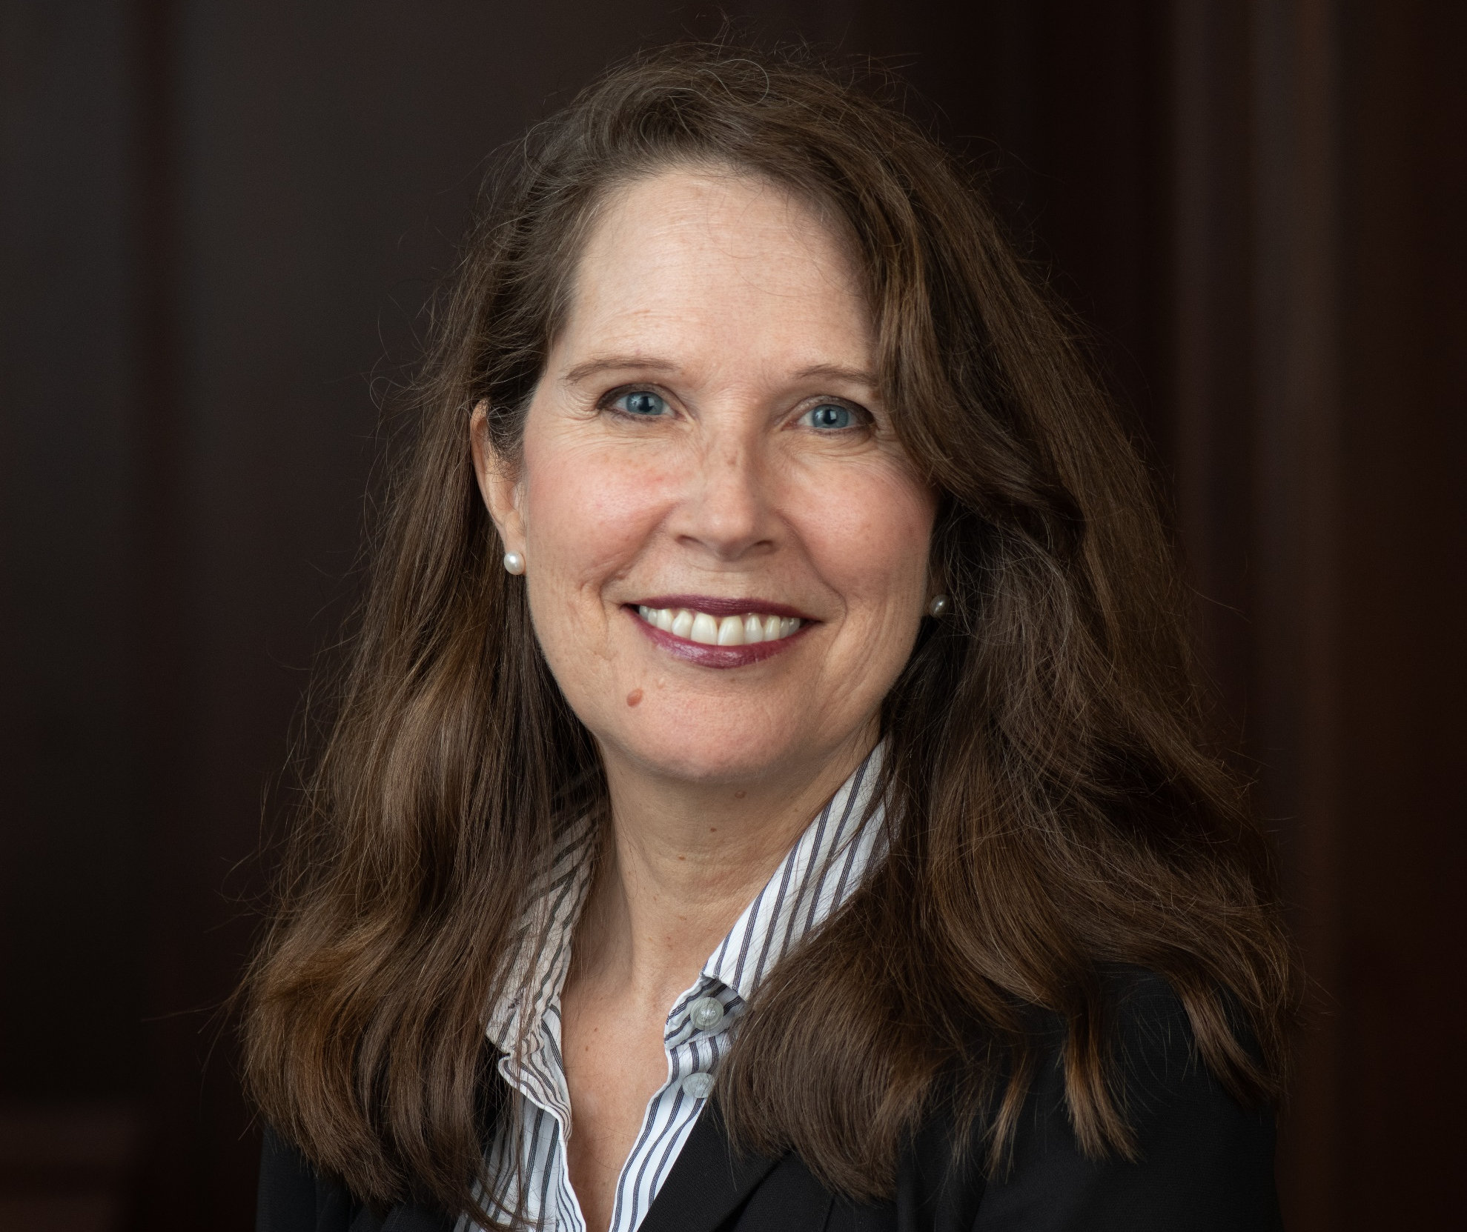
Hi again! I've got some more things to tell you in the next slides.
Nancy Schertzing, MS
Director of Restorative Approaches in Education for the Center for Dispute Resolution at the University of Maryland Francis King Carey School of Law (C-DRUM)
Notes:
There is no audio on this slide

Slide 3
Balanced and Restorative Justice Triangle
Based on design by US Dept. of Justice, Office of Juvenile Justice and Delinquency Prevention Division (OJJDPD)
Community
Together, participants work through a three-phase process represented by the questions on the next slides.
Public Safety
Accountability
Affected
Responsible
Competency
© 2022, Center for Dispute Resolution, Maryland Carey Law
Notes:
US Department of Justice, Office of Juvenile Justice and Delinquency Prevention Division (OJJDPD); https://www.ncjrs.gov/pdffiles/91415.pdf; retrieved 2/4/2015.

Slide 4
The 3 Stages of Restorative Interventions
Together, the affected and responsible parties (often with members of the community who have been affected) meet face-to-face in circle.
Sitting together, participants work through a three-stage process, with each stage defined by the following three questions.
© 2022, Center for Dispute Resolution, Maryland Carey Law
Notes:
You will unpack each question individually in the following slides.

Slide 5
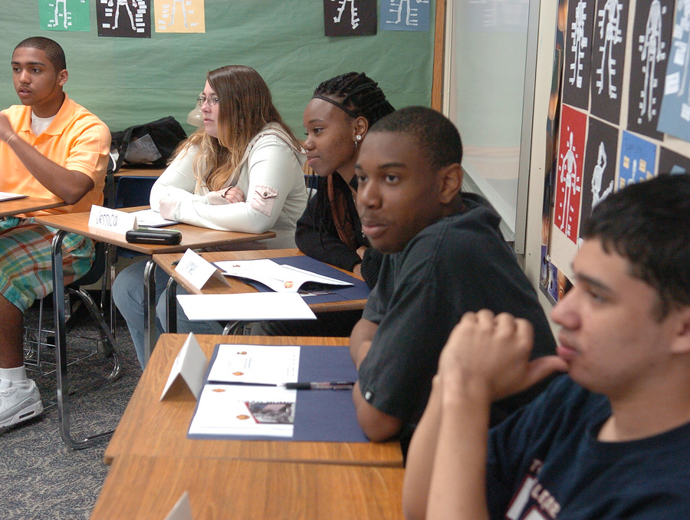
Story-Telling Phase
What Happened?
The facilitator asks this question openly and with respect, inviting every person to answer in their turn.
This Photo by Unknown Author is licensed under CC BY
© 2022, Center for Dispute Resolution, Maryland Carey Law
Notes:
You may want to illustrate different tones and attitudes you could use that either facilitate or close down participants’ honest and open answers. These often come back to how much respect you show participants.
The International Institute for Restorative Practices publishes question cards, available through their website, iirp.org, which include the three questions above along with a series of additional affective questions you might find useful. These include, “What were you thinking at the time?” “What have you thought about since?” “What has been the hardest thing for you?” and more. You can purchase the cards at https://store.iirp.edu/restorative-questions-cards-pack-of-100-english-or-spanish/

Slide 6
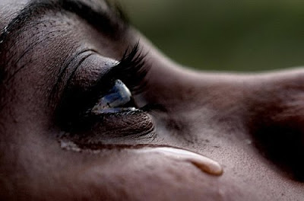
Empathy-Building Phase
Who has been affected, and how?
Still working in circle, participants each share their ideas about how this incident of harm affected people.
© 2022, Center for Dispute Resolution, Maryland Carey Law
Notes:
This Photo by Unknown Author is licensed under CC BY-NC-ND

Slide 7
Healing Phase
How do we make things right?
After everyone has told their story and knows they have been heard, those most affected by the incident offer ideas for how it can be made right.
This process involves every participant’s input so the solution can be developed by consensus. Only elements endorsed by every participants get included in the final agreement.
© 2022, Center for Dispute Resolution, Maryland Carey Law
Notes:
Many facilitators write our agreements and have participants sign it so they have a document to follow up with. For minor incidents, a simpler agreement (handshake, etc.) may be just fine.
This Photo by Unknown Author is licensed under CC BY-NC-ND

Slide 8
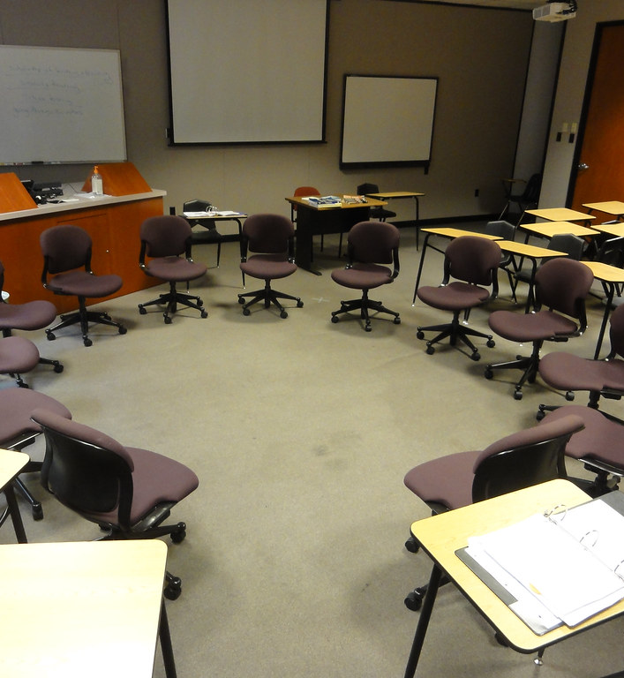
Circle Time
Thank you for thinking about these key concepts of restorative approaches and how they might affect school culture.
Now please move your chairs into one large circle so everyone can see and hear each other clearly.
You will use circle to unpack what you’ve learned and considered.
This Photo by Unknown Author is licensed under CC BY-SA-NC

Slide 9
Sitting in your chairs . . .
Take a moment to get quiet and calm.
Take a deep, cleansing breath that fills your lungs, then exhale slowly.
Repeat two more times so you’ve taken three full, deep breaths.
© 2022, Center for Dispute Resolution, Maryland Carey Law

Slide 10
Remember How to Use the Talking Piece?
Talk only when you are holding the talking piece.
When you are done sharing, hand the talking piece object to the person on your right.
If you are not holding it, listen respectfully to the person talking.
You always have the right to pass the talking piece without comment if you prefer not to speak.
© 2022, Center for Dispute Resolution, Maryland Carey Law

Slide 11
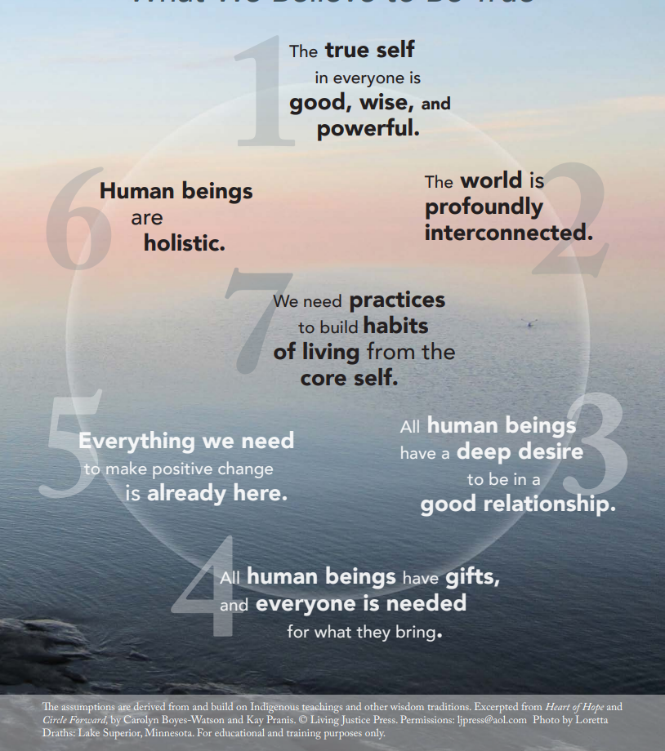
The Seven Core Assumptions
Read this slide together, with the first person starting with the text in number 1, then the person to their right reading the text in number 2, and so on around the circle.
When someone has read number 7, the person to their right begins again, reading number 1 until everyone has had a chance to read one core assumption.
If you prefer not to read, simply say “pass” and the next person can take the next number.

Slide 12
Review Your Guidelines
Look at the guidelines you adopted in the last lesson.
Do they include what’s needed to help you feel safe and comfortable when you participate in circle?
Show your agreement with a thumbs-up or indicate that you want to make some changes with a thumbs-down signal.
If you need to add, remove, or modify any part of the Guidelines, follow the process from the last lesson until everyone agrees to each element.
© 2022, Center for Dispute Resolution, Maryland Carey Law

Slide 13
Briefly . . .
Thinking about what we’ve explored in these lessons and your experience of being harmed, do you think it would have been helpful if you had a chance to say how the person harmed you and tell them what you needed to move on from the experience?
When you caused harm to someone else, would you have found it helpful if you could have made things right or healed the harm right away?
If you weren’t directly harmed, would you participate in a restorative circle to support someone else?

Slide 14
Special Thanks to . . .
This series of restorative approaches lessons is made possible through the generous financial support of the Charles Crane Family Foundation.
C-DRUM recognizes:
US Department of Justice, Office of Juvenile Justice and Delinquency Prevention Division for their Balanced and Restorative Justice Triangle
International Institute for Restorative Practices for their Restorative Questions Cards and Restorative Circles in Schools: Building Community and Enhancing Learning by Bob Costello, Joshua Wachtel and Ted Wachtel
Living Justice Press for The Seven Core Assumptions (developed by Kay Pranis and Carolyn Boyes-Watson) available for free at https://livingjusticepress.org/free-stuff/
© 2022, Center for Dispute Resolution, Maryland Carey Law

