Slide 1
Restorative Approaches: Where It Can Work
Restorative Approaches Lesson 6

Slide 2
Welcome!
By now you have used circle to share thoughts, collaborate on guidelines and explore and share something about your experiences with harm—from both experiencing and causing it.
In today’s lesson you will learn how restorative approaches treat situations of harm and conflict, and how their approach differs from the traditional way we have addressed problem behavior in schools.
Don’t move your chairs into circle yet! Stay in your desk to take a look at the following information.
© 2022, Center for Dispute Resolution, Maryland Carey Law
This Photo by Unknown author is licensed under CC BY-NC-ND.

Slide 3
Restorative Approaches Illustrated
C-DRUM thanks Luke Roberts, formerly of Resolve Consultants, for their video, A Short Introduction to Restorative Approaches
Notes:
https://www.youtube.com/watch?v=gJJxbn1VjYo

Slide 4
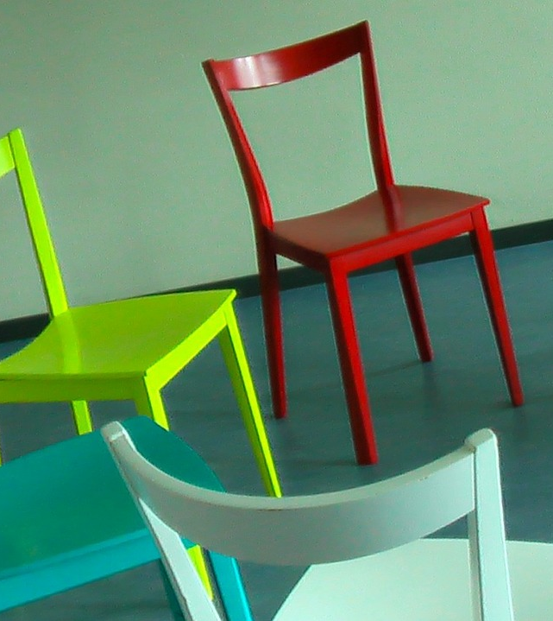
Circle Time
Thank you for thinking about these key concepts of restorative approaches.
Please move your chairs into one large circle where everyone can see and hear each other clearly.
You will use this circle to unpack some of what you've learned about restorative approaches so far, and to think about how they might apply to situations in schools and other places.

Slide 5
Sitting in your chairs . . .
Take a moment to get quiet and calm.
Take a deep, cleansing breath that fills your lungs, then exhale slowly.
Repeat two more times so you’ve taken three full, deep breaths.
© 2022, Center for Dispute Resolution, Maryland Carey Law

Slide 6
Remember the Process?
Talk only when you are holding the talking piece.
When you are done sharing, hand the talking piece object to the person on your right.
If you are not holding it, listen respectfully to the person talking.
You always have the right to pass the talking piece without comment if you prefer not to speak.
© 2022, Center for Dispute Resolution, Maryland Carey Law

Slide 7
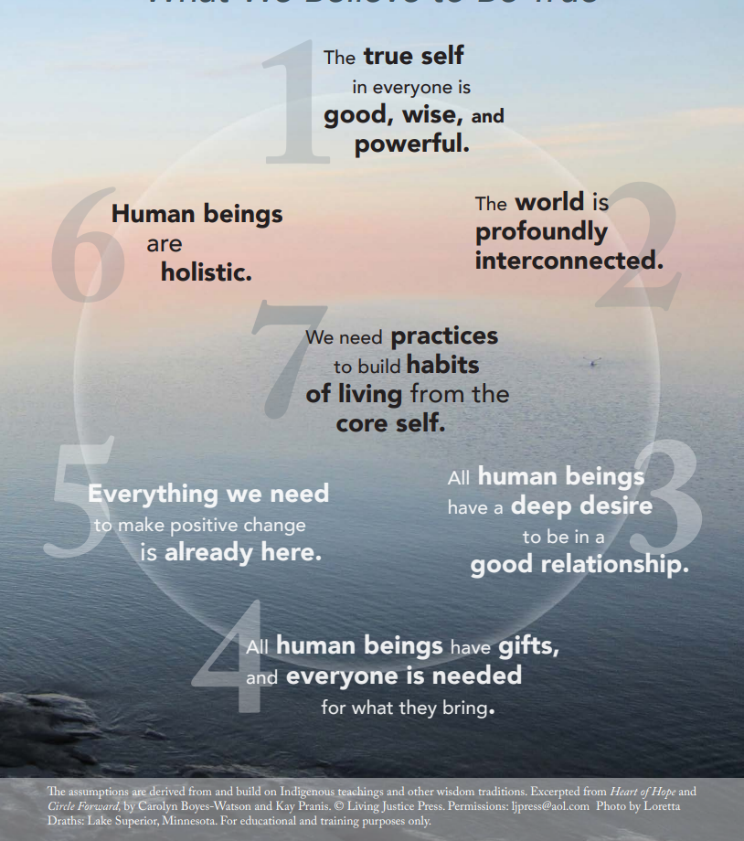
The Seven Core Assumptions
Read this slide together, with the first person starting with the text in number 1, then the person to their right reading the text in number 2, and so on around the circle.
When someone has read number 7, the person to their right begins again, reading number 1 until everyone has had a chance to read one core assumption.
If you prefer not to read, simply say “pass” and the next person can take the next number.

Slide 8
Review Your Guidelines
Do your guidelines still include what’s needed to help you feel safe and comfortable when you participate in circle?
Show your agreement with a thumbs-up or indicate that you want to make some changes with a thumbs-down signal.
If you need to add, remove, or modify any part of the Guidelines, follow the process from the last lesson until everyone agrees to each element.
© 2022, Center for Dispute Resolution, Maryland Carey Law

Slide 9
Regarding the Video . . .
What is one thing you remember from the Restorative Approaches video?
It said that restorative approaches are used in “schools, care homes, prisons and beyond.” Pick one of those places and suggest how restorative approaches might help the people there.
Do you think restorative approaches could work in your school?

Slide 10
You Have Mastered Some Important Skills:
You have explored the concepts behind a different paradigm for discipline and conflict resolution called Restorative Approaches.
You looked at a fictional case study and considered how traditional discipline impacted one student’s experience and how restorative approaches might have led to a different experience.
You have used your circle skills to share your insights and to hear your colleagues’ thoughts as well.
© 2022, Center for Dispute Resolution, Maryland Carey Law

Slide 11
Special Thanks to . . .
This series of restorative approaches lessons is made possible through the generous financial support of the Charles Crane Family Foundation.
C-DRUM recognizes:
Luke Roberts, formerly of Resolve Consultants, for their video, A Short Introduction to Restorative Approaches
Howard Zehr, for his Little Book of Restorative Justice, page 30, 31, and 36
Living Justice Press for The Seven Core Assumptions (developed by Kay Pranis and Carolyn Boyes-Watson) available for free at https://livingjusticepress.org/free-stuff/
© 2022, Center for Dispute Resolution, Maryland Carey Law

