Slide 1
Restorative Approaches: The Restorative Philosophy
Restorative Approaches Lesson 5
© 2022, Center for Dispute Resolution, Maryland Carey Law

Slide 2
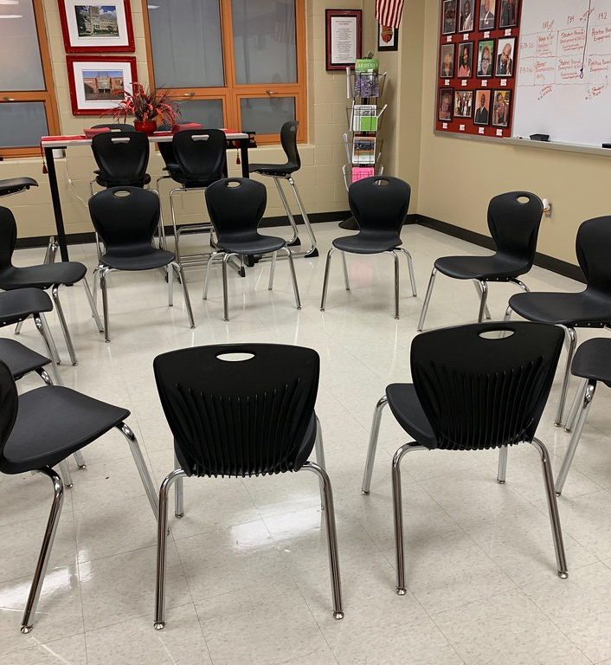
Welcome!
By now you know how to participate in circle, and you’ve used that skill to learn a bit more about your classmates. Now let’s use it to learn a bit more about restorative approaches.
This exercise is designed to help you consider aspects of the restorative philosophy and how they might apply to your life experiences.
As usual, let’s begin by moving your chairs into one large circle so everyone can see and hear each other clearly.
© 2022, Center for Dispute Resolution, Maryland Carey Law
This Photo by Unknown Author is licensed under CC BY

Slide 3
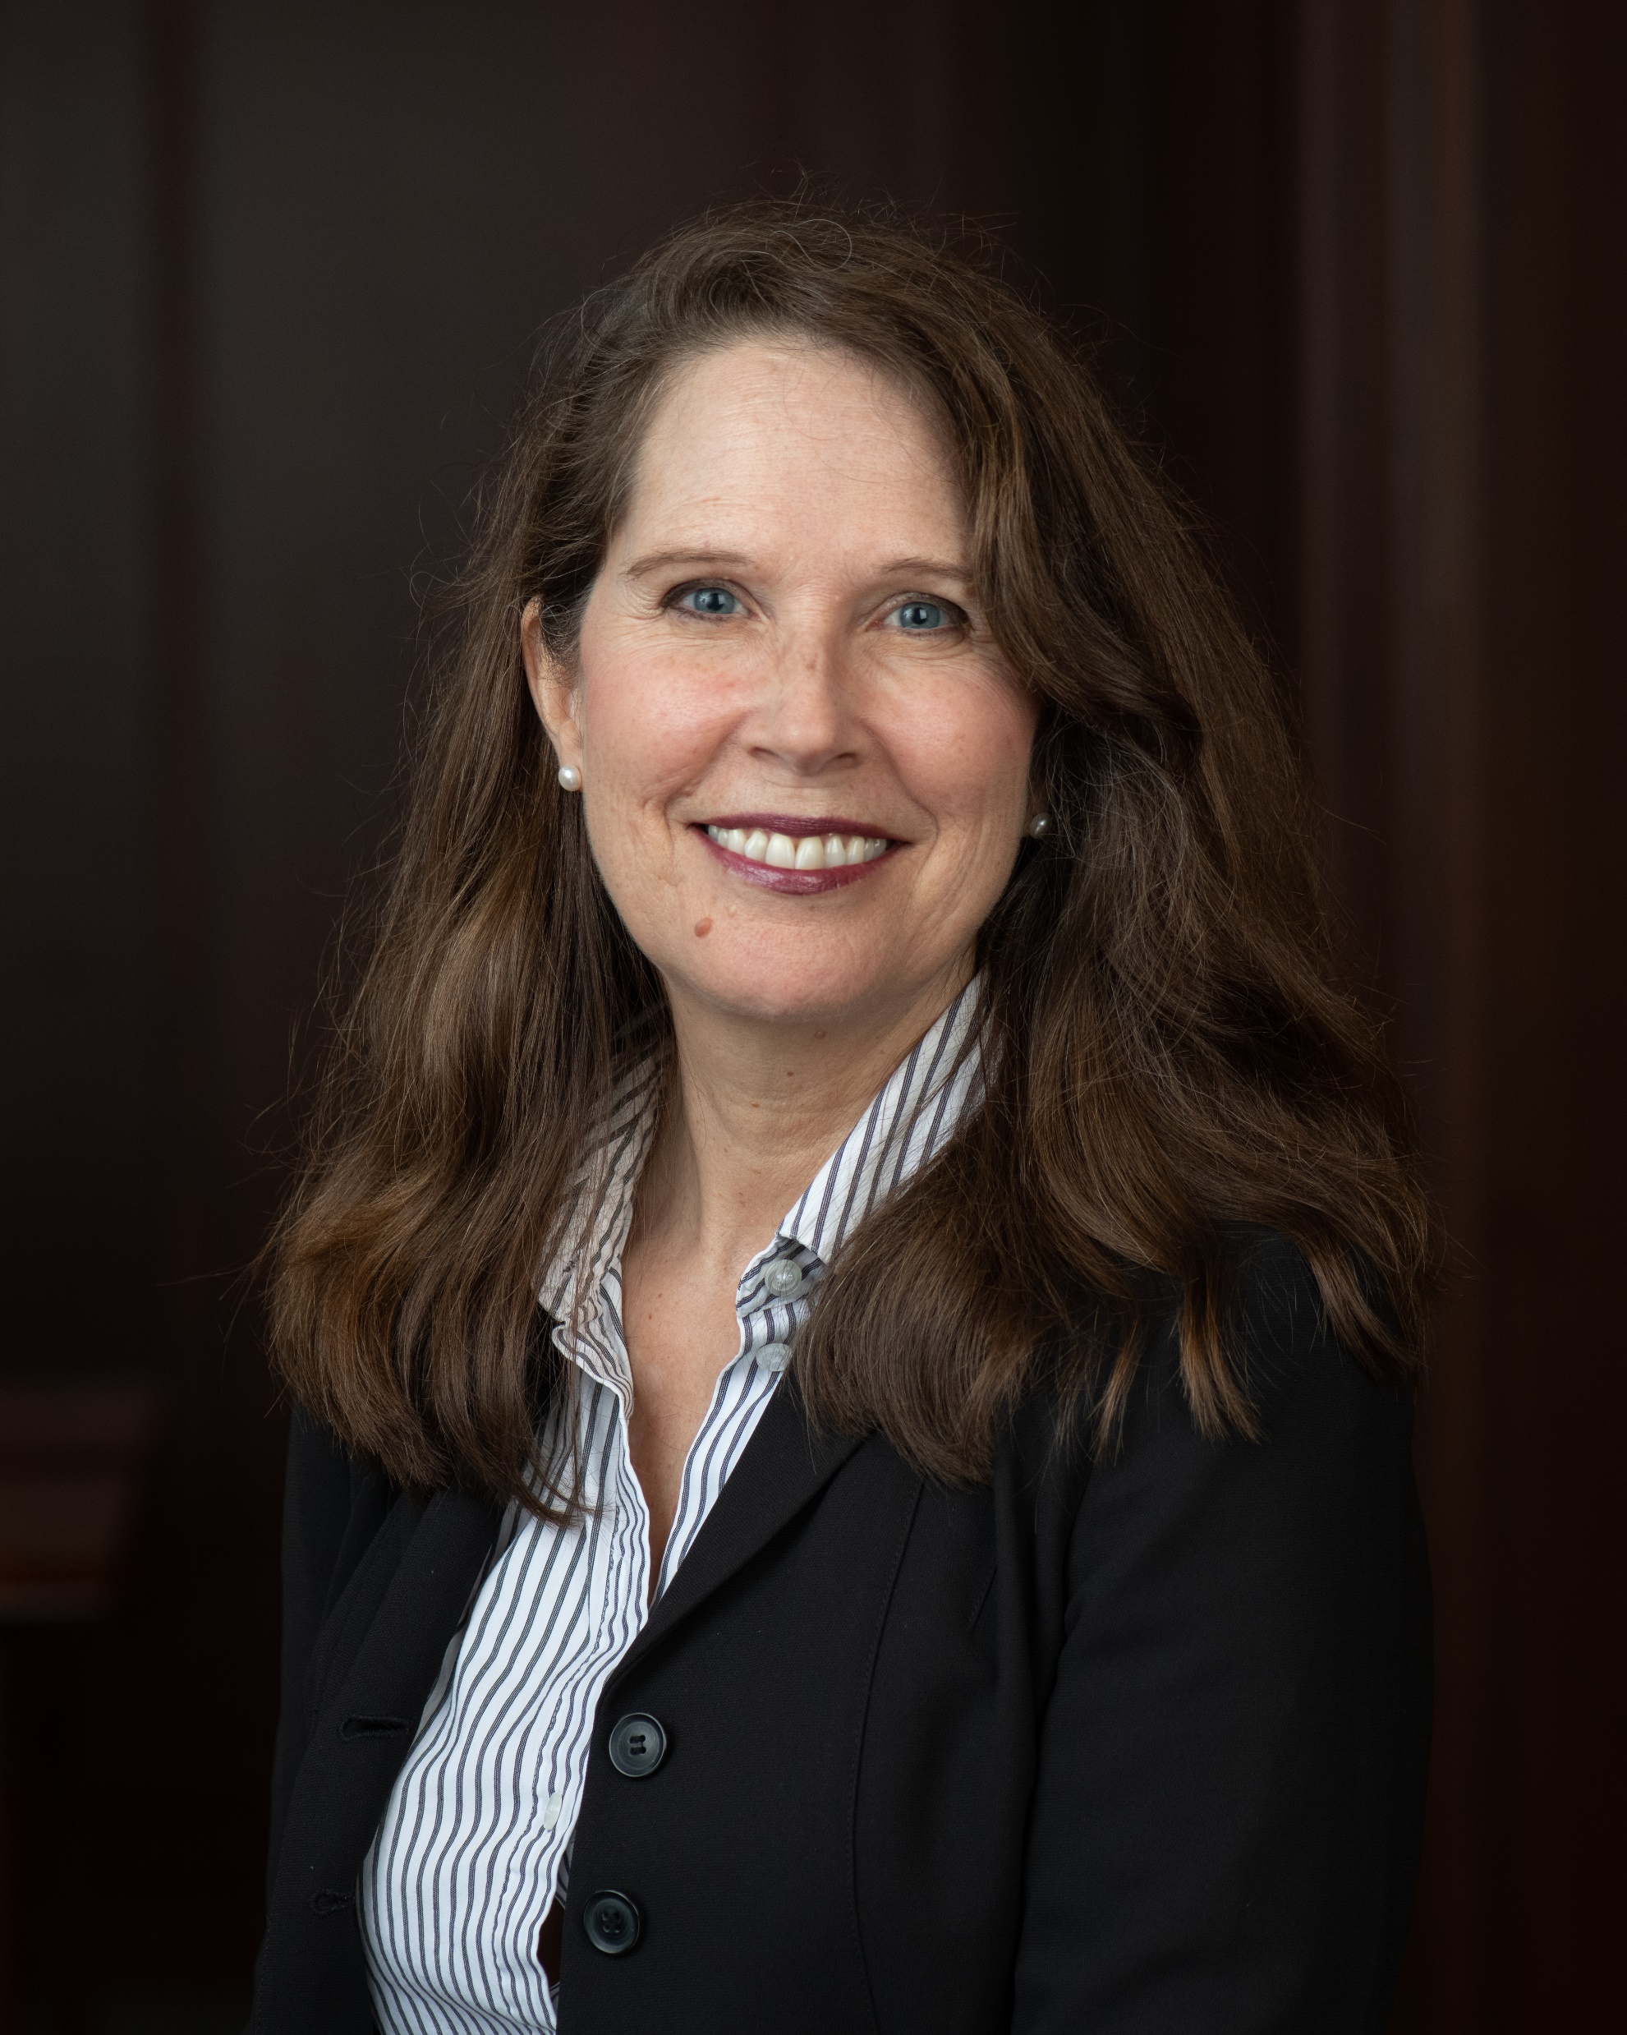
Hi again.
In this lesson, I'm excited to explain some fundamental aspects of restorative approaches at the foundation of the restorative philosophy. That means they are essential to everything restorative!
Nancy Schertzing, MS, Director of Restorative Approaches in Education, Center for Dispute Resolution at Maryland Carey Law (C-DRUM)
Notes:
There is no audio for this slide

Slide 4
Discipline Paradigms Compared
RULES
TRADITIONAL DISCIPLINE
RESTORATIVE DISCIPLINE
HARM
© 2022, Center for Dispute Resolution, Maryland Carey Law
Notes:
IF YOUR STUDENTS TAKE NOTHING ELSE FROM THIS TRAINING, REMEMBER THIS SLIDE. Traditional discipline focuses on Rules and Punishment, while restorative discipline focuses on Harm and Healing.

Slide 5
We do this from a Foundation of Respect
Restorative Justice is respect.
Respect for all, even those who are different from us; even those who seem to be our enemies. Respect reminds us of our interconnectedness, but also of our differences.
Respect insists we balance concerns for all parties.
If we pursue justice as respect, we will do justice restoratively.
Howard Zehr, The Little Book of Restorative Justice, p.36
© 2022, Center for Dispute Resolution, Maryland Carey Law
Notes:
Zehr, H. (2002), The Little Book of Restorative Justice, Intercourse, PA, Good Books.

Slide 6
Take a minute or two to examine this infographic comparing school cultures built on traditional and restorative philosophies.
Notes:
The creators of this infographic are listed at the bottom of the slide.

Slide 7
Remember the Process?
Talk only when you are holding the talking piece.
When you are done sharing, hand the talking piece object to the person on your right.
If you are not holding it, listen respectfully to the person talking.
You always have the right to pass the talking piece without comment if you prefer not to speak.
© 2022, Center for Dispute Resolution, Maryland Carey Law

Slide 8
Sitting in your chairs . . .
Take a moment to get quiet and calm.
Take a deep, cleansing breath that fills your lungs, then exhale slowly.
Repeat two more times so you’ve taken three full, deep breaths.
Let’s repeat the Seven Core Assumptions reading on the next slide to help you center on the foundational elements of circle.
© 2022, Center for Dispute Resolution, Maryland Carey Law

Slide 9
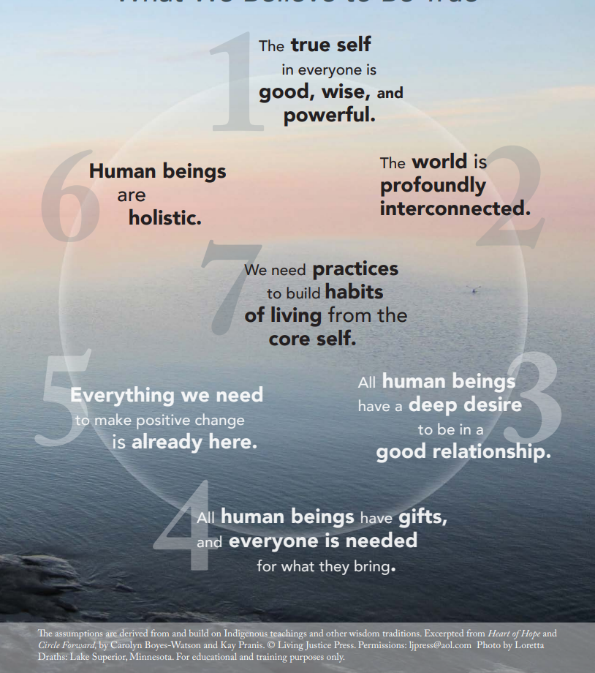
The Seven Core Assumptions
Read this slide together, with the first person starting with the text in number 1, then the person to their right reading the text in number 2, and so on around the circle.
When someone has read number 7, the person to their right begins again, reading number 1 until everyone has had a chance to read one core assumption.
If you prefer not to read, simply say “pass” and the next person can take the next number.

Slide 10
Review Your Guidelines
Look at the guidelines you adopted in the last lesson.
Do they include what’s needed to help you feel safe and comfortable when you participate in circle?
Show your agreement with a thumbs-up or indicate that you want to make some changes with a thumbs-down signal.
If you need to add, remove, or modify any part of the Guidelines, follow the process from the last lesson until everyone agrees to each element.
© 2022, Center for Dispute Resolution, Maryland Carey Law

Slide 11
Share in Circle
What is one thought you’d like to share about your discussion of the infographic?
Can you identify with either situation, or know someone who can?
Just answer yes or no, please.
Based on what you know about restorative approaches, what difference did they make to Carlos’ situation?
Just give one example or observation.
© 2022, Center for Dispute Resolution, Maryland Carey Law

Slide 12
You Have Mastered Some Important Skills:
You are pros at using a talking piece and working collaboratively and exploring ideas.
You have learned about restorative approaches and considered together how they might affect your learning community.
You have shared important information about yourself in circle—and heard important things about your colleagues.
© 2022, Center for Dispute Resolution, Maryland Carey Law

Slide 13
Special Thanks to . . .
This series of restorative approaches lessons is made possible through the generous financial support of the Charles Crane Family Foundation.
C-DRUM recognizes:
Kay Pranis and Carolyn Boyes-Watson for their book Circle Forward: Building a Restorative School Community, especially Lesson 11.1, Module 11 Learning Restorative Discipline
Living Justice Press for The Seven Core Assumptions (developed by Kay Pranis and Carolyn Boyes-Watson) available for free at https://livingjusticepress.org/free-stuff/
Howard Zehr, The Little Book of Restorative Justice
© 2022, Center for Dispute Resolution, Maryland Carey Law

