Slide 1
Restorative Approaches: How Did You Feel?
Restorative Approaches Lesson 4
© 2022, Center for Dispute Resolution, Maryland Carey Law

Slide 2
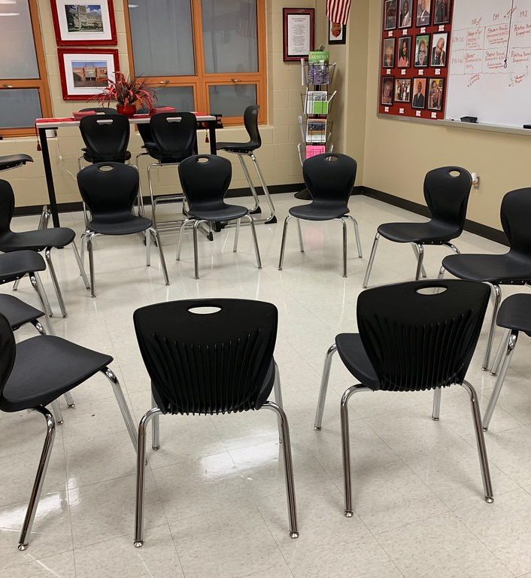
Welcome!
By now you know how to participate in circle, and you’ve used that skill to learn a bit more about your classmates. Now let’s use it to learn a bit more about restorative approaches.
This exercise is designed to help you consider aspects of the restorative philosophy and how they might apply to your life experiences.
As usual, let’s begin by moving your chairs into one large circle so everyone can see and hear each other clearly.
© 2022, Center for Dispute Resolution, Maryland Carey Law
This Photo by Unknown Author is licensed under CC BY

Slide 3
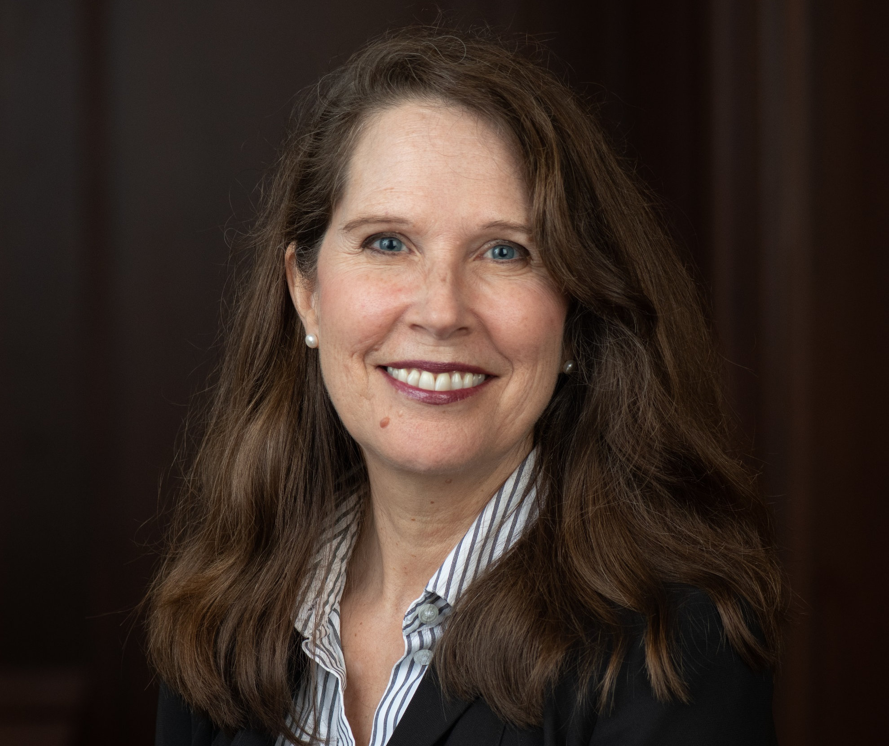

Hello!
Nancy Schertzing
Director, Restorative Approaches in Education for the Center for Dispute Resolution at the University of Maryland School of Law

Slide 4
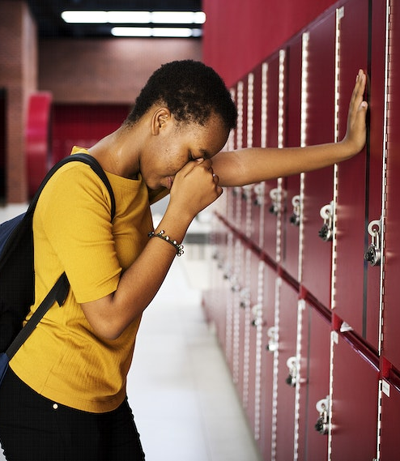
Your Early Experience
Think of a time in your life when you felt that someone had harmed or excluded you in some way.
Choose one word to describe how you felt when you were harmed in this way.
Write your word near the top of your 3x5 card.
© 2022, Center for Dispute Resolution, Maryland Carey Law

Slide 5
Share Your Word (Not Your Story)
5
4
3
2
1
DONE!
Once you have your word, move around the room and talk with 5 other people to learn their word.
Write down each of their words on your 3x5 card under your word.
When you have six words written on your card, sit back down.
© 2022, Center for Dispute Resolution, Maryland Carey Law
Notes:
If you are tight on time, you can click through the numbers quickly and ignore the narration if it lags.

Slide 6
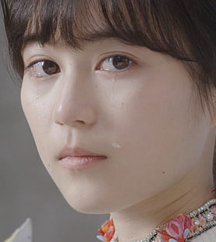
Restorative Approaches Center the Harm
Restorative approaches defines accountability as Healing the Harm so those affected can release feelings associated with victimization.
© 2022, Center for Dispute Resolution, Maryland Carey Law

Slide 7
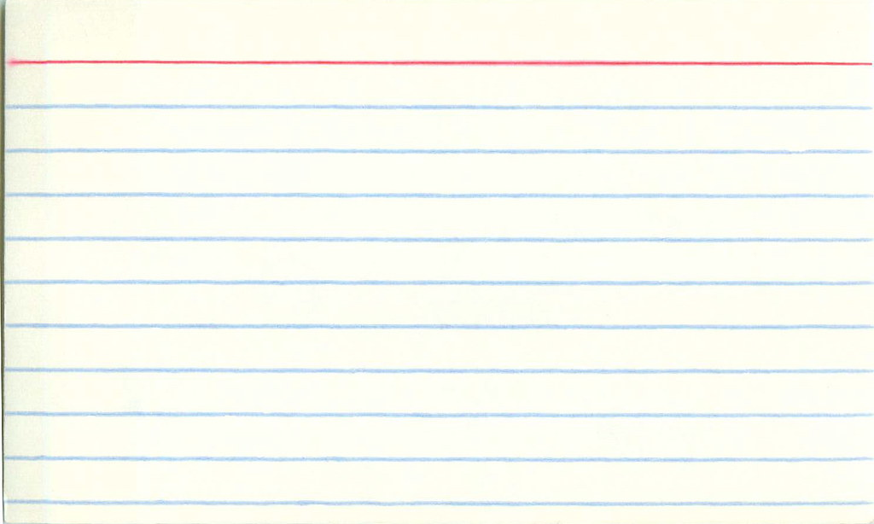
Turn your card over.
This Photo by Unknown Author is licensed under CC BY
© 2022, Center for Dispute Resolution, Maryland Carey Law
Notes:
This slide takes longer than necessary. Feel free to click through it quickly to save time.

Slide 8

The Flip Side
Think of a time when you caused harm to or excluded someone. Again, please do not choose a particularly traumatic incident.
Choose one word to describe how you felt when you realized you had hurt this person in this way.
Write your word at the top of this side of your 3x5 card.
© 2022, Center for Dispute Resolution, Maryland Carey Law
This Photo by Unknown Author is licensed under CC BY-NC-ND

Slide 9
Share Your Word (Not Your Story)
5
4
3
2
1
DONE!
Once you have your word, Once you have your word, move around the room and talk with 5 other people to learn their word.
Write down each of their words on your 3x5 card under your word.
When you have six words written on your card, sit back down.
© 2022, Center for Dispute Resolution, Maryland Carey Law
Notes:
This follows the same process as the earlier slide. If you are tight on time, you can click through the numbers quickly and ignore the narration if it lags.

Slide 10
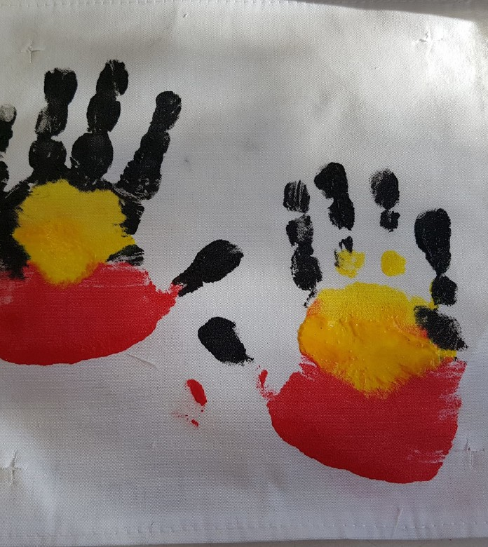
Restorative Approaches Empower and Support
BOTH the persons affected and those responsible for causing the harm.
By distinguishing the (unacceptable) deed from the do-er (a valuable member of our community) restorative approaches can help those responsible clear their name and not be defined by one poor choice they made.
This Photo by Unknown Author is licensed under CC BY
Notes:
This is the end of the recorded slides. Get ready to engage students in circle after this slide.

Slide 11
Sitting in your chairs . . .
Take a moment to get quiet and calm.
Take a deep, cleansing breath that fills your lungs, then exhale slowly.
Repeat two more times so you’ve taken three full, deep breaths.
© 2022, Center for Dispute Resolution, Maryland Carey Law

Slide 12
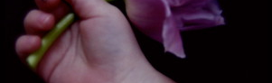
Remember How to use the Talking Piece?
Talk only when you are holding the talking piece.
When you are done sharing, hand the talking piece object to the person on your right.
If you are not holding it, listen respectfully to the person talking.
You always have the right to pass the talking piece without comment if you prefer not to speak.
© 2022, Center for Dispute Resolution, Maryland Carey Law

Slide 13
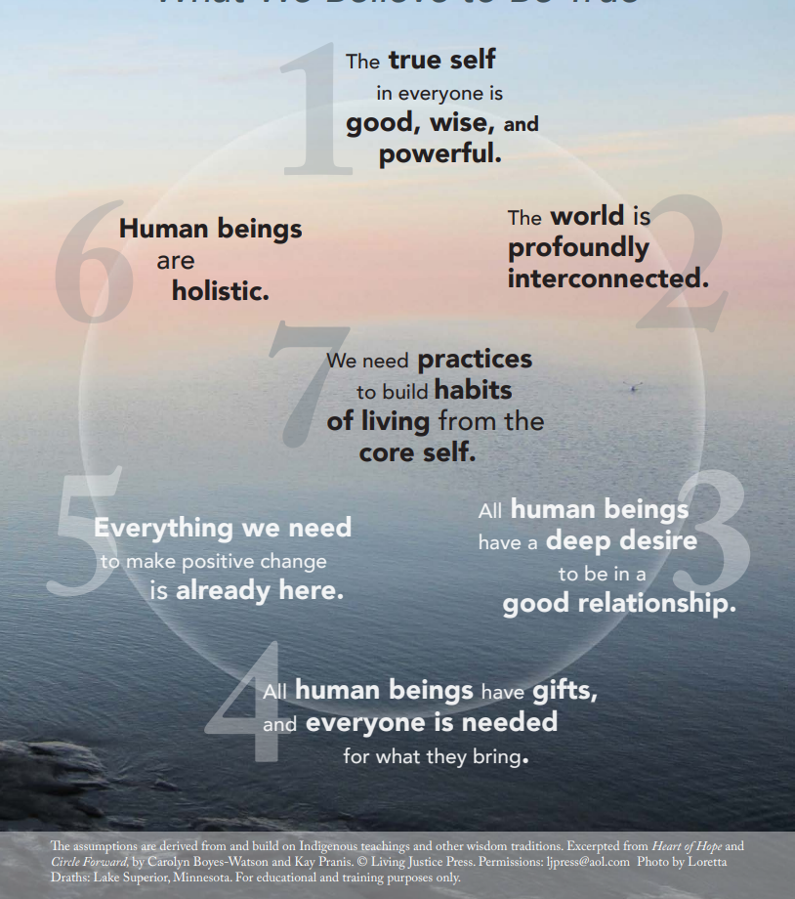
The Seven Core Assumptions
Read this slide together, with the first person starting with the text in number 1, then the person to their right reading the text in number 2, and so on around the circle.
When someone has read number 7, the person to their right begins again, reading number 1 until everyone has had a chance to read one core assumption.
If you prefer not to read, simply say “pass” and the next person can take the next number.

Slide 14
Review Your Guidelines
Look at the guidelines you adopted in the last lesson.
Do they include what’s needed to help you feel safe and comfortable when you participate in circle?
Show your agreement with a thumbs-up or use a thumbs down to indicate that you want to make some changes.
If you need to add, remove, or modify any part of the Guidelines, follow the process from the last lesson until everyone agrees to each element.
© 2022, Center for Dispute Resolution, Maryland Carey Law

Slide 15
From Your 3x5 Card . . .
When the talking piece comes to you, please share just one word on your card about being harmed that resonates with you.
Turn your card over and share one word on your card about causing harm that resonates with you.
As you say your word, please lay your card down in the center of your circle.
Your words become the centerpiece of this circle and lesson.
© 2022, Center for Dispute Resolution, Maryland Carey Law
Notes:
When introducing these next questions, please mention that the word that resonates could be their own word, or it could be one they got from a classmate. Make it clear this is not a time to share stories, just say one word and pass the talking piece to your neighbor.
Note that for the second go-around once they have shared their resonant word, they should get up and place the 3x5 card in the center of your circle. When the cards are in the center, they become part of your centerpiece just as they are part of your educational experience.

Slide 16
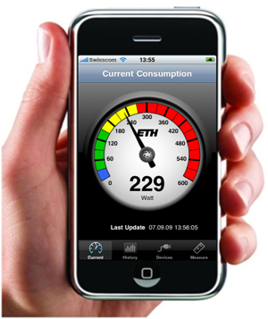
Looking Ahead
These are heavy words that carry a lot of emotion. There is no unacceptable word. Whatever you and your colleagues were feeling is legitimate, but it takes energy to carry around heavy feelings—especially negative ones.
Our next lessons explain restorative approaches and how they help release some of that heaviness.
This Photo by Unknown Author is licensed under CC BY
Notes:
As you hear the words your students share, it is worth noting that it may be worth the investment of time to help students clear away some of that heavy energy so they can focus on the lessons you are trying to teach them.

Slide 17
You Have Mastered Some Important Skills:
You are pros at using a talking piece and working collaboratively to create goals and honor each other.
You looked at your own life and considered how it felt when you experienced harm and when you hurt others.
You have shared important information about yourself in circle and understand something about how restorative approaches differ from the traditional approach to school discipline.
© 2022, Center for Dispute Resolution, Maryland Carey Law

Slide 18

Special Thanks to . . .
This series of restorative approaches lessons is made possible through the generous financial support of the Charles Crane Family Foundation.
C-DRUM recognizes:
Kay Pranis and Carolyn Boyes-Watson for their book Circle Forward: Building a Restorative School Community, especially Lesson 11.1, Module 11 Learning Restorative Discipline
Living Justice Press for The Seven Core Assumptions (developed by Kay Pranis and Carolyn Boyes-Watson) available for free at https://livingjusticepress.org/free-stuff/
© 2022, Center for Dispute Resolution, Maryland Carey Law

