Slide 1
Introduction to Circle: Sharing Who We Are
Restorative Approaches Lesson 3
© 2022, Center for Dispute Resolution, Maryland Carey Law

Slide 2
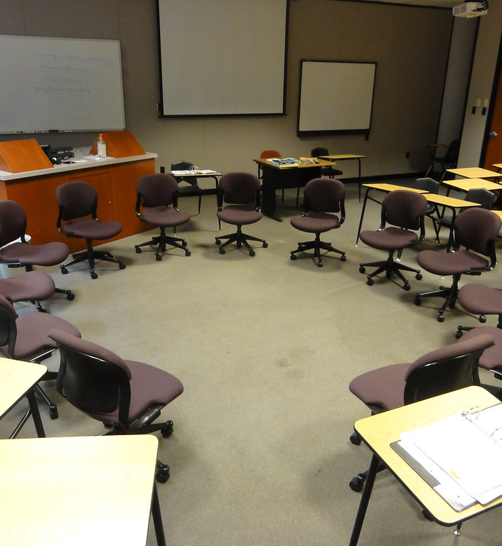
Welcome!
Our first lessons introduced you to Circle and using a talking piece and helped you establish guidelines for how you will be together. This lesson encourages you share something more about yourself so you all can show up authentically.
The circle can be a place where you feel safe and honored for being you and for what you bring. This exercise is designed to make it easier for you and your classmates to understand each other and where you’re coming from.
Let’s begin by moving your chairs into one large circle so everyone can see and hear each other clearly.
© 2022, Center for Dispute Resolution, Maryland Carey Law
This Photo by Unknown Author is licensed under CC BY-SA-NC

Slide 3
Sitting in your chairs . . .
Take a moment to get quiet and calm.
Take a deep, cleansing breath that fills your lungs, then exhale slowly.
Repeat two more times so you’ve taken three full, deep breaths.
Together, you will do a simple reading on the next slide to help you center on the core elements of circle.
© 2022, Center for Dispute Resolution, Maryland Carey Law

Slide 4
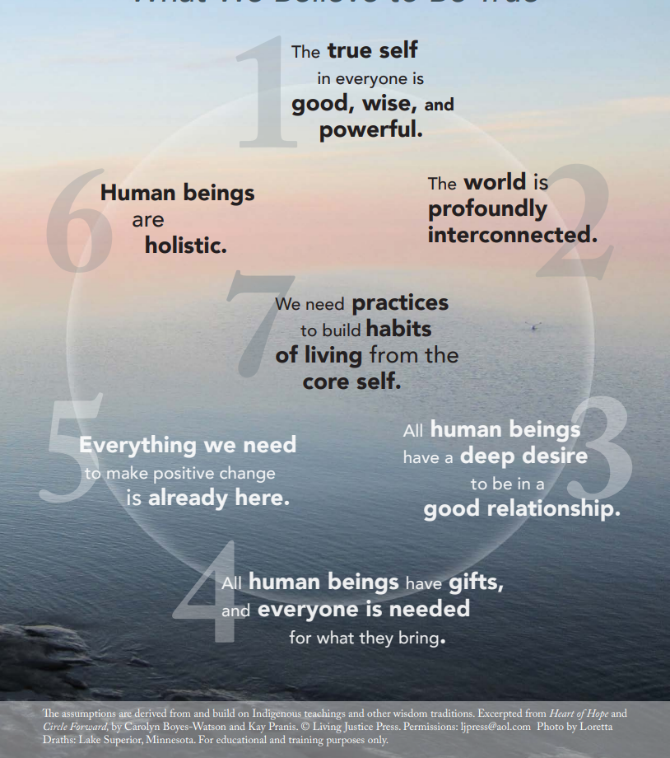
The Seven Core Assumptions
Read this slide together, with the first person starting with the text in number 1, then the person to their right reading the text in number 2, and so on around the circle.
When someone has read number 7, the person to their right begins again, reading number 1 until everyone has had a chance to read one core assumption.
If you prefer not to read, simply say “pass” and the next person can take the next number.

Slide 5
Remember the Process?
This Photo by Unknown Author is licensed under CC BY-NC-ND
Talk only when you are holding the talking piece.
When you are done sharing, hand the talking piece object to the person on your right.
If you are not holding it, listen respectfully to the person talking.
You always have the right to pass the talking piece without comment if you prefer not to speak.
© 2022, Center for Dispute Resolution, Maryland Carey Law

Slide 6
Affirming Guidelines
Look at the guidelines you drafted in the last lesson. Do they include what’s needed to help you feel safe and comfortable when you participate in circle?
If you need to add, remove, or modify any part of the Guidelines, offer your edit when the talking piece comes to you. (This may require a few rounds so that everyone has a voice in creating the best Guidelines for your group.)
Once everyone has had a chance to offer their edits and you have discussed them in circle, have someone read the edited version of the Guidelines.
Pass the Talking Piece around so everyone can either agree or suggest more adjustments. Once everyone agrees with all statements then the Guidelines have been adopted.
© 2022, Center for Dispute Resolution, Maryland Carey Law

Slide 7
Congratulations!
Use these Guidelines to help you all participate in circle safely and comfortably.
You may want to place them at the center of your circle or somewhere everyone can easily see them.
If one of you acts against the Guidelines, others can remind everyone by pointing to the paper or mentioning them when holding the talking piece.
This is a living document. It will be good to review these Guidelines periodically to make sure they still define how you want to be together in circle.
© 2022, Center for Dispute Resolution, Maryland Carey Law

Slide 8
Putting It All Together in Circle
Now that you have established and affirmed or adjusted your guidelines and reviewed the skills you use in the Circles process, use the circle to discuss the questions on the next two slides.
Share as much or as little as you like, but we hope you have fun and learn a bit more about your classmates than you would in a regular lesson.

Slide 9
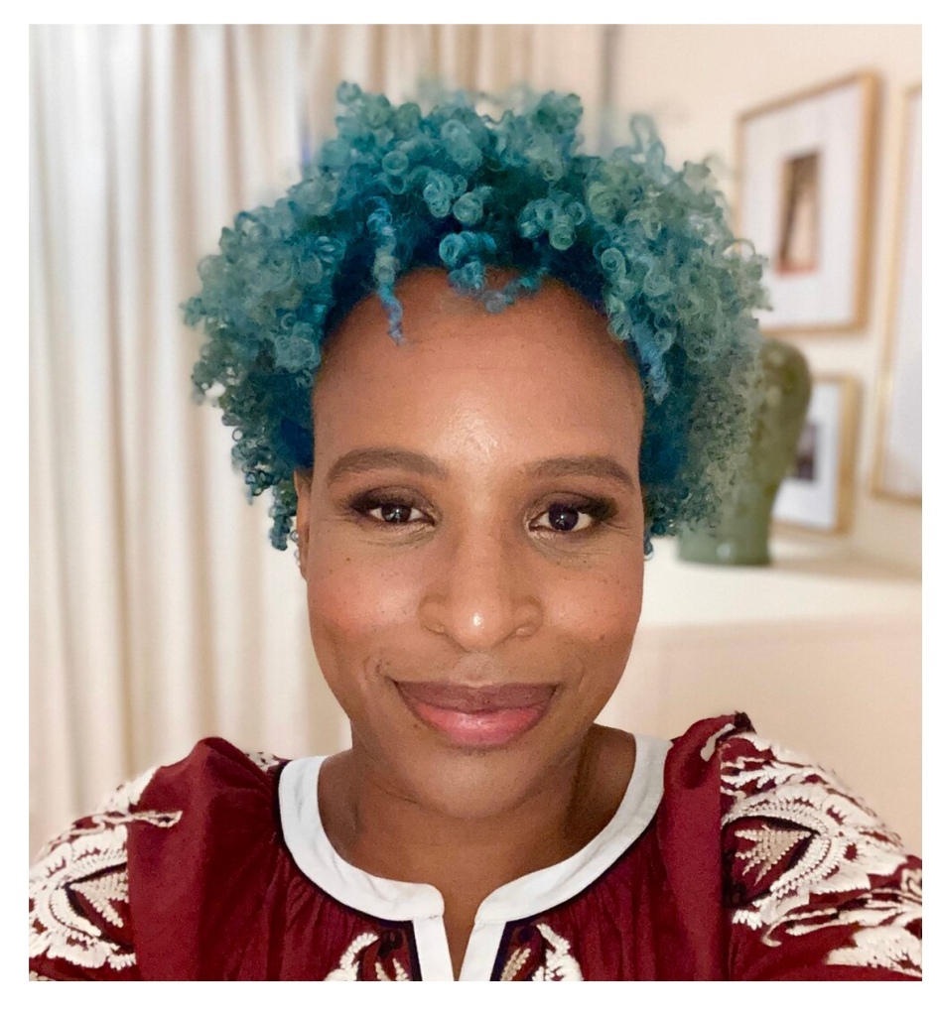
From Nicola Yoon
“Names are Powerful things. They act as an identity marker and a kind of map, locating you in time and geography. More than that, they can be a compass.”
This Photo by Unknown Author is licensed under CC BY-SA-NC
What is the story of your name?
© 2022, Center for Dispute Resolution, Maryland Carey Law
Notes:
Nicola Yoon is a #1 New York Times bestselling author. She’s also a National Book Award finalist, Michael L. Printz Honor Book recipient and a Coretta Scott King New Talent Award winner. Her heritage is Jamaican-American.

Slide 10
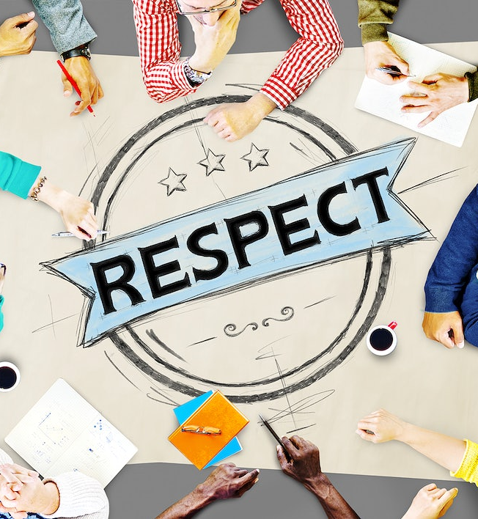
R-E-S-P-E-C-T
How do you show respect?
How do you know others are treating you with respect?
© 2022, Center for Dispute Resolution, Maryland Carey Law

Slide 11
You Have Mastered Some Important Skills:
You are pros at using a talking piece.
You have shared important information about yourself in circle—and heard important things about your colleagues.
You worked collaboratively to create the best conditions for everyone to participate and learn.
© 2022, Center for Dispute Resolution, Maryland Carey Law

Slide 12
Special Thanks to . . .
This series of restorative approaches lessons is made possible through the generous financial support of the Charles Crane Family Foundation.
C-DRUM recognizes:
Kay Pranis and Carolyn Boyes-Watson for their book Circle Forward: Building a Restorative School Community, especially Lesson 1.3 of Module 2.3, 2.4 and 2.5.
Living Justice Press for The Seven Core Assumptions (developed by Kay Pranis and Carolyn Boyes-Watson) available for free at https://livingjusticepress.org/free-stuff/
Nicola Yoon, #1 New York Times bestselling author. She’s also a National Book Award finalist, Michael L. Printz Honor Book recipient and a Coretta Scott King New Talent Award winner.
© 2022, Center for Dispute Resolution, Maryland Carey Law

