Slide 1
Introduction to Circle: How Will We Be Together?
Restorative Approaches Lesson 2
© 2022, Center for Dispute Resolution, Maryland Carey Law

Slide 2
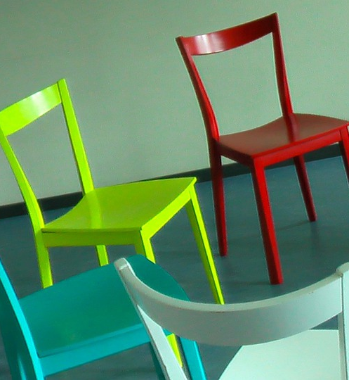
Welcome!
Our first lesson introduced you to Circle and using a talking piece. This lesson helps you decide how you will be together so that everyone feels safe and has an opportunity to contribute.
The guidelines you establish in this exercise can become your roadmap for how you treat each other and share in all your future circles.
Let’s begin by moving your chairs into one large circle so everyone can see and hear each other clearly.
© 2022, Center for Dispute Resolution, Maryland Carey Law

Slide 3
Sitting in your chairs . . .
Take a moment to get quiet and calm.
Take a deep, cleansing breath that fills your lungs, then exhale slowly.
Repeat two more times so you’ve taken three full, deep breaths.
Think about a place where you feel calm and safe.
© 2022, Center for Dispute Resolution, Maryland Carey Law

Slide 4
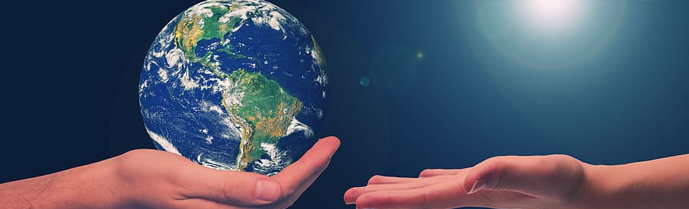
Remember the Talking Piece Process?
Talk only when you are holding the talking piece.
When you are done sharing, hand the talking piece to the person on your right.
If you are not holding it, listen respectfully to the person talking.
You always have the right to pass the talking piece without comment if you prefer not to speak.
© 2022, Center for Dispute Resolution, Maryland Carey Law

Slide 5
What do You Need to Feel Safe & Comfortable?
Using the talking piece your teacher has chosen for this circle, answer the following questions in circle.
Please let everyone answer the first before you move on to the second.
When you hold the talking piece, please share one thing you observed from our last lesson about how you felt in circle.
At the end of our last lesson, we asked you to identify one thing you need to feel safe and comfortable in circle. What is it?
© 2022, Center for Dispute Resolution, Maryland Carey Law

Slide 6
Using the marker and paper your teacher gave you, write down your answer to the following questions:
NEEDS on the first piece of paper
GIFTS on the second piece of paper
What do you need to participate most easily (safely and comfortably) in our circles?
What can you bring to your circles that will help everyone have what they need to participate easily?
When the talking piece comes to you, share what you’ve written and place each of your papers in the center of our circle.
© 2022, Center for Dispute Resolution, Maryland Carey Law

Slide 7
Move and Sort
Group the Needs into general categories—there should be duplicates and some with similar meanings.
When you have the Needs laid out by category or type, go through the list of Gifts and try to match them with the Needs.
Notes:
When students group the Needs and Gifts into categories they can paraphrase to match them within categories, but encourage them to confirm with everyone that their paraphrasing captured the correct meaning. If not, honor the original definition.
Working from the piles of similar attributes, consider how each Need will be met by a Gift and put those piles near each other or write them together in a draft statement.
If you have some unmatched Needs and/or Gifts, list them after the matches.

Slide 8
Collaborate to Consensus
Now you know what everyone needs and how you are willing to support each other.
These statements form the basis of how you can work together most effectively in circle.
Using them, decide together how you will state your guidelines—as a list, in a short statement, through pictures, etc.
© 2022, Center for Dispute Resolution, Maryland Carey Law

Slide 9
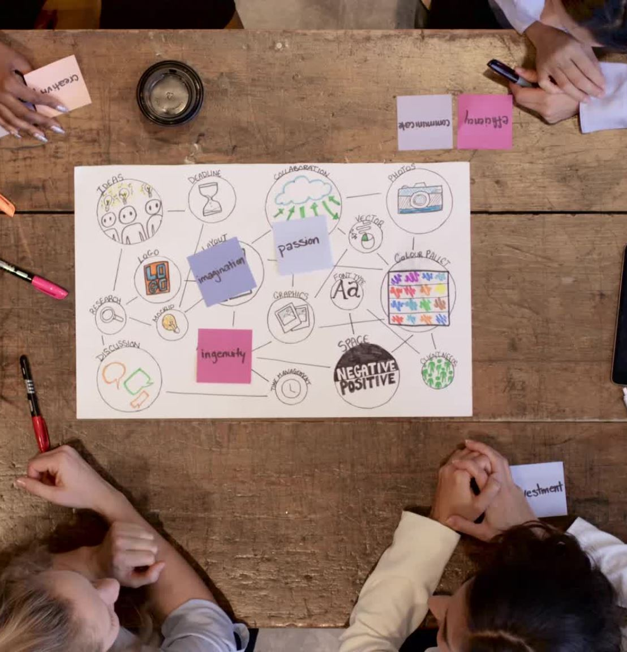
Craft Your Circle Guidelines
Draft the guidelines in the chosen format using whatever process works most effectively for your group.
Once you have completed the process, return to your circle and bring the guidelines with you.
Notes:
There is no right or wrong way to develop guidelines. It's worth the time it takes for your class to create their guidelines in whatever format they prefer.

Slide 10
Confirm
Using the talking piece, ask every participant to say if they agree that this lays out how you all will treat each other and operate in circle.
1
If anyone disagrees with any element, suspend the talking piece and discuss that point until everyone agrees on new wording or deleting the contested language.
2
Once everyone agrees, post the document or list on the classroom wall near your circle space so you can refer to it when needed.
3
© 2022, Center for Dispute Resolution, Maryland Carey Law
Notes:
This consensus-based process helps your students understand how restorative agreements are created. When everyone has a part in creating behavior guidelines, everyone is more likely to comply with the agreement. This helps with self-enforcement and should lighten the teacher's need to enforce "the rules" in circle.

Slide 11
Congratulations! You have mastered some important skills central to circles:
You know how to use a talking piece and have gotten familiar with it.
You have shared something about yourself in circle—stating what you need and what you can bring takes some vulnerability.
You worked collaboratively, sorting and discussing how you can all create the best conditions for everyone to participate and learn.
You reached consensus, ensuring that every voice was valued and every member of your circle has what they need to participate.
© 2022, Center for Dispute Resolution, Maryland Carey Law

Slide 12
Special Thanks to . . .
This series of restorative approaches lessons is made possible through the generous financial support of the Charles Crane Family Foundation.
C-DRUM recognizes:
Kay Pranis and Carolyn Boyes-Watson for their book Circle Forward: Building a Restorative School Community, especially Lesson 1.3 of Module 2.3, 2.4 and 2.5.
Collaborative for Academic, Social and Emotional Learning (CASEL) for their Core Competencies.
© 2022, Center for Dispute Resolution, Maryland Carey Law

