Slide 1
Introduction to Circle
Restorative Approaches Lesson 1
© 2022, Center for Dispute Resolution, Maryland Carey Law

Slide 2
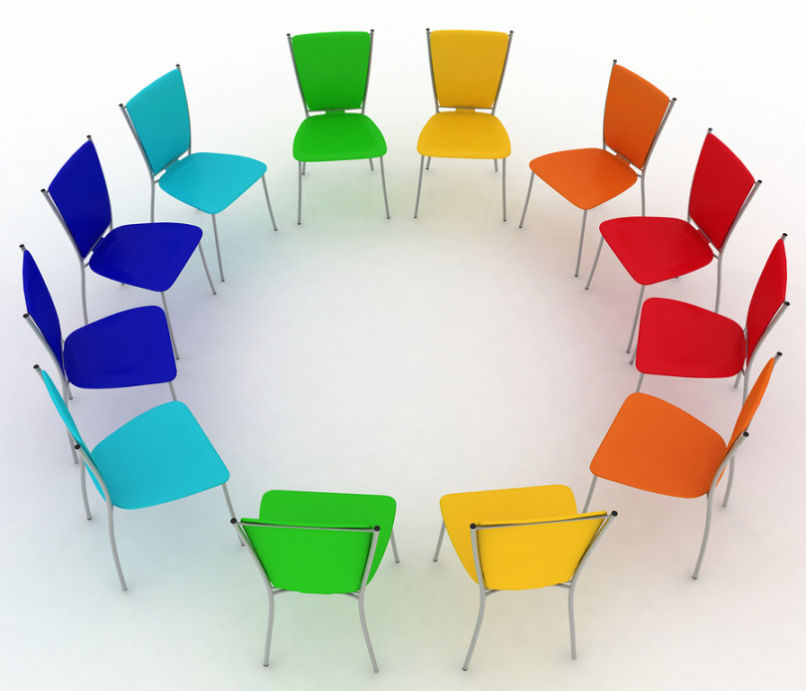
Welcome!
This lesson introduces you to a way of being together that you will find useful in nearly every restorative interaction.
If you’ve never participated in a circle before, we think you’re in for a treat.
Let’s begin by moving your chairs into one large circle so everyone can see and hear each other clearly.
This Photo by Unknown Author is licensed under CC BY-NC
© 2022, Center for Dispute Resolution, Maryland Carey Law

Slide 3
Sitting in your chairs . . .
Take a moment to get quiet and calm.
Take a deep, cleansing breath that fills your lungs, then exhale slowly.
Repeat two more times so you’ve taken three full, deep breaths.
Focus on how your body feels, but don’t say anything out loud.
© 2022, Center for Dispute Resolution, Maryland Carey Law

Slide 4
Talking in Circle
Because Circle is a place to share thoughts and feelings, many people find a talking piece useful for making sure everyone has a chance to speak if they choose.
A talking piece can be any object or gesture that everyone in circle recognizes.
© 2022, Center for Dispute Resolution, Maryland Carey Law

Slide 5
Using the Talking Piece
Today we will use the talking piece your teacher is holding.
When you hold the talking piece, it is your turn to speak.
If you are not holding it, you are invited to listen carefully to what the holder says.
You always have the right to pass the talking piece without comment if you prefer not to speak.
This Photo by Unknown Author is licensed under CC BY-SA
© 2022, Center for Dispute Resolution, Maryland Carey Law

Slide 6
Sharing in Circle
4. Everyone continues with
this process of answering the same question then handing the talking piece to the person sitting next to them until the talking piece has made it back to the teacher from their left.
5. Then the teacher asks
the second question and repeats the process.
Your teacher will begin by asking a question.
The teacher will answer that question, then hand the talking piece to the person sitting next to them on the right.
That person will answer the question and hand the talking piece to the person sitting at their right.
© 2022, Center for Dispute Resolution, Maryland Carey Law

Slide 7
Testing it Out
Let’s try it with this first question:
How are you feeling today?
Answer our second question:
What is the weirdest food you’ve ever eaten?
Answer our third question:
What do you need to feel safe and comfortable in circle?
© 2022, Center for Dispute Resolution, Maryland Carey Law

Slide 8
Building on This Skill
Great Job! You have just participated in your first circle.
Talking Pieces are key elements of circles, so we will come back to this skill for nearly every lesson we do together.
If time allows, share one thing you noticed about this circle experience.
© 2022, Center for Dispute Resolution, Maryland Carey Law

Slide 9
Special Thanks to . . .
This series of restorative approaches lessons is made possible through the generous financial support of the Charles Crane Family Foundation.
C-DRUM recognizes:
Kay Pranis and Carolyn Boyes-Watson for their book Circle Forward: Building a Restorative School Community, especially Lesson 1.3 of Module 1.
The Restorative Practices Consortium of Ontario Canada for their Restorative Practice Resource Project: Tools and Successful Practices for Restorative Schools Supporting Student Achievement and Well-Being, especially Unit 4, “Circles: Creating Safety in the Circle”.
© 2022, Center for Dispute Resolution, Maryland Carey Law

