Slide 1
Restorative Interventions: What Do You Know?
Restorative Approaches Lesson 10
© 2022, Center for Dispute Resolution, Maryland Carey Law

Slide 2
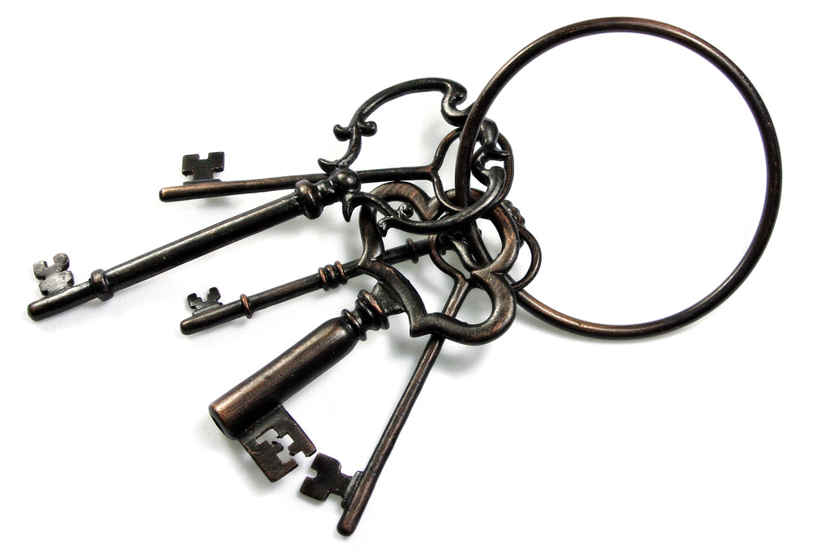
Key Points of These Lessons
Let’s take a quick look back on the lessons we learned together about restorative approaches.
If your teachers allows it, you may want to follow along with the Restorative Approaches Study Guide to fill in the blank spaces of the study guide sheet.
This Photo by Unknown Author is licensed under CC BY

Slide 3
Discipline Paradigms Compared
RULES
TRADITIONAL DISCIPLINE
RESTORATIVE DISCIPLINE
HARM
© 2022, Center for Dispute Resolution, Maryland Carey Law

Slide 4
We do this from a Foundation of Respect
Restorative Justice is respect.
Respect for all, even those who are different from us; even those who seem to be our enemies. Respect reminds us of our interconnectedness, but also of our differences.
Respect insists we balance concerns for all parties.
If we pursue justice as respect, we will do justice restoratively.
Howard Zehr, The Little Book of Restorative Justice, p.36
© 2022, Center for Dispute Resolution, Maryland Carey Law
Notes:
Zehr, H. (2002), The Little Book of Restorative Justice, Intercourse, PA, Good Books.

Slide 5
Balanced and Restorative Justice (BARJ) Triangle
Based on design by US Dept. of Justice, Office of Juvenile Justice and Delinquency Prevention Division (OJJDPD)
Community
Affected
Responsible
© 2022, Center for Dispute Resolution, Maryland Carey Law
Notes:
US Department of Justice, Office of Juvenile Justice and Delinquency Prevention Division (OJJDPD); https://www.ncjrs.gov/pdffiles/91415.pdf; retrieved 2/4/2015.

Slide 6
The 3 Stages of Restorative Interventions
Together, the affected and responsible parties (often with members of the community who have been affected) meet face-to-face in circle.
Sitting together, participants work through a three-stage process, with each stage defined by the following three questions.
What happened?
Who has been affected and how?
How do we make things right as much as possible?
© 2022, Center for Dispute Resolution, Maryland Carey Law

Slide 7
Follow your Teacher’s Instructions for Completing the Restorative Approaches Study Guide
Once you have all the blank spaces filled in on your study guide, let’s look together at the preferred answers revealed on the next two slides!
This Photo by Unknown Author is licensed under CC BY

Slide 8
Restorative approaches are a peaceful conflict resolution process that favors
_HEALING____ over __PUNISHMENT__.
Traditional discipline asks “What ________ was broken?”
But restorative approaches ask “What _______________ has resulted from this incident?”
RULE
HARM
C
Restorative approaches are based in __ __ __ __ __ __ __
R
E
S
P
E
T
© 2022, Center for Dispute Resolution, Maryland Carey Law
Notes:
You will need to click to bring up each answer here—including every letter of the last word.

Slide 9
AFFECTED
Restorative interventions bring together the _________, the person ___________, and members of the ______________
RESPONSIBLE
COMMUNITY
Together participants work through a process defined by three main questions:
What _________?
Who has been __________ and how?
How do we make things ________, as much as possible?
HAPPENED
AFFECTED
RIGHT
Notes:
You will need to click each time you want to bring up the answers here for every blank space.

Slide 10
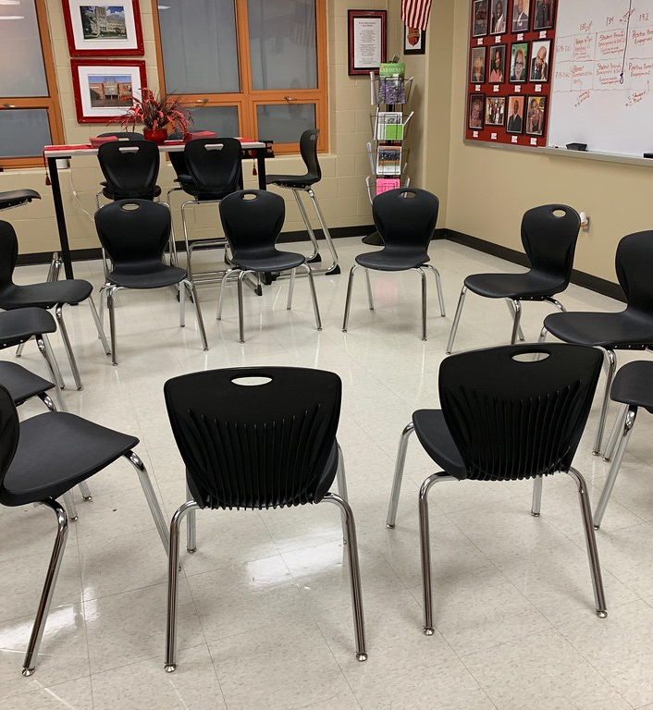
Last Circle of this Series
You know how to participate in circle, and you’ve used that skill to:
create guidelines,
learn more about your classmates,
explore meaning of the lesson exercises,
share your thoughts and feelings.
Now let’s use it once more to talk about restorative approaches. As usual, let’s begin by moving your chairs into one large circle so everyone can see and hear each other clearly.
© 2022, Center for Dispute Resolution, Maryland Carey Law
This Photo by Unknown Author is licensed under CC BY

Slide 11
Sitting in your chairs . . .
Take a moment to get quiet and calm.
Take a deep, cleansing breath that fills your lungs, then exhale slowly.
Repeat two more times so you’ve taken three full, deep breaths.
Remembering the guidelines you developed and have followed in these lessons, please use them to guide you in your final circle of learning about restorative approaches.
© 2022, Center for Dispute Resolution, Maryland Carey Law

Slide 12
Share in Circle
What is one thing (idea, memory, insight, feeling, etc.) you take from these lessons about restorative approaches?
How could you apply some aspect of what you’ve learned here to your own life?
Name one concrete action you will take this semester to use something you have learned from these lessons.
© 2022, Center for Dispute Resolution, Maryland Carey Law

Slide 13
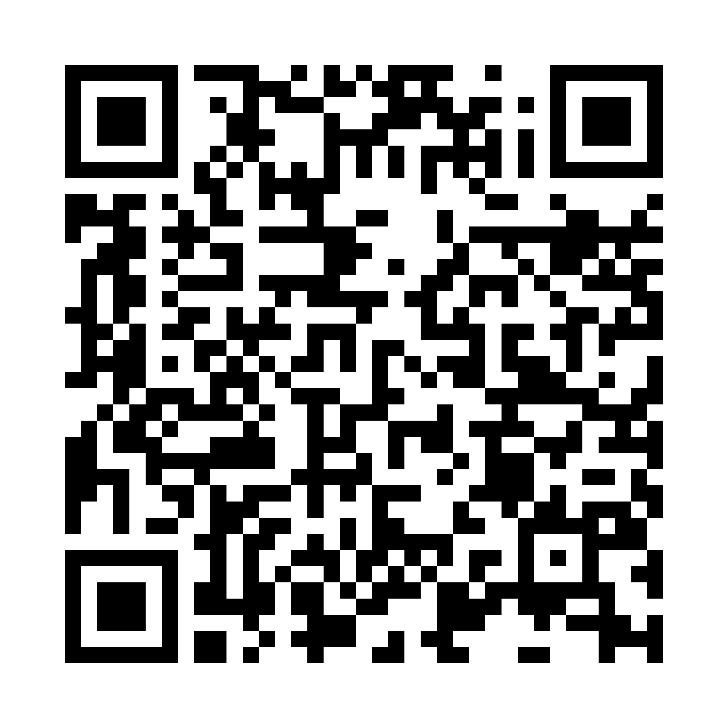
Thank you for learning with us!
For more resources about restorative approaches in education, explore the Restorative Approaches Collaborative Website at https://www.law.umaryland.edu/Programs-and-Impact/Dispute-Resolution/CDRUM/Restorative-Practices/

Slide 14
Special Thanks to . . .
This series of restorative approaches lessons is made possible through the generous financial support of the Charles Crane Family Foundation.
C-DRUM recognizes:
Howard Zehr, for his widely-repeated teachings of the distinction between restorative and traditional discipline and his description of respect on page 36 of his Little Book of Restorative Justice, available from Skyhorse Publishers.
US Department of Justice, Office of Juvenile Justice and Delinquency Prevention Division for their Balanced and Restorative Justice Triangle
International Institute for Restorative Practices for their Restorative Questions Cards and Restorative Circles in Schools: Building Community and Enhancing Learning by Bob Costello, Joshua Wachtel and Ted Wachtel
© 2022, Center for Dispute Resolution, Maryland Carey Law

