Slide 1
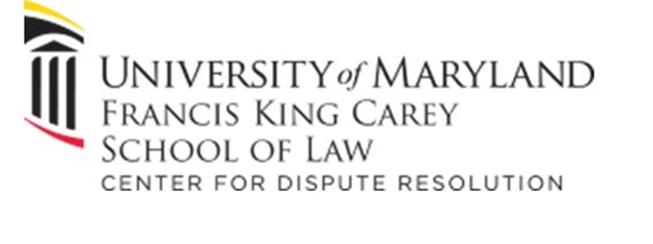
Restorative Approaches in Maryland:
Discovering Our Next Steps
June 7, 2022, 1:00 to 2:00 pm
Maryland State Department of Education
with the

Slide 2
Quick Poll
Who is the villain of the fable
Jack and the Beanstalk?
Please answer in your Chat Function.

Slide 3
The Restorative Paradigm
Briefly Explained
Notes:
I want to offer some of the basics of the restorative philosophy so we all have a shared understanding and language for the case study we will engage in shortly. The video on the next slide offers and elegant and effective overview.

Slide 4
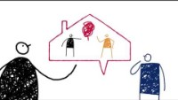
Resolve Consultants, UK; Retrieved June 2, 2022, from https://www.youtube.com/watch?v=gJJxbn1VjYo
Notes:
https://www.youtube.com/watch?v=gJJxbn1VjYo

Slide 5
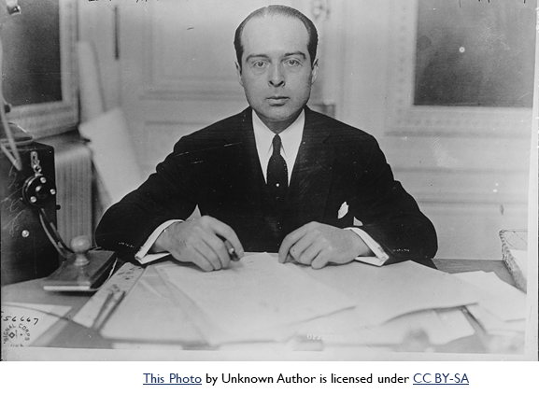

Discipline Paradigms Compared
RULES
TRADITIONAL DISCIPLINE
RESTORATIVE DISCIPLINE
HARM
Notes:
Traditional discipline: wrong-doer goes before an authority figure who asks three basic questions:
1. What Rule was broken 2. Who broke it? 3. What is the consequence for breaking that rule? Usually the authority figure (principal or judge) looks at the discipline rubric or sentencing guidelines for the answer. Very often, the guidelines demand some sort of punishment such as removal from their community—suspension, expulsion, incarceration. “You do the crime; you do the time.”
Restorative justice comes at the exact same situation from a different angle. Instead of an authority figure imposing “justice” restorative discipline engages the person who caused harm with those affected by the incident of harm. Together, all those affected explore three different questions:
Who was harmed? 2. What are their needs relating to the incident? 3. Who has an obligation to address those needs? Restorative philosophy defines accountability as healing the harm, keeping everyone in community and empowering, expecting and supporting them to do the hard work of healing.
The key point you must remember: Traditional discipline focuses on Rules and Punishment, while restorative discipline focuses on Harm and Healing.

Slide 6
The 3 Stages of Restorative Interventions
Together, the affected and responsible parties (often with members of the community who have been affected) meet face-to-face in circle.
Sitting together, participants work through a three-stage process, with each stage defined by the three questions below.
What happened? (Story telling)
Who has been affected and how? (Empathy building)
How do we make things right as much as possible? (Healing)
Notes:
In a restorative discipline intervention, affected parties sit together in circle with a facilitator who guides them in exploring a number of questions. Tin this cursory explanation of a restorative process, I am just offering the three questions that define the stages of a restorative circle. Your practitioners will surely ask more as they need to.
NAN READ QUESTIONS
There are MANY other important elements of restorative interventions, but this cursory explanation is designed to help you see how restorative interventions differ from traditional discipline. It really is a different paradigm based in ancient practices humans evolved with and its practices, such as circle, have been shared by elders from. American Indian and First Nations peoples. It is a Different approach to discipline, not New.

Slide 7
We do this from a Foundation of Respect
“Restorative Justice is respect.
Respect for all, even those who are different from us; even those who seem to be our enemies. Respect reminds us of our interconnectedness, but also of our differences.
Respect insists we balance concerns for all parties.
If we pursue justice as respect, we will do justice restoratively.”
Howard Zehr, The Little Book of Restorative Justice, p.36
Notes:
This quote from the Grandfather of the current Restorative movement, Howard Zehr’s The Little Book of Restorative Justice underscores the truth that restorative interventions are based on a fundamental respect for the human dignity of every person.
It can be difficult to feel respect for someone who has hurt another person or yelled at us. But Zehr’s message is essential to the process because if we want to motivate someone to heal the harm they’ve caused or work to make things right, we MUST show equal respect for everyone.
If you treat anyone disrespectfully, you may close the door on some parties’ participation.

Slide 8
Jack and the Beanstalk
Case Study Through a Restorative Lens
Notes:
Now we want you to apply what you’ve just learned! I will read this abbreviated (Wikipedia) version of the famous fairy tale, then you will go into small groups to unpack the story as a case study. As I read, please decide whose perspective you would like to take of the six characters mentioned. In your small group, you will answer the three restorative questions FROM YOUR CHARACTER’S PERSPECTIVE.

Slide 9

From Wikipedia
To his starving mother’s dismay, Jack, a poor country boy, trades the family cow for a handful of magic beans. Distressed, Jack’s mother throws the beans out the window. Over night, the beans grow into a massive, towering beanstalk reaching up into the clouds.
Jack climbs the beanstalk and finds himself in the castle of an unfriendly giant. The giant senses Jack's presence and cries,
Fee-fi-fo-fum! I smell the blood of an Englishman.
Be he alive, or be he dead, I'll grind his bones to make my bread.^{[8]}
With help from the Giant’s spouse, Jack is able to retrieve many goods once stolen from his family, including:
a bag of gold,
an enchanted goose that lays golden eggs, and
a magic golden harp that plays and sings by itself.
When he realizes Jack took his treasures, the Giant pursues him. Jack then escapes by chopping down the beanstalk. The giant falls to his death, and Jack and his family prosper.
Retrieved 5/24/2022 from https://en.wikipedia.org/wiki/Jack_and_the_Beanstalk with minor edits by presenter
This Photo by Unknown Author is licensed under CC BY
Notes:
Also in Wikipedia: The original story portrays a "hero" gaining the sympathy of a man's wife, hiding in his house, robbing him, and finally killing him. In Tabart's moralized version, a fairy woman explains to Jack that the giant had robbed and murdered his father justifying Jack's actions as retribution^{[17]} . . .
Jacobs gave no justification because there was none in the version he had heard as a child.^{[18]}

Slide 10

Through a Restorative Lens
Each person take the perspective of a character from this story:
Jack
Jack’s Mother
The Giant
The Giant’s Wife
The Enchanted Goose
The Magic Harp
From your character’s perspective, share with your group:
What Happened?
Who was Affected and How?
What Could be Done to Make Things as Right as Possible?
Notes:
As you go into your small groups, think about which character you want to “be” for the case study. You will think about the story’s events from your character’s perspective. Then in your group, answer the three defining questions (we will put them in Chat so you can see them) taking them one at a time as you would in circle. If you have time after everyone has shared their answer to each of the three questions, talk about any insights you gained by seeing this story from each character’s different perspective.

Slide 11

Who is the Villain of this Story?
This Photo by Unknown Author is licensed under CC BY
Notes:
Please enter your answer.
Hopefully this gave you a taste of how different perspectives can help us develop a fuller picture of situations that we might assume we understand. Often in my restorative practice, when people are respected, heard, and given the chance, they opt to make things right—sometimes before situations rise to disciplinary offenses. The RA Collaborative is working to help more Marylanders make that paradigm shift toward restorative approaches in schools and across learning communities.

